Slide 1
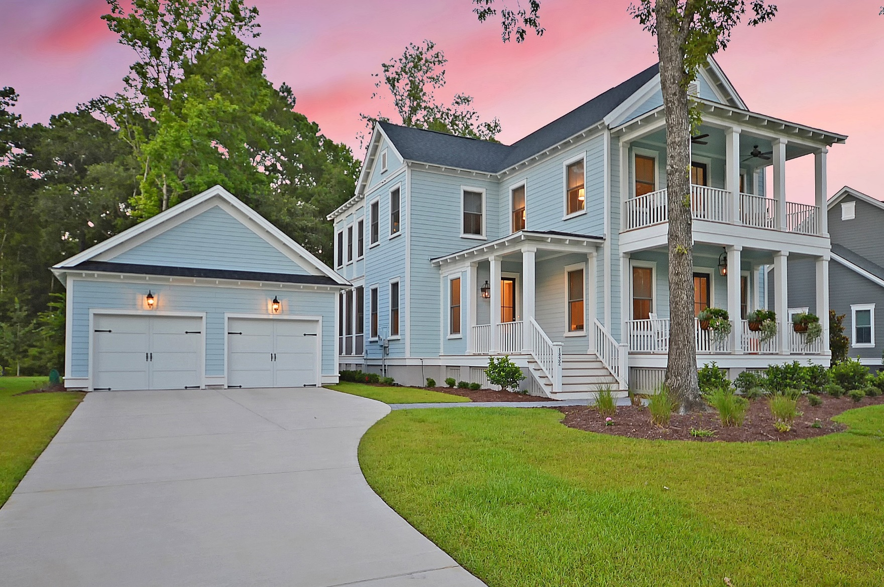
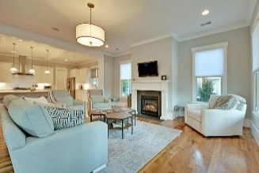
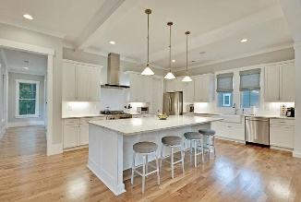
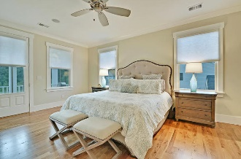
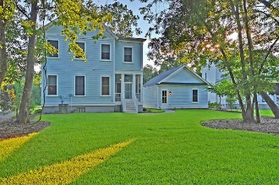


1832 Carolina Park Boulevard
Mount Pleasant, SC 29466
MLS# 18022192 :: $824,900
4 Bed / 3½ Bath
Riverside at Carolina Park
Move in Ready
Just Reduced!
Move-in-ready Carolina Park home for the most discerning buyer. Located across from a large POND and backing up to a private HOA-owned wooded buffer with beautiful HARDWOOD FLOORING in ALL living areas (including upstairs) and tile flooring in the bathrooms. NO CARPET anywhere! The Gourmet kitchen includes a HUGE quartz topped island and cabinet counter tops with under-cabinet lighting. All appliances convey including the washer/dryer pedestals. Attractive PAVER PATHWAYS have been added from long driveway to the front porch and from the garage to the screened porch. DESIGNER WINDOW TREATMENTS have been added throughout, and a custom CA CLOSET SYSTEM was added to the large master walk-in. Enjoy the Pond/Sunset views and breezes from either of the TWO FULL-WIDTH front COVERED PORCHES and all the natural light that pours in through the TWO kitchen sink windows. A 1-year home warranty is offered to buyer at closing. Be sure to visit Bolden Lake and Kayak Park that is being developed down the street and the amenity center that includes a state-of-the-art pool facility, playground and tennis courts. The schools and service amenities in the neighborhood just keep getting better. Ride your bike to Carolina Park Elementary or take a short trip to Costco. Best of all, it can be only a 20 minute trip to the BEACH at Isle of Palms.
Steve Kaul, REALTOR
(843) 817-5547 · skaul@carolinaone.com
www.charlestonhousehunt.com
Carolina One Real Estate · 195 W Coleman Blvd · Mt Pleasant, SC 29464-3495

