Slide 1
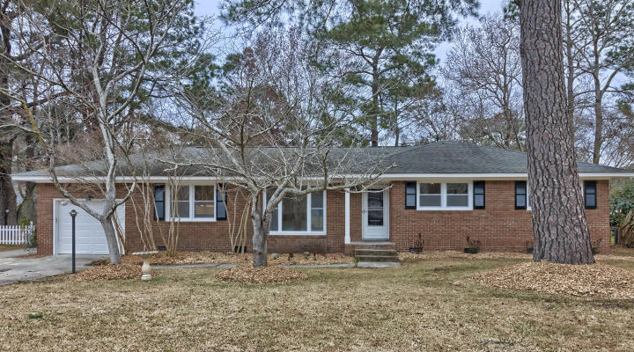
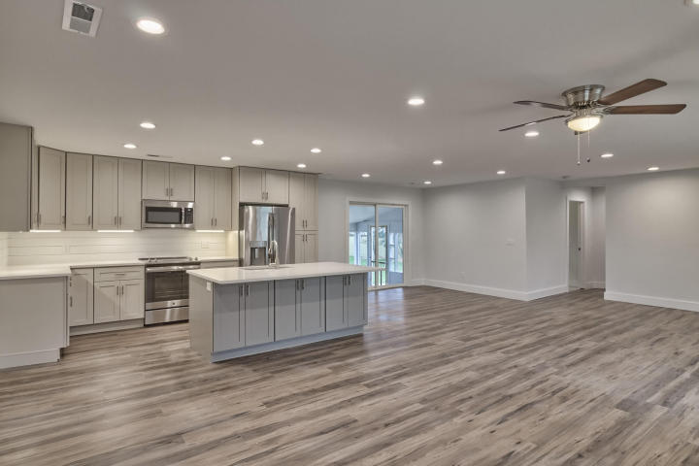
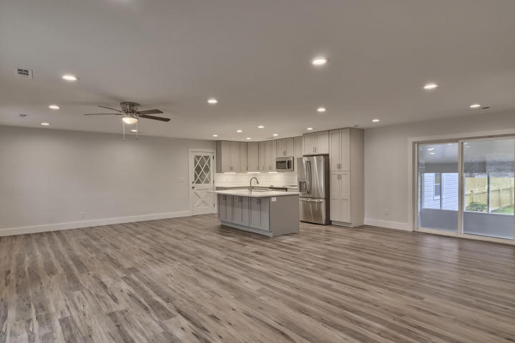
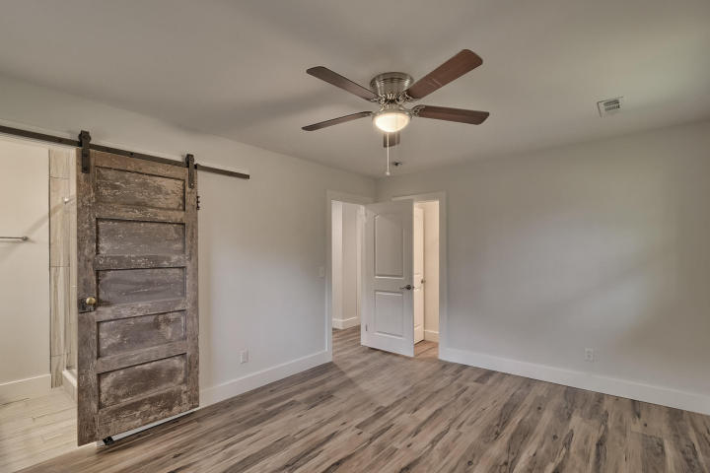
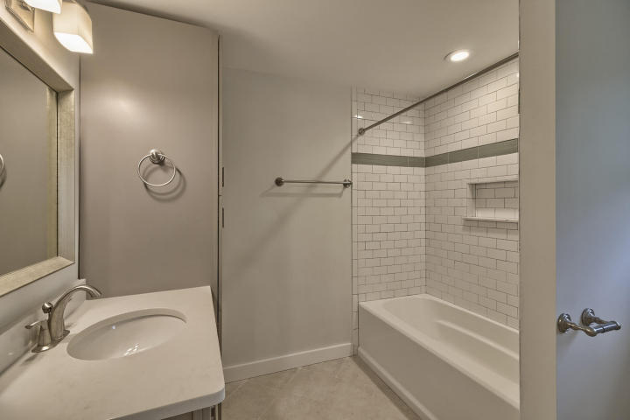
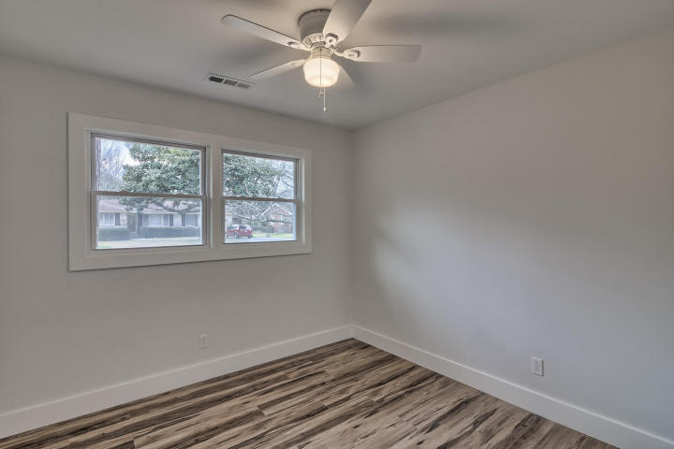
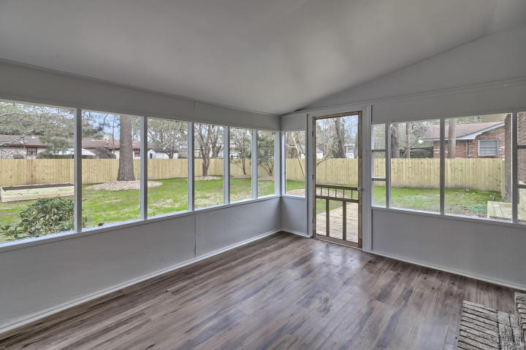
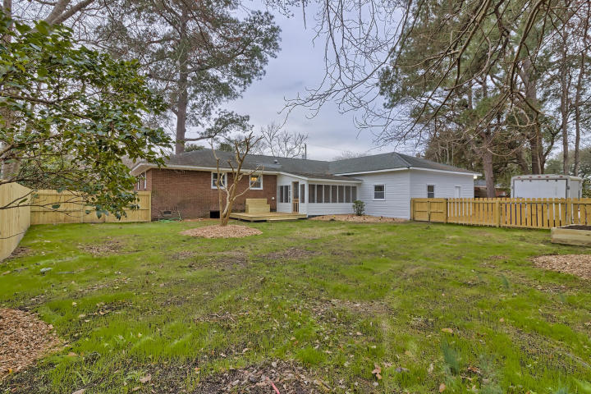
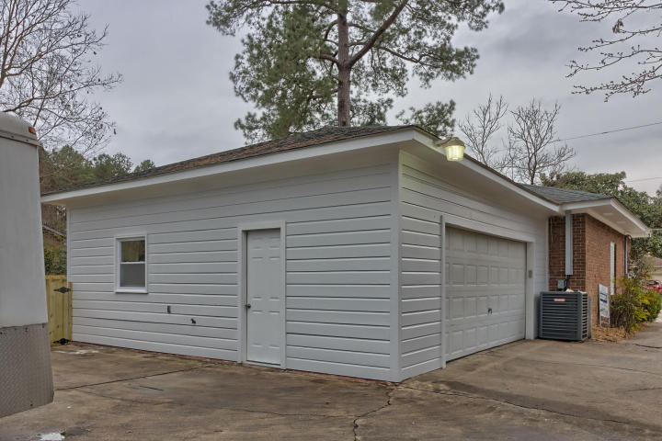


1833 Saint Julian Drive
West Ashley Plantation ~ Charleston ~ MLS# 18004013 ~ $354,000
PROFESSIONALLY RENOVATED
3BD/2BA home in West Ashley with a 1 and 2 car garage attached!!! NO HOA!!!!
5 Bed / 4½ Bath
3,889 Sq Ft
Custom Home
Desirable Location
Hardwood Floors
2-Story Great Room
Great Backyard
PROFESSIONALLY RENOVATED 1 STORY BRICK HOME WITH A 1 AND 2 CAR GARAGE ATTACHED!!!THIS 3 BEDROOM 2 BATH HOME ON.34 ACRE OFFERS EVERYTHING .. AN OPEN FLOOR PLAN, MODERN KITCHEN WITH QUARTZ COUNTER TOPS, RENOVATED BATHROOMS, ALL NEW DOUBLE HUNG WINDOWS, NEW LED LIGHTING AND FIXTURES, NEW HVAC SYSTEM, SCREENED PORCH, WOOD DECK, PRIVATE AND FULLY FENCED YARD, SPACIOUS LOT, AMPLE PARKING AND STORAGE, NO HOA, EASY ACCESS TO HIGHWAYS AND CLOSE TO SHOPPING AND DINING. THIS HOME IS A MUST SEE AND WOULD BE A PERFECT FIT FOR A HOME BUSINESS!! SEE LIST OF ALL NEW ITEMS IN THE DOCUMENT SECTION OF MLS.
Leah M. Rust
843-709-9211 Mobile
843-856-8800 Office
leahmrust@gmail.com
Coldwell Banker RESIDENTIAL BROKERAGE

