Slide 1
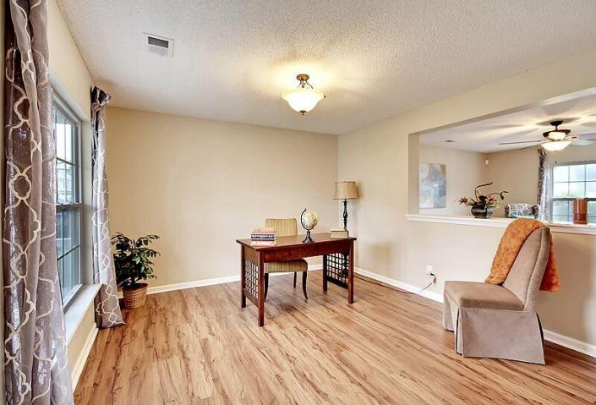
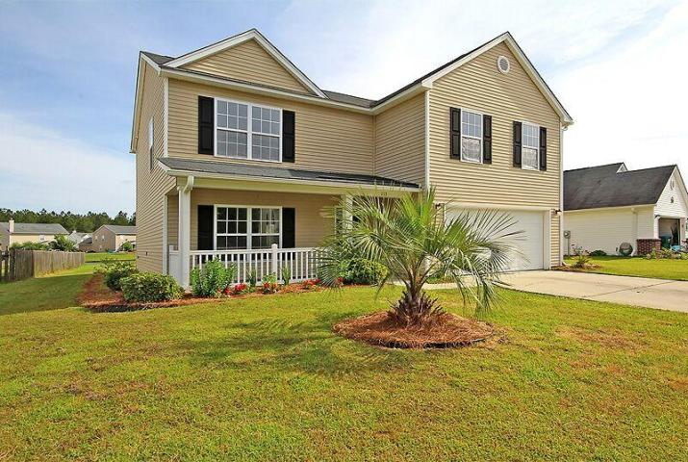
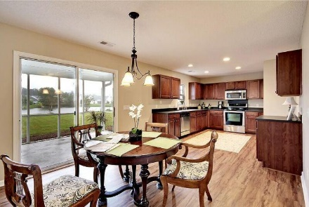
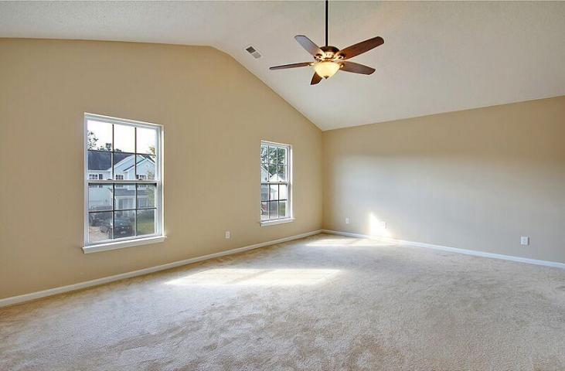
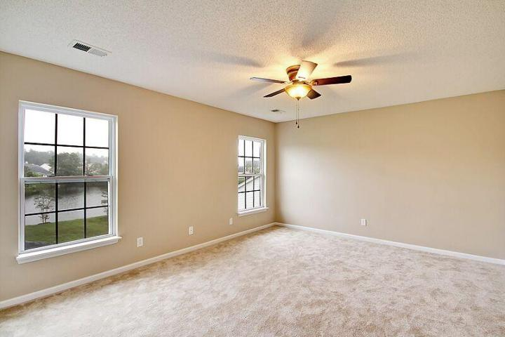
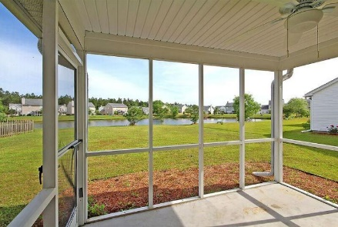
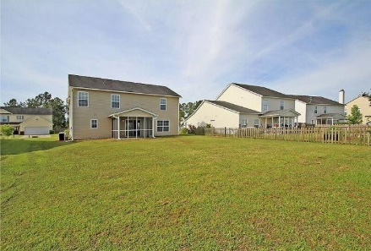


Weatherstone Agent Luncheon
Wednesday, Oct. 28th, 12-2
RSV‎P by email by 10/27 @ 5:00pm
183 Southport Drive
Summerville, SC
ML# 15025640
$212,900
3,285 Sq Ft ~ 4 Bedrooms ~ 2½ Baths
WOW this home is in perfect move in condition, beautiful in and out! Too many upgrades to mention. Great lot features amazing views of the pond! Open floor plan offers spacious family room and living room with breakfast area! Enjoy your morning coffee looking out to the pond and watch for the beautiful variety of birds it attracts. The kitchen has amazing counter space with upgraded cherry Aristokraft cabinets and stainless appliances. Very large upstairs master bedroom suite with vaulted ceilings, generous walk-in closet, master bath with dual sink vanity, and a Garden tub. All of the bedrooms are great sized and offer beautiful energy efficient ceiling fans. The entire interior has just been professionally painted, along with NEW, NEW, NEW just about everything!! Generous sized screened-in porch that is perfect for entertaining and offers spectacular views of the pond. Exterior features awesome curb appeal with a lawn irrigation system to keep the grass looking at its best! Termite bond recently renewed good through next year. Zoned for The sought after Cane Bay High School. Home is very convenient to I-26 and the popular Azalea Square Shopping Center.
Ray & Sherry Walsh
Ray Cell: 843-830-1440
Sherry Cell: 843-697-2843
Office: 843-875-4676
Fax: 866-830-4848
walshr@sc.rr.com
HORNE REALTY, LLC
133 E. 1st‎ N. St
Ste 5
Summerville SC 29483

