Slide 1
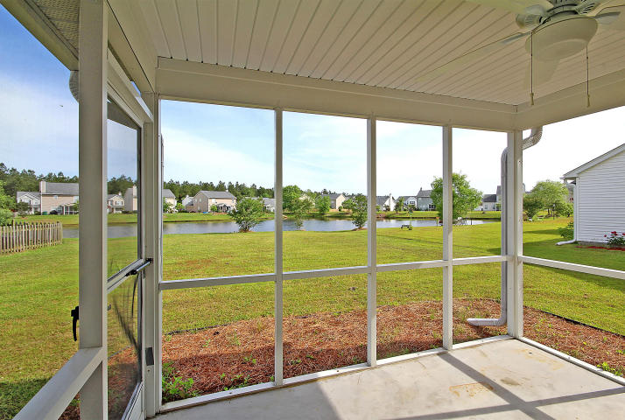
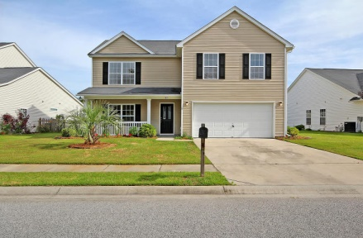
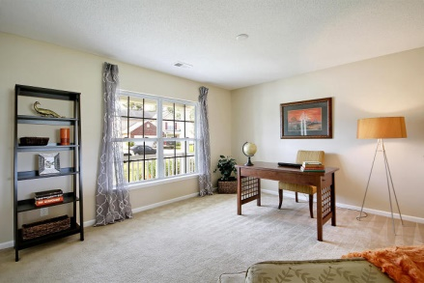
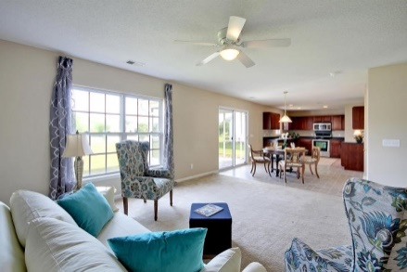
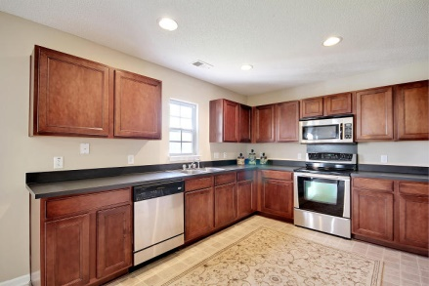
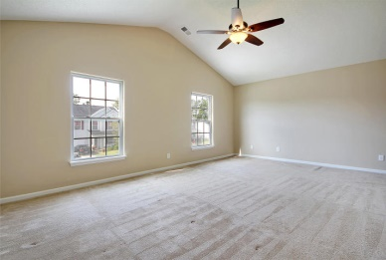
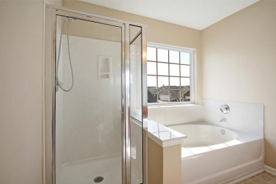
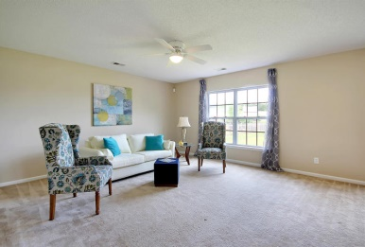
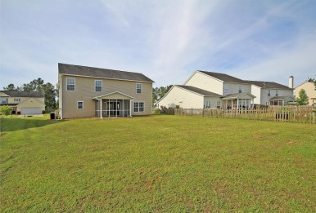
Great House With A Premium View!
183 Southport Drive
Weatherstone
Summerville, SC 29483
MLS# 15012269
Just Reduced to $204,900
Stunning home in mint condition on prime lot features fantastic views of the pond! Spacious living room and family room with grand breakfast; the kitchen is loaded with counter space and upgraded cabinets area and black whirlpool appliance package; wonderful upstairs master bedroom suite features vaulted ceilings, gracious walk-in closet and generous master bath. All the bedrooms are spacious! Nice screened-in porch off the back offers pleasant long range views of the scenic pond. THE ENTIRE INTERIOR of this home has just been professionally painted!! Very attractive curb appeal. This charming home is move in ready!!
Sean Harrington
(843) 226-9652
sean@milerproperties.com

