Slide 1

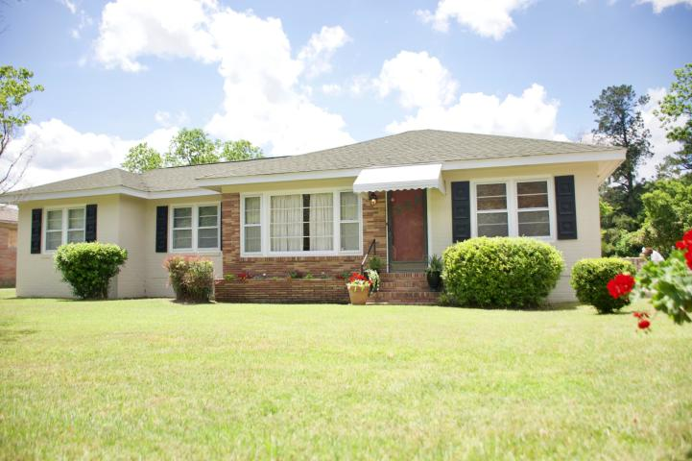
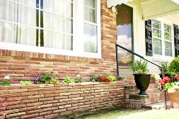
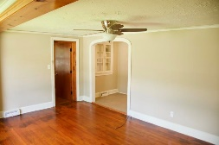
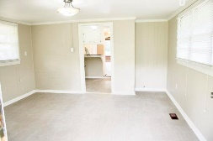
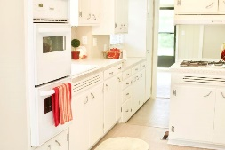
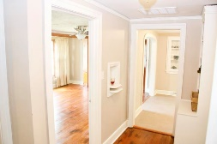
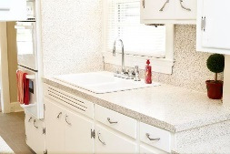
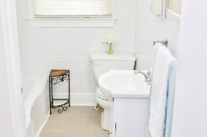
1840 Rowesville Road Orangeburg, SC 29115 · MLS# 19013116 & 42111 · $135,000
Don’t Miss This One!
Beautifully upgraded Ranch style home which is conveniently located close to town. 3 Bedroom/2 Baths brick home with large Bonus Room off the Master suite. Refinished hardwood floors throughout the home. Newly painted interior and exterior with brand new light fixtures throughout. Fig fruit trees in the back yard. Motivated seller so bring all offers.
Ryan Crawford · (843) 708-3923 · cdr3ch@yahoo.com
Brand Name Real Estate | 4 Carriage Lane Suite 106 | Charleston, SC 29407

