Slide 1
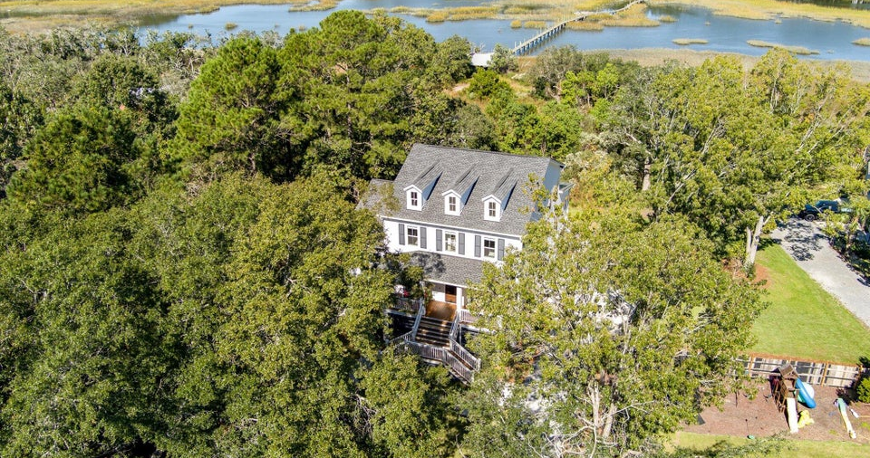
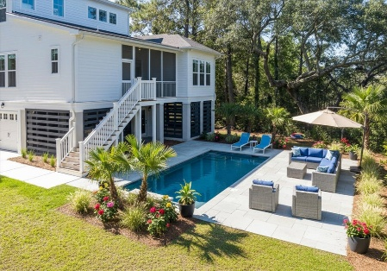
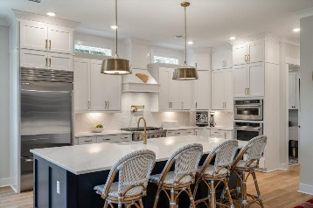
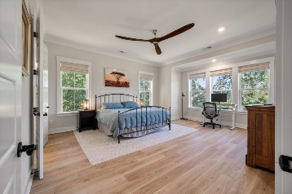
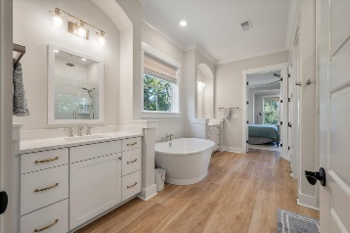
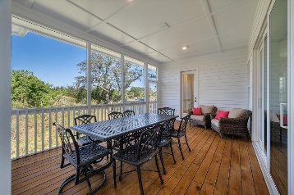
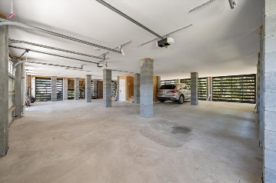


James Island ~ No HOA ~ 3 Lights to Downtown
5 Bedrooms
4.5 Baths
3,841 sqft
Built New in 2024
Tons of Privacy
Room to build a pool
AI Generated
1840 Cornish Avenue
Camp Road Estates | Charleston, SC 29412 | MLS# 25030638 | $1,550,000
Modern coastal living without the rules - this newer elevated home offers sleek construction, room to park your boats, space for your chickens, and the freedom of no HOA! Built New in 2024, this 5 bedroom 4.5 bathroom elevated drive under (4 car garage) home is 3,400+sqft and sits on a large .61 +/- acre private lot. No HOA and 3 Traffic Lights from Downtown Charleston! Folly Beach and James Island County Park just around the corner as well. Golf Cart, walk, or bike to Camp Road Middle School, literally at the end of Hale Street. Bring your toys, enjoy your outdoor space, build your pool, work in your gardens or greenhouse, and enjoy easy traffic light access onto Camp Road. Quietly nestled off the main road closer to the marsh with partial views of James Island Creek, this is an incredible opportunity to get a 1 year old house with an abundance of living flexibility and outdoor amenities on your own property. The first floor features a bright, open, spacious floor plan with the kitchen completely overlooking the living room and elevated screened porch. Truly a chefs kitchen, the house is tastefully updated with a 36 inch Sub-Zero classic refrigerator, custom fit surround cabinetry, 36 inch KitchenAid commercial six burner gas stove, wall mounted KitchenAid oven and microwave combo, complete with KitchenAid dishwasher. If you're a coffee aficionado, you will appreciate the dedicated water and waste lines in the kitchen for your home coffee station. ECM Synchronika espresso maker negotiable. A formal dining room is quietly located separately towards the front of the home for relaxed formal entertaining. Also on this level is the primary bedroom with oversized private bathroom, separate sinks, walk in closet, and tile shower. Continuing around the first floor is another large bedroom located on the opposite side of the house with a full bathroom, as well is the home office space at the front of the house, perfect for that home office, library, study, playroom or whatever your lifestyle needs. Upstairs is a secondary large living room area, providing a separate living space on each floor. Bedrooms 3, 4, and 5 are all upstairs complete with 2 full bathrooms and ample privacy for everyone. The home has a 10 year builder warranty in place, a Termite Warranty, a dedicated 50 Amp circuit with 240 V plug charging station in the garage, and the conveniences city utilities. Fresh landscaping around the yard was just completed in October as well as the 1 year builder walk through. This is a chance to get your newer construction dream home on over ½ acre with marsh and creek views, No HOA, and 3 red lights to downtown Charleston! Plenty of more details and photos available upon request, come and see it today!
Jerod Coulter, ABR, REALTOR
843-513-3741
jerodcoulter@gmail.com
The Boulevard Company, LLC | 35 Broad Street | Charleston, SC 29401

