Slide 1
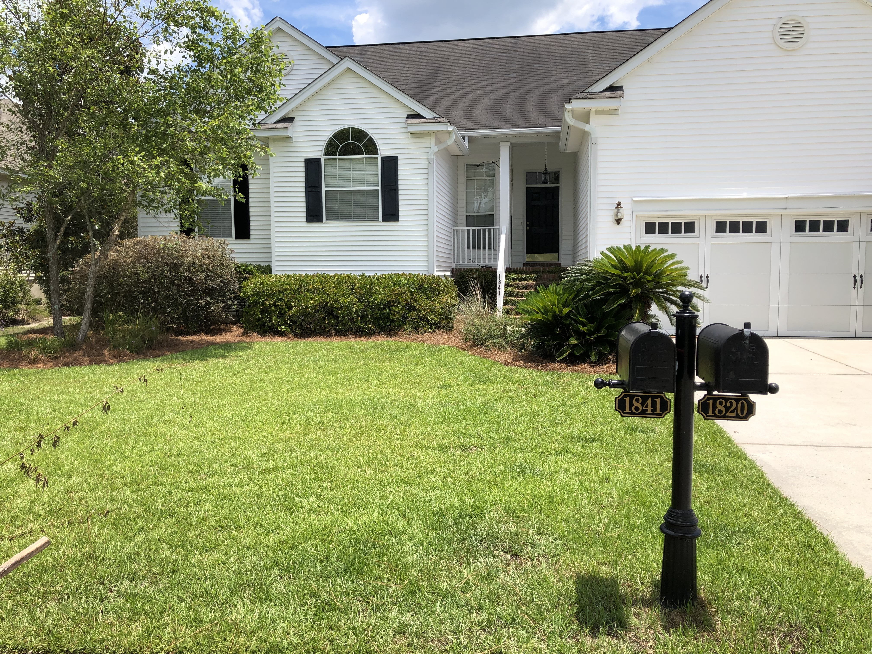


Exquisite One-story Home
Located On A Tidal Creek With A Shared Dock
1841 Palmetto Isle Drive
Rivertowne Country Club | Mount Pleasant, SC 29466
MLS# 19018525 | $415,000
Open floor plan (LR/DR/Kitchen/Sun Room/Living Room with wood burning fireplace. Large Sun Room with beautiful views of marsh and Dock. Kitchen with eat-in dining area/separate Dining Room. Large Master Bedroom with full bath and closet with built in storage. 2 addl. Bedrooms with another full bath. This is a must to see Home!!!!
Professional photos coming soon!
Ursula Erichsen
(843) 696-2346 | uerichsen@carolinaone.com
www.realestateofcharleston.com
Carolina One Cane Bay/Nexton | 1909 State Rd | Summerville, SC 29486

