Slide 1
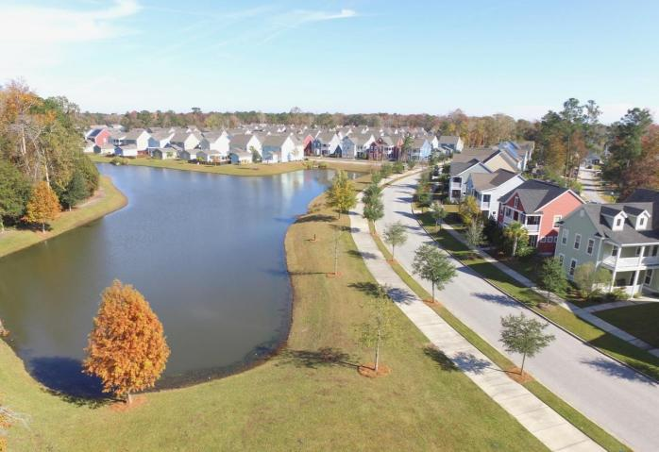
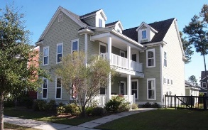
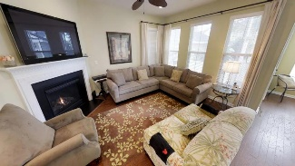
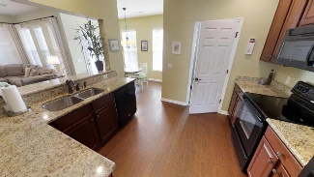
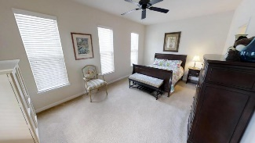
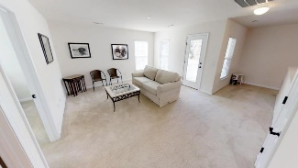


Add This Immaculate Home To Your "Short-list"
1842 Carolina Bay Drive
Carolina Bay ~ Charleston, SC 29414 ~ MLS# 17031930 ~ $382,000
NOTICE THE NEW PRICING AT $155/SF!
Screen porch, open porches and balconies abound... bring the outside in. Nice breezes throughout... Incredible 4/3.5 floorplan includes separate living room, family room, dining room, AND a large loft. Secondary bedrooms are spacious, all with private or semi-private bathroom access. Enjoy lots of granite-topped counterspace in the kitchen. The empty-nester sellers rarely venture upstairs except to meticulously clean it. You will not find any wear and tear in this impressive 7 year old home. Carolina Bay neighborhood is centrally located for commuters and access to shopping, ocean beaches, and historic downtown Charleston. A dog park, neighborhood pools, play yards, and a three acre central park area make this sidewalk neighborhood so desirable.
John Crowley
843-819-4951
john.crowley@agentowned.com
AgentOwned Preferred Group | 1400-G Palm Blvd | Isle Of Palms, SC 29451

