Slide 1
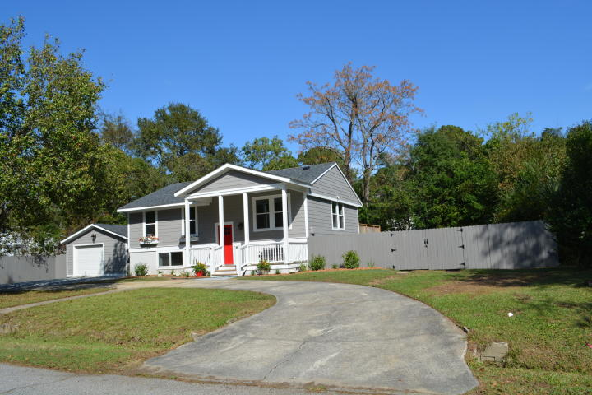
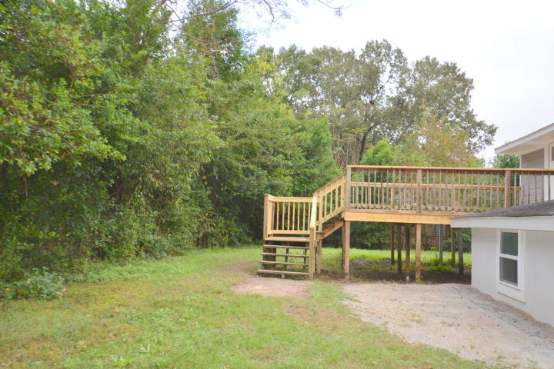
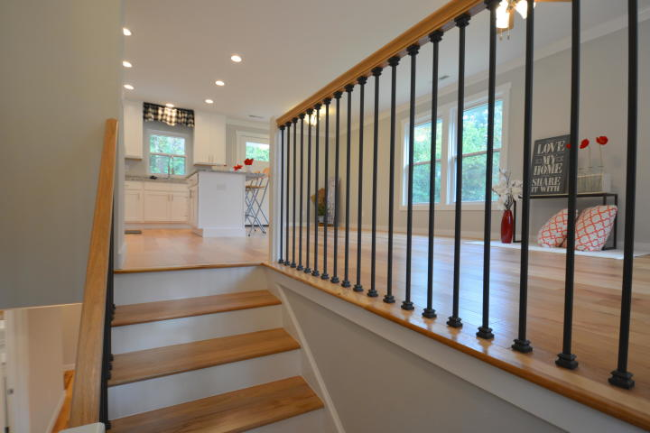
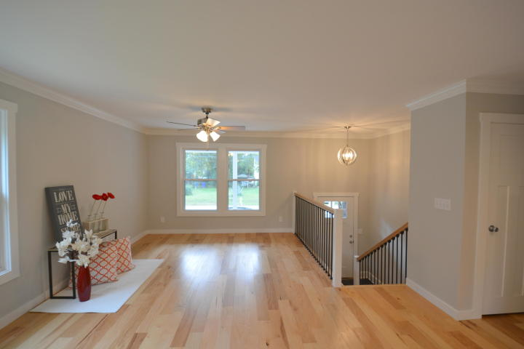
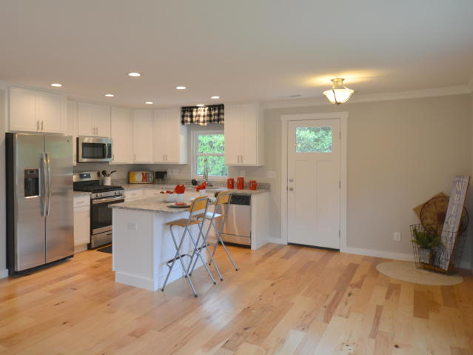
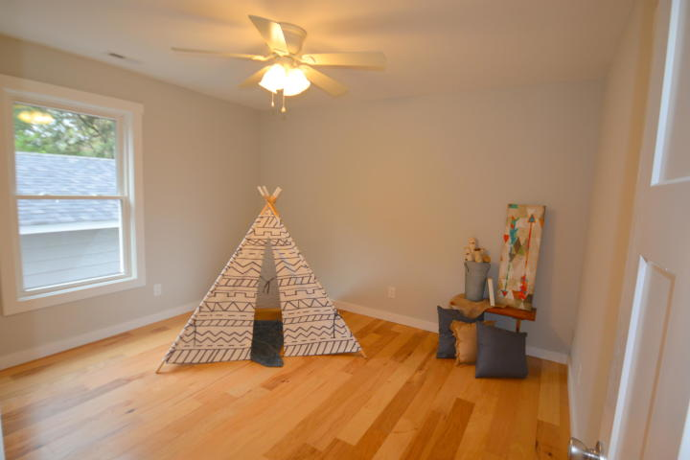
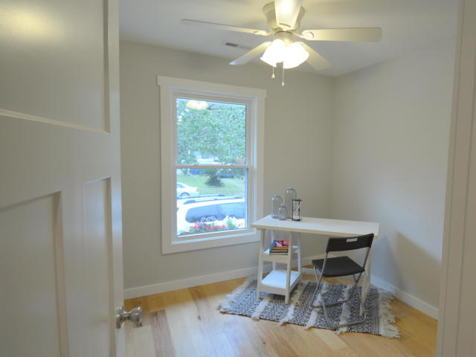
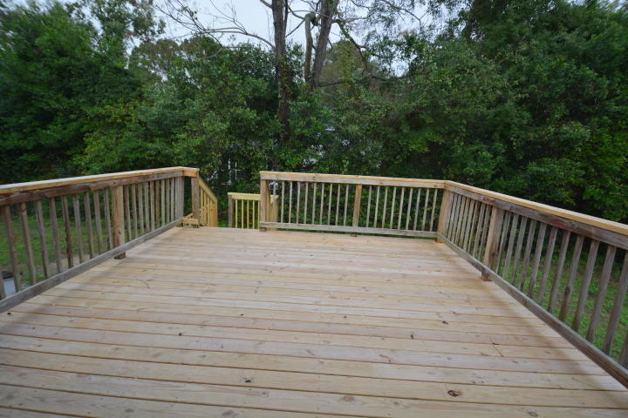
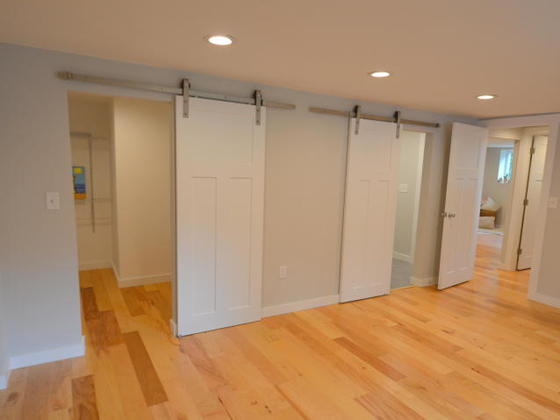
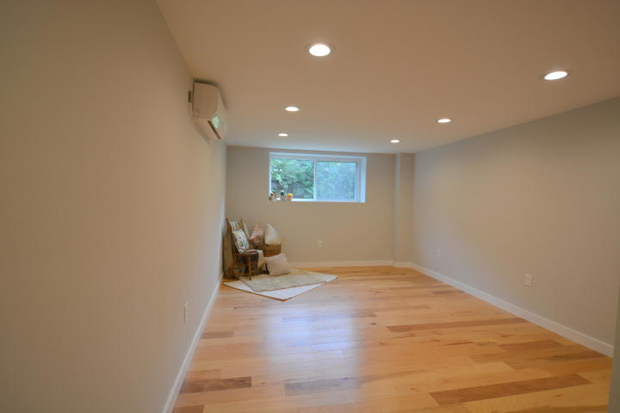
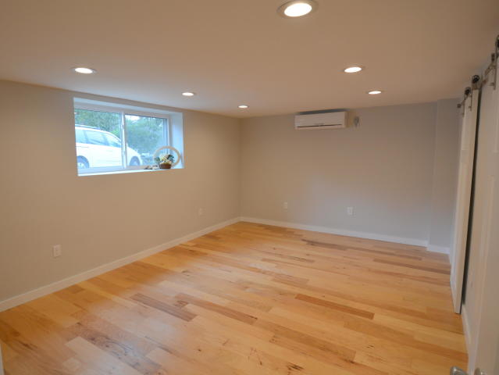
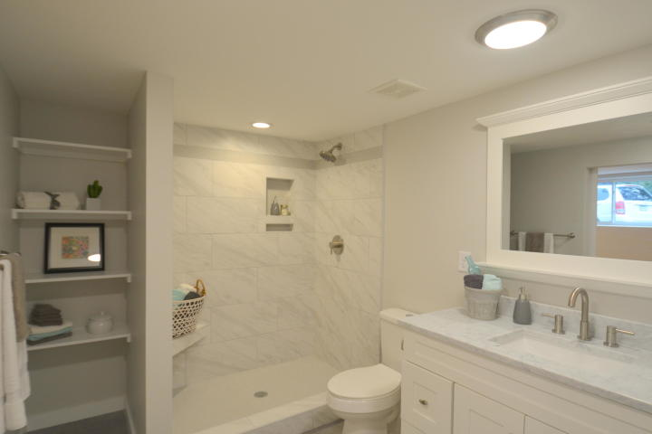
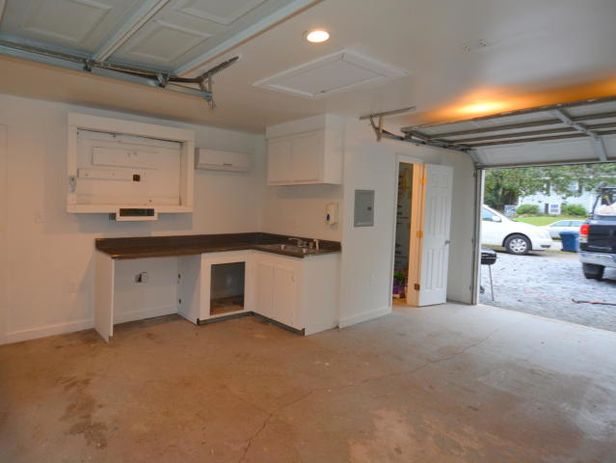
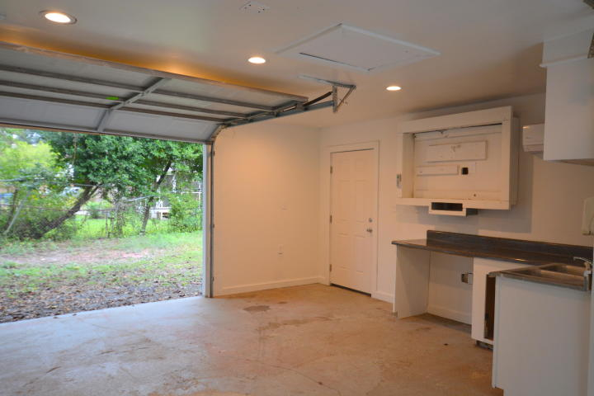
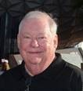

Open House ~ Saturday 3/9 ~ 1-4
Hosted by Adam Bailey | (843) 754-9095 | adambailey@kw.com
Buy.......Build.....Begin
1843 Debbenshire Drive
West Ashley Plantation | Charleston | MLS# 18030860 | $346,500
Welcome to 1843 Debbenshire Drive located in West Ashley Plantation. This five bedroom, two bath home is newly renovated and has 2069 square feet of beautifully designed living space. The floor plan has been opened up and all new electrical and light fixtures have been added. The Kitchen is all new cabinets with Granite Counter Tops and a GE Stainless Steel appliance package with Natural Gas Range. There is a new island in the kitchen as well. New energy efficient windows have been added throughout along with new five inch wide Maple hardwood floors. All of the bathrooms have new vanities and Carrara Marble counter tops. The HVAC for the upstairs is a traditional heat pump but the downstairs and the garage are heated and cooled with the new Mini Split system. This gives you ultimate flexibility in zone heating and cooling and it is very energy efficient. Both bathrooms have new custom tile floors. The master bathroom has a very large custom tile walk-in shower. The oversized master bedroom has new "barn door" sliders for the entrance to the large walk-in closet and the master bathroom. A Natural Gas Rinnai Tankless hot water system is installed. All of the interior and exterior doors are new Craftman Style doors. All of the plumbing is new as are the plumbing fixtures. New paint inside and out with new finish and trim too. On the right side of the house is a large gate in the privacy fence that allows you to park your RV, Boat or camper securely. An oversized deck has been added that has a walk out door from the kitchen area. The detached finished garage contains 440 square feet of heated and cooled space. It contains a kitchen area that could easily be finished into a complete kitchen. The cabinetry is in place with the sink and countertops. There is a finished half bathroom with an unfinished shower here too. Each end of the garage has garage doors. If you wanted to remove one and frame in one or both ends, you would have a wonderful apartment/man cave/she cave. The back yard is fenced in. This great property is move in ready.
Bob Ramella, Broker
CRS, CDPE, RCC, e-Pro
(843) 330-8300
bob@bobramella.com | bobramella.kw.com
Keller Williams Realty Charleston | 496 Bramson Ct Ste 200 | Mt. Pleasant, SC 29464

