Slide 1
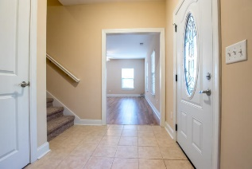
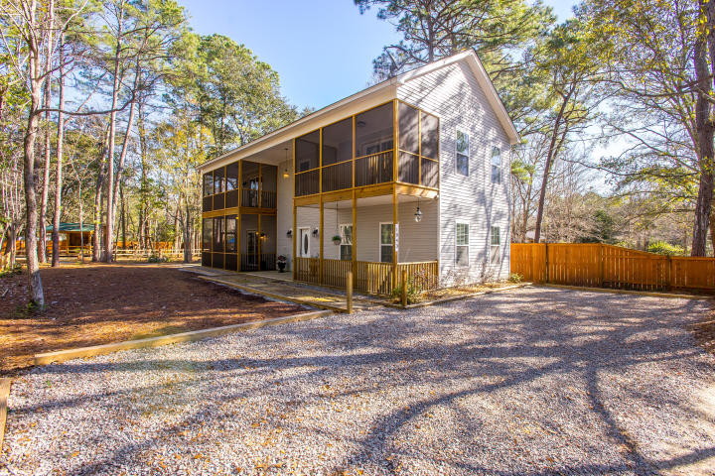
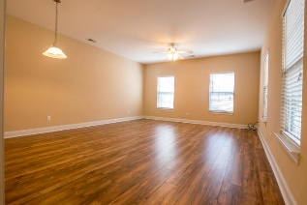
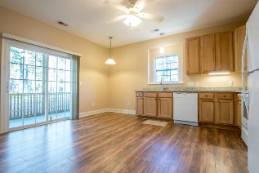
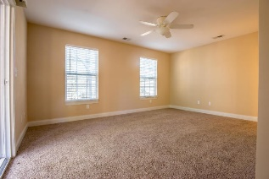
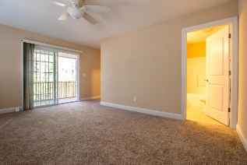
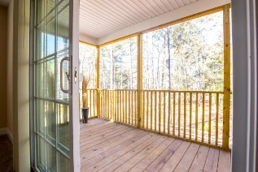
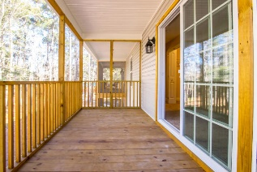
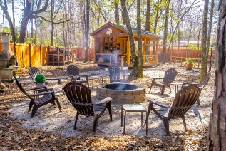
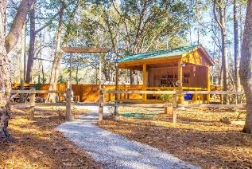
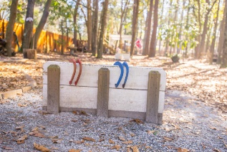


1843 Zelasko Drive Enclave Park ~ Johns Island ~ MLS# 19000712 ~ $285,000
New 55+ Community
Welcome to Johns Island's new secret, Enclave Park! This home is unique as it is located in a new small 55+ pocket community right in the center of Johns Island. Brand new, this home offers a very large eat in kitchen with granite countertops with brand new appliances and lovely finishes. It is spacious enough that if the new owner would like to add an island they could very easily do so. There is a large laundry/utility room off of the kitchen as well and it also boasts a nice pantry and a screened in porch located just off of the breakfast area. The living room is quite large and can be used as a living/dining room combo or you can simply have a very large living room or a separate sectioned off area for a study or office area.
This home also has dual master bedrooms. Each comes complete with its own en suite master bath and very large walk in closet. But what makes this home both unique and desirable is that both master bedrooms also have their own private screened in porch. Surrounding this lovely Charleston single style home is the nicely developed Enclave Park. Behind the home is a gorgeous community park that has several amenities including two fire pits, a community barbecue area, storage shed, horseshoes, a large 2 story pergola and a picnic pavilion with natural landscaping to match the landscaping of the home itself. The developer chose to do a low maintenance landscape on the property for ease of living. Aside from the 3, yes 3, screened in porches that adorn this home, there is also a 4th porch located off of the living room and a large patio in the back of the home just off of the kitchen.
Carey Nikonchuk
(843) 276-1701 M
cnikonchuk@gmail.com
www.palmettoproperty.net

