Slide 1
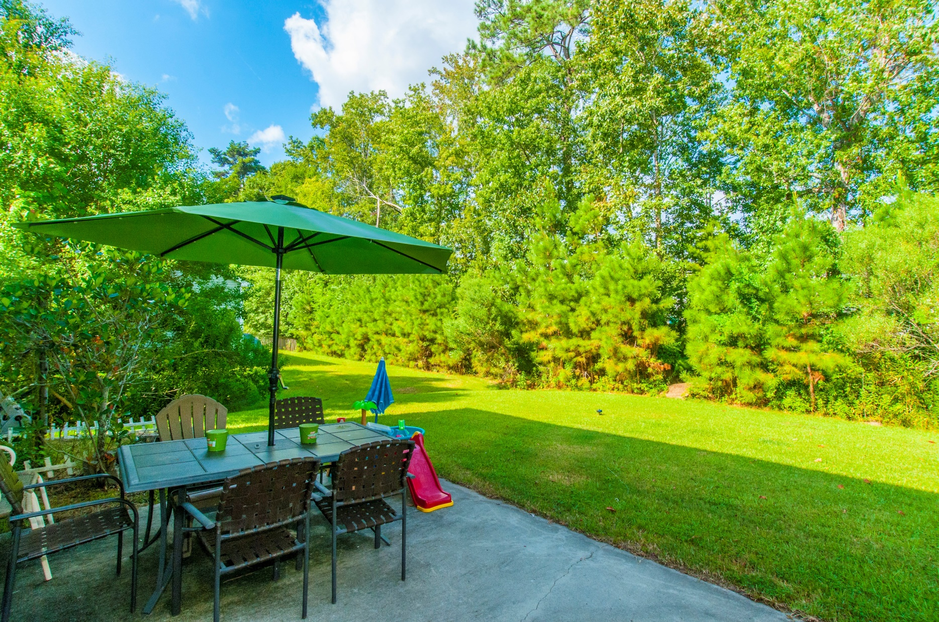
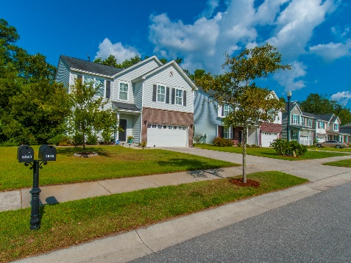
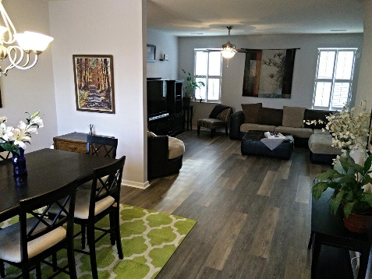
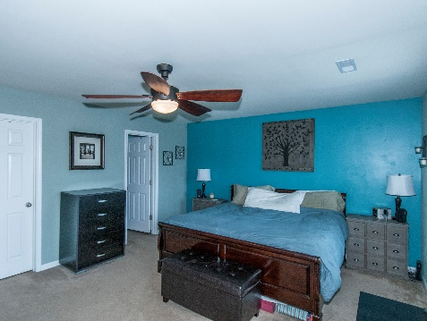

1845 Cornsilk Drive
Carolina Bay ~ Charleston
MLS# 16022287
$287,500
Bring Your Offer...
Ocean Views looking down 49th Ave
Great Rental Potential!
Beautiful main floor upgrades! 7'' wide plank flooring installed 9/14/2016, granite kitchen counter tops and smudge proof stainless appliances March 2016. This open concept plan in sought after Carolina Bay has a wood buffer and extra space between neighbors. Second floor features an expansive Owner's Suite, plus 3 additional large bedrooms and 2 full baths. Property is occupied by the original owner. - Plantation shutters - Ceiling fans through out with new ceiling fan in master bedroom - Dual zone HVAC - Close to 2 of the 3 pools - Close to the park and dog park.
Property Upgrades & Highlights
Recently upgraded granite kitchen counter tops (done in March of this year) and smudge proof stainless appliances
Plantation shutters
New ceiling fan in master bedroom
Extra large back patio
Great water run off that helps the backyard stay avoid flooding
Close to the entrance (a lot of the newer homes built are about an 8-10 minute drive just within the community
Close to 2 of the 3 pools (could bike ride)
Close to the park (could bike ride)
Close to the dog park (could walk there)
Quiet neighbors
Close to 17 and Glenn McConnell (can get to both from within the neighborhood)
Good size lot and generous space between neighbors and wood buffer in rear
Mary Warren
ABR, RSPS, REALTOR
Mobile - (843) 224-6272
mwarren@carolinaoneplus.com
Carolina One Real Estate | 1265 Folly Rd | Charleston, SC 29412

