Slide 1
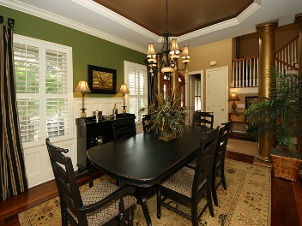
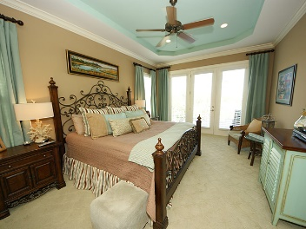
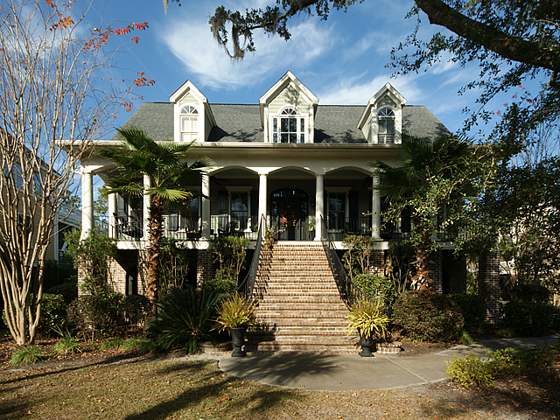
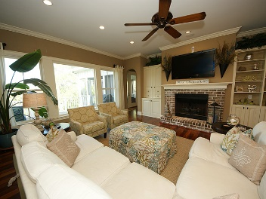
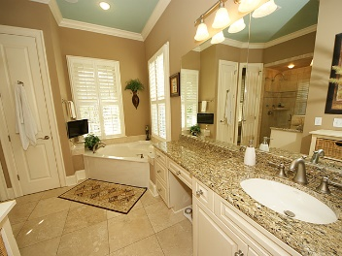
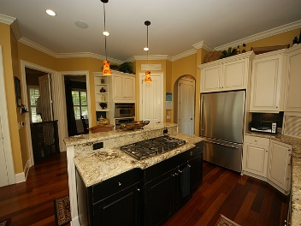
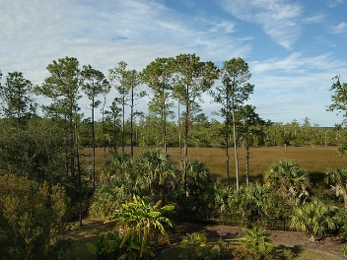
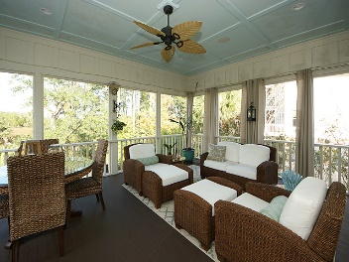
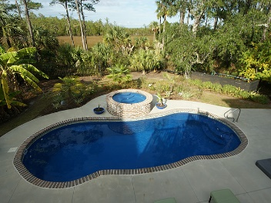


1845 W Canning Drive Park West ~ Mount Pleasant, SC 29466 MLS# 16030272 ~ $825,000
Open House Luncheon February 22nd 11a-1pm
This house is beautiful to look at, but also has exceptional details that take it to the next level. From the marsh views, elevator and lower level of approximately 900 square feet, that brings the home square footage to 4200, prepare to be visually delighted. Walk up the brick front steps with wrought iron railings shaded by large mature oaks and you are greeted by gas lanterns and Ipe on the front porch deck. Enter the front door to see the marsh of Toomer Creek framed by the large window in the great room. The formal dining room on the right is accented by large columns and molding detail and a stunning try ceiling. The well designed keeping room style kitchen has an island with breakfast bar overlooking a 5-burner gas GE Monogram cook-top, stainless steel appliances, granite counters, slate tiled backsplash and spacious eating area with bay window plus adjoining large laundry room with a sink and cabinets. There is even a dumb waiter to assist you in bringing groceries up from the lower level. The room currently being used as an office is the ideal sitting room or homework spot and has a coffered ceiling. The large great room has built-in bookshelves with base cabinets with grass cloth accent. Don't miss the elevator that goes to all 3 floors. The oversized screened porch and adjoining deck look out on the in-ground saltwater pool and hot tub with expansive decking all surrounded by a garden filled with rose bushes and native plants. Enjoy the fire pit on a cool evening or take a refreshing shower after leaving the pool. This backyard has it all! Main floor master with outside access is spacious and bright with over-sized tiled shower, jetted tub, dual vanities and linen closet. Two walk-in closets give you space for everything.
Upstairs there are 2 bedrooms with a hall bath, and an ensuite bedroom. An office with French doors leads to a balcony porch that overlooks the pool and the marsh beyond. Don't miss the lower level with hidden insulated music or bedroom, full bath and another room currently being used as a bedroom. The large room in the center is flex space at its best and could be a play or rec room. The garage with 3 bays has lots of storage space.
Franne Schwarb
843-270-1207
franne@charlestonfinehomes.com
Chari Karinshak
843-810-8287
Chari_Karinshak@yahoo.com
Coldwell Banker Residential Brokerage, 1127 Queensborough Blvd, Mount Pleasant, SC 29464

