Slide 1
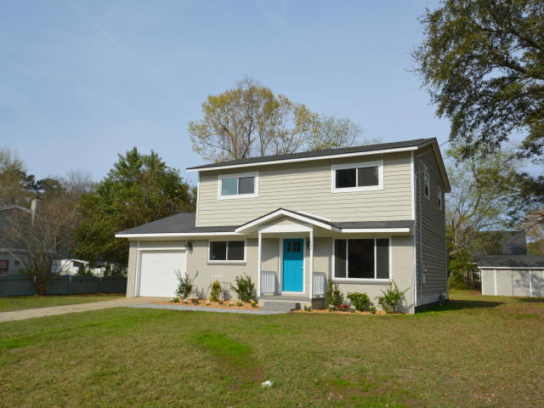
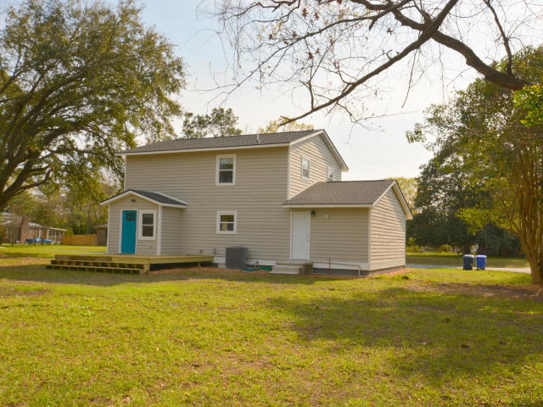
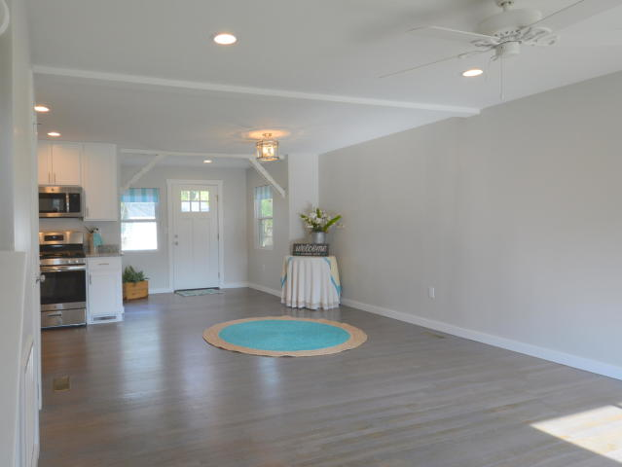
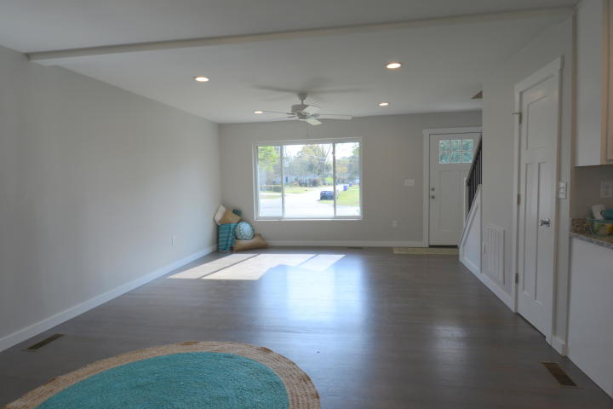
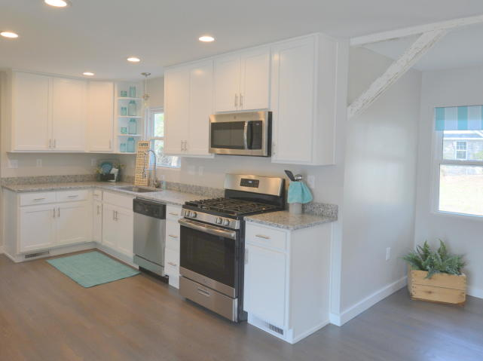
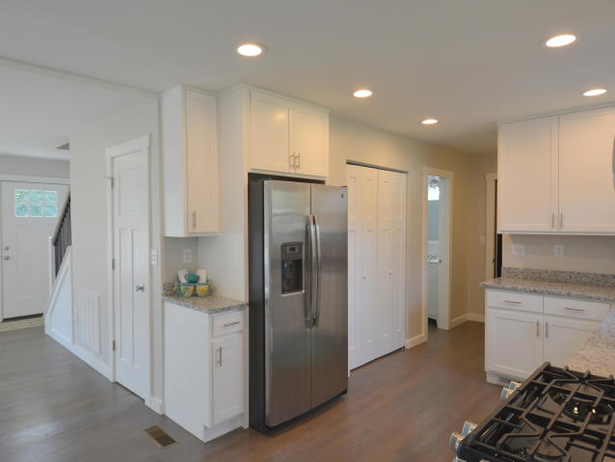
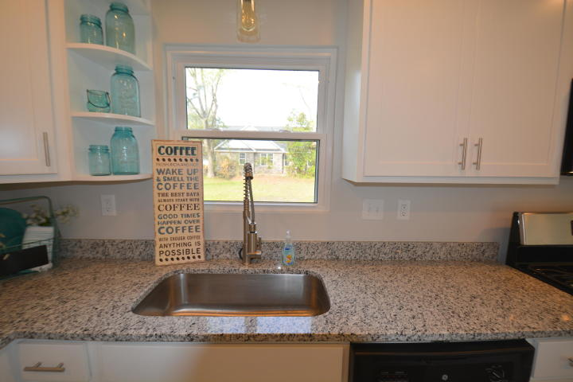
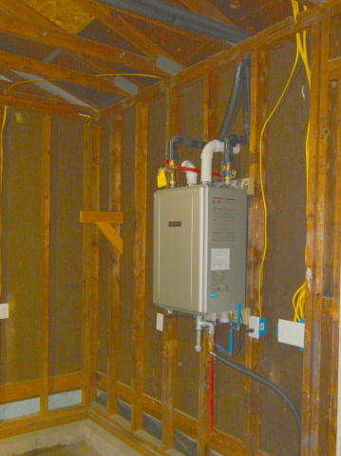
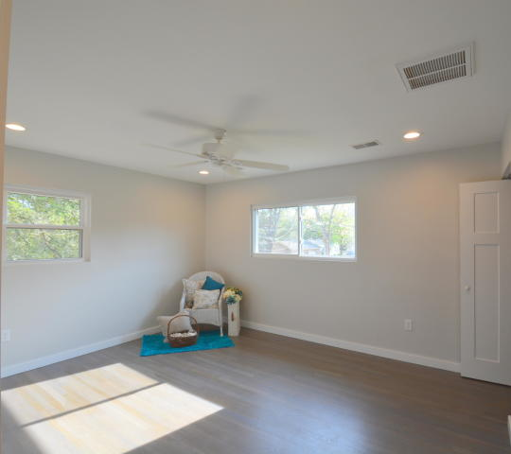
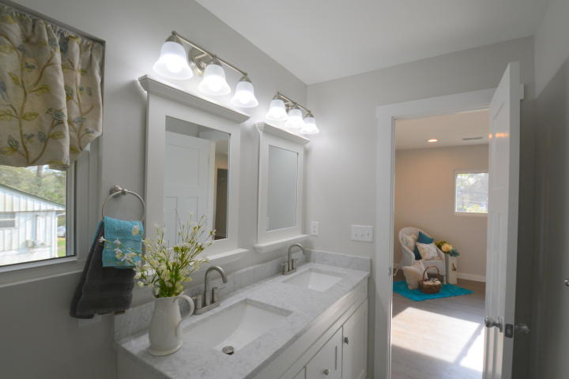
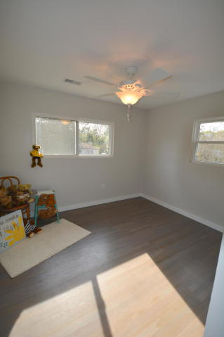
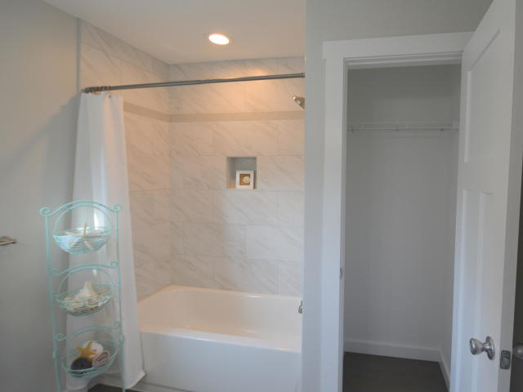
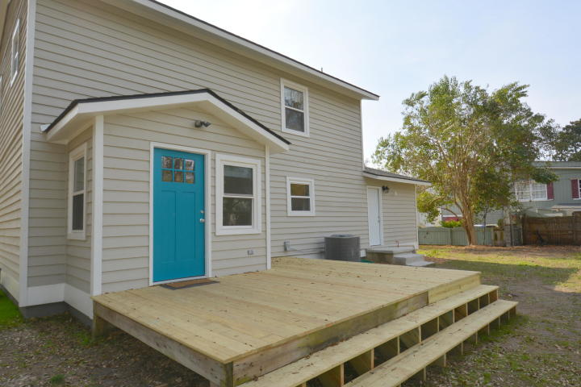
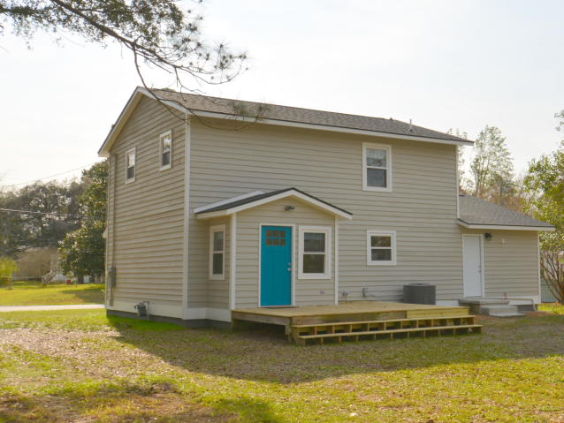


Open House ~ Friday 5/31 from 2 to 4
Hosted by Cynthia Partrick | 252-721-3179 | cynthiapartrick@kw.com
Buy.......Build.....Begin
1847 Sandcroft Drive
Charleston, SC 29407 | MLS# 19007399 | $329,000
Welcome to 1847 Sandcroft Drive. This wonderfully renovated home has 4 bedrooms, 2.5 Bathrooms and contains 1567 Square Feet. Inside you will find All new electrical including all new fixtures, All new plumbing including new fixtures, A commercial Natural Gas Instant Hot Water System delivering 11 gallons per minute on demand, All of the bathrooms have been renovated with new tub and shower with custom tile and surrounds, All new HVAC and duct work, New bathroom vanities, Completely renovated Kitchen with all new cabinets, new Granite counter tops, a large pantry, Stainless Steel Appliance package including Gas Range, Microwave, Refrigerator and Dishwasher, A large breakfast nook is adjacent to the kitchen and features a Builder's Accent distressed beam, The laundry room is at the end of the hall leading to the garage, In the spacious master bathroom we find a double vanity with Carrara Marble counter top and large walk in custom tile shower, The Master Bedroom has two closets, one is a large walk-in, the third bedroom upstairs also has a walk-in closet, All new doors and hardware throughout, White oak hardwood floors throughout, The crawl space has been closed in and a humidifier system installed, A French drain has been installed in the front of the house. There are New energy efficient windows throughout, A new walk out deck was added, The outside and inside have all been freshly painted, There are two exterior lockable storage sheds in the large back yard. The driveway on the left leads to the garage and another cut in on the right leads to the backyard area.
Bob Ramella, Broker
CRS, CDPE, RCC, e-Pro
(843) 330-8300
bob@bobramella.com | bobramella.kw.com
Keller Williams Realty Charleston | 496 Bramson Ct Ste 200 | Mt. Pleasant, SC 29464

