Slide 1
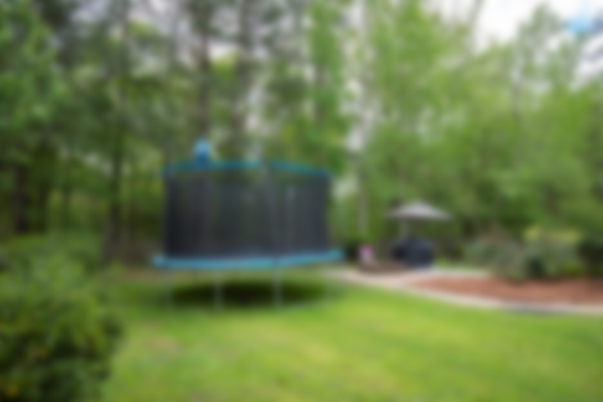
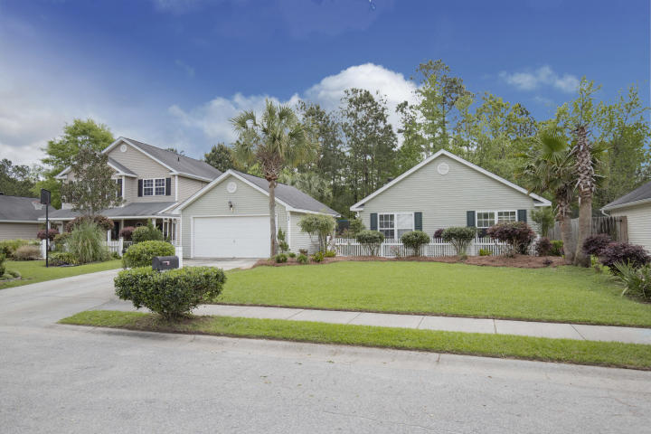
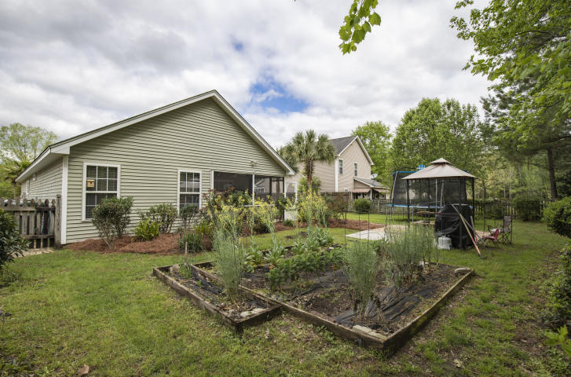
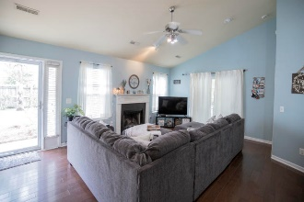
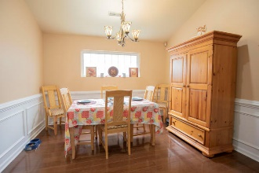
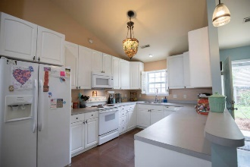
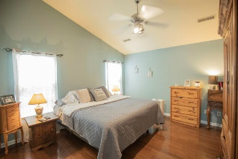
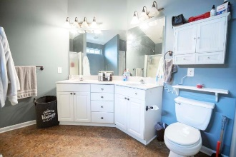
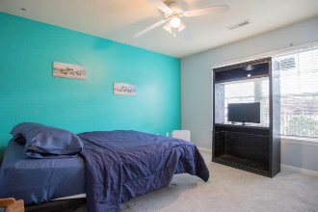
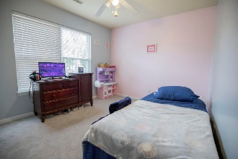
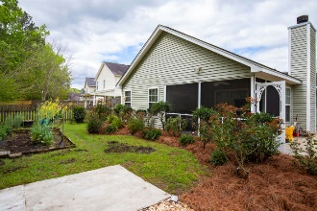

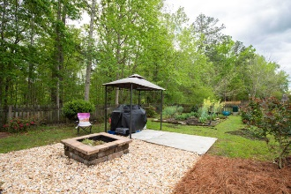

Owner Says Bring All Offers! Move-in Ready Single-story Home With Private Backyard In D2 Schools
184 Jupiter Lane
Sunburst Lakes | Summerville, SC 29483 | MLS# 20009109 | $229,000
Charming 3 bedroom ranch style home with a desirable open floor plan located in the highly sought after Dorchester II School District. This a real dream house that backs up to a large wooded lot for added privacy. As you enter the home, you are greeted with a vaulted ceiling, wonderful dark hardwood floors in the master and living space and a wood-burning fireplace- great for those cool nights. The large kitchen and dining room are open light and airy. Spacious master bedroom with vaulted ceiling and a walk-in closet, dual vanities, shower and garden tub. The master suite is in the back of the house, which makes for a good retreat. The 2 additional bedrooms are a generous size and bath are on the opposite side of the home. HVAC less than 5 yrs old. Enjoy the evening from your screened-in porch so quiet and peaceful you can hear the fountain from the pond. Outback you'll find a lush garden and a fire pit perfect for entertaining guests or enjoying a family evening. Sunburst Lakes is a popular neighborhood with a neighborhood pool, great schools and close to lots of shopping.
Marthe Teixeira (917) 325-8033
marthe@agentownedrealty.com
Scott Fulton 843-324-8845
scott.fulton@agentownedrealty.com
AgentOwned Preferred Group · 824 Johnnie Dodds Blvd · Mt Pleasant, SC 29464

