Slide 1

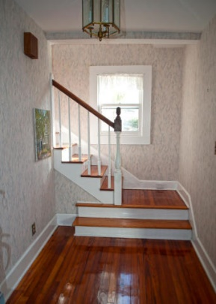
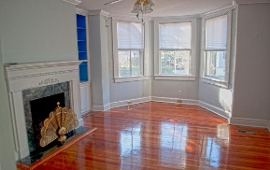
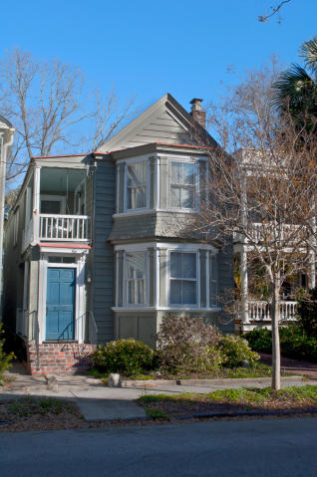
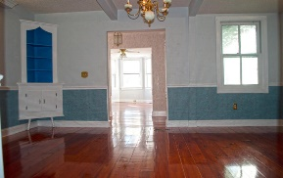
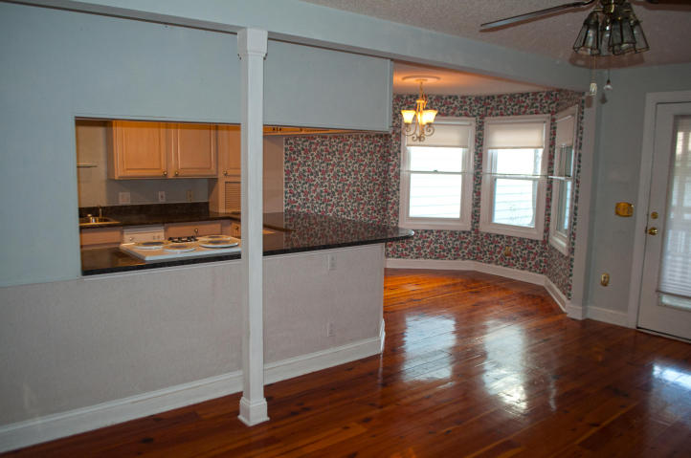
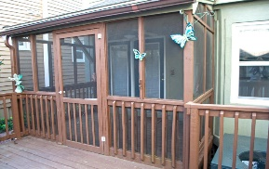
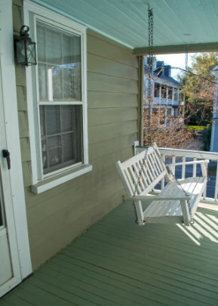
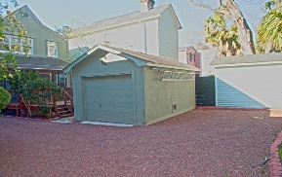


1880's Home
184 Wentworth Street Charleston, SC 29401 MLS# 18007563 • $979,000
This 1880 home was built in the Charleston Single Style of Architecture. Beautiful''Heart of Pine'' floors throughout the home. Large multiple windows allow for lots of sunlight permeating throughout the home. Kitchen was updated around 1995 -nice built-in wall oven and microwave. Formal Living Room with Fireplace- Formal Dining Room with Built-Ins- Bright kitchen nook overlooking the screened-in porch and deck that leads to a detached one car garage and an additional parking spot. Home shares 8' easement with neighbor on the right to allow access to garage and parking spot. Upstairs are 3 nice sized bedrooms including the master with large walk-in closet, bath has separate tub and shower with dual sinks. Front bedroom has access to upstairs porch.
Lisa Stine, REALTOR
(843) 364-5359 lisastine61@gmail.com
Elaine Brabham and Associates, LLC • 1890 Sam Rittenberg Boulevard, Suite 217 • Charleston, SC 29407

