Slide 1
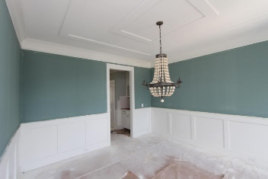
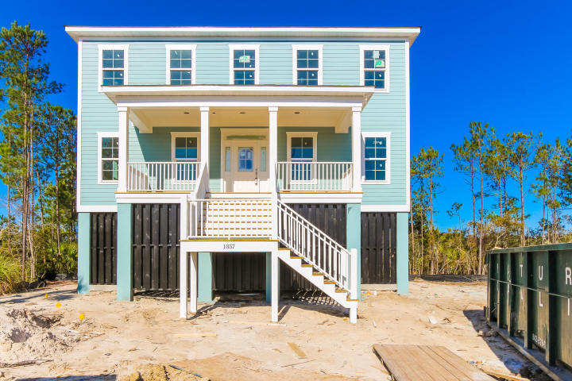
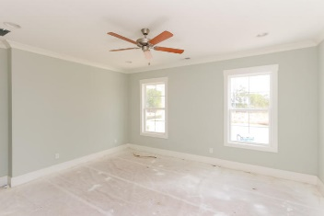
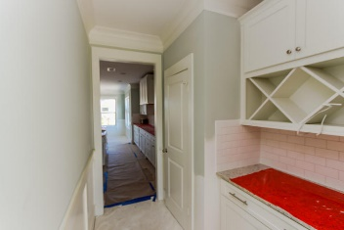
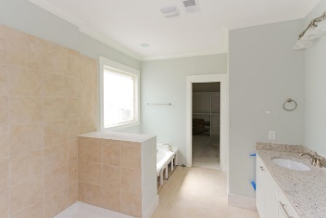
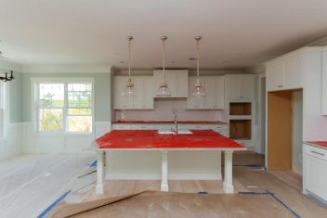
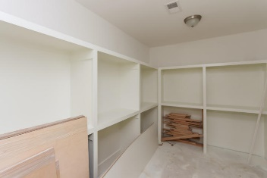
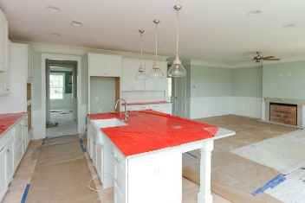
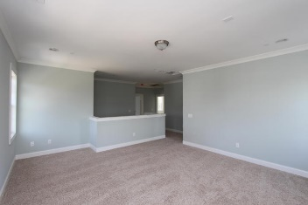
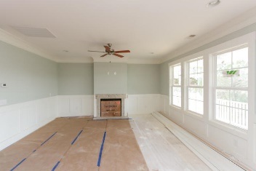
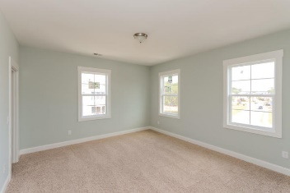
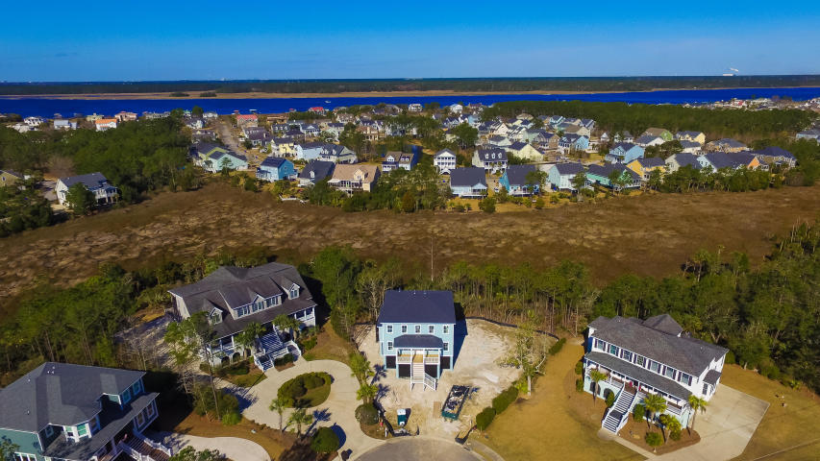
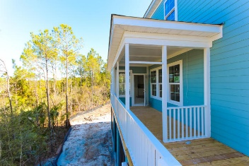
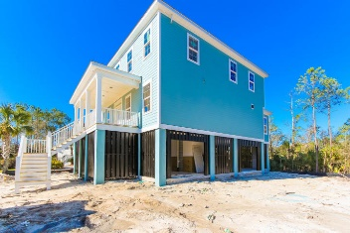

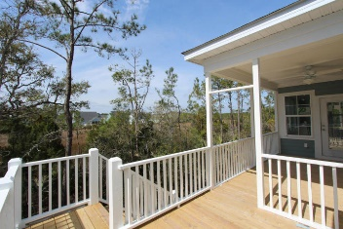
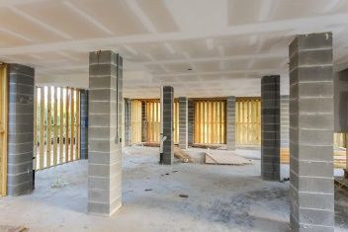
1851 Delacourt Avenue
Planters Pointe :: Mount Pleasant :: MLS# 15029466 :: $599,990
The Perfect Elevated home and located on an amazing marsh Homesite in a cul-de-sac. Simply breathtaking views of the Marsh that lead out to the Wando River! This architecturally distinctive, elevated, bright and open home offers incredible sunsets. Being filled with upgrades, character and charm. The Front Porch is great for Rocking Chairs and/or a swing. The Appliances included are Over the Range Hood, Gas Stove, Built-in Oven and Dishwasher. Granite counters, custom cabinets with a huge granite island make this home a chef's dream. The Kitchen and Family Room are open for fantastic entertainment for family and guests. A comfortable eat-in kitchen area offers plenty of space. The Screened porch is a perfect place to watch the sunset over the marsh.
Chris Eller
EPRO, GRN, SFR, REALTOR, CRS
(843) 343-3359
iconicdevelopments@gmail.com
GFH Realty, LLC
498 Wando Park Blvd Suite 1125
Mt. Pleasant, SC 29464
www.gallowayfamilyhomes.com

