Slide 1
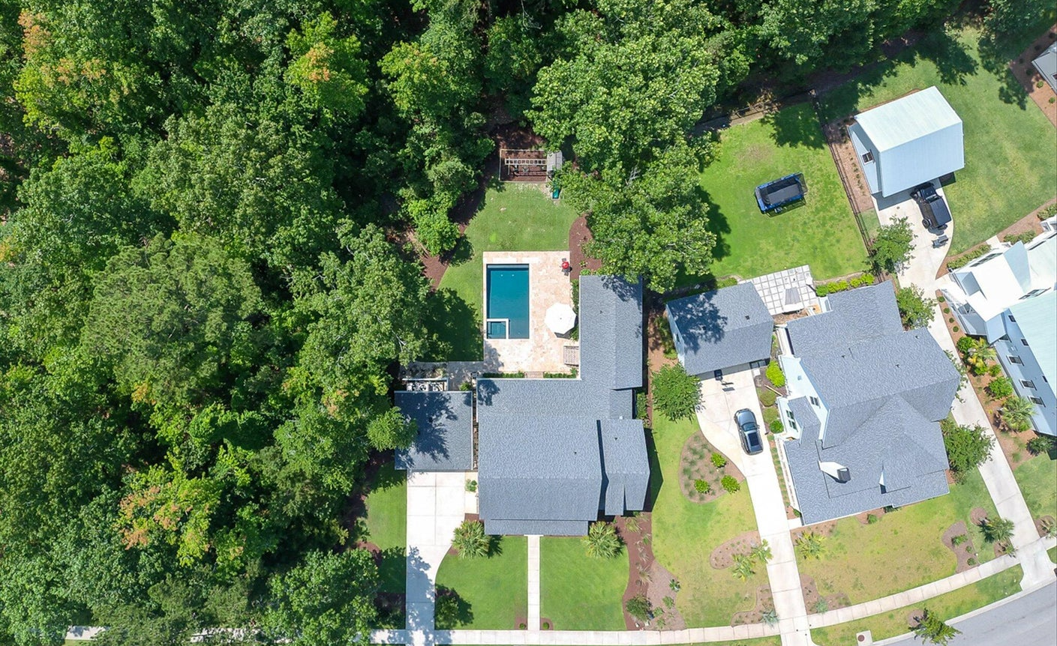
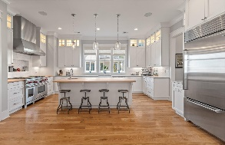
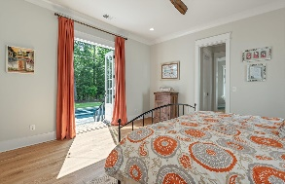
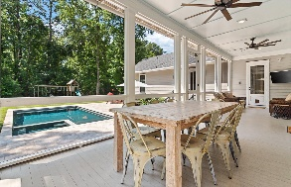
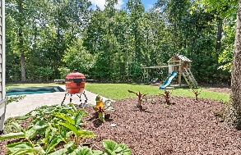
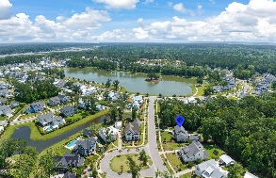


Private .34 Acre Wooded Lot
Inground Salt Water Pool w/ Hot Tub
Master Down with Private Outside Access
1852 Carolina Park Boulevard
Carolina Park | Mount Pleasant, SC 29466
MLS# 23017049 | $1,795,000
Exquisite custom built home in Riverside at Carolina Park located on a highly sought after .34 acre (14,500sqft +/-) private wooded lot with inground salt water pool, hot tub, 328 sqft screened porch, gourmet kitchen, and master bedroom down. In Riverside there are a variety of builders with different price ranges that can help dictate price per sqft and finish levels, this home was custom built by local Prism Luxury Best Product award-winning and multiple Builder of The Year Award recipient, Structures Building Company. The Chefs Kitchen features an impressive 48" Wolf dual fuel range with a 22" wide double infrared griddle, 1,200 cubic foot overhead ventilation system, Sub-Zero Refrigerator, and massive solid Butcher Block countertop island with custom prep sink, disposal system, and trash chute. The beautiful master bedroom is conveniently located downstairs and offers private outdoor access through French Doors to the hot tub, pool, and patio areas. Perfect for enjoying that private evening dip in the hot tub or just relaxing on the patio within the compounds of this incredibly serene setting. You truly must see it to feel and experience this private setting.
The master bathroom features a large custom tiled shower, Signature 63" Bellbrook Clawfoot oversized tub, dual separate sinks and matching closets. Located at the top of the stairs is a loft area, perfect for that 2nd living room/media area or another great place for a kids play area. Two large bedrooms share a bathroom and a third upstairs bedroom (4th overall) has a full ensuite private bathroom for children or special visitors. If you're looking for an open floor plan, it does not get more open than this! The kitchen completely overlooks the living room and flows seamlessly onto the screened porch that overlooks an absolute oasis of a private backyard. Step off the screened porch and onto the Travertine Tile Patio that surrounds a custom built salt water pool and hot tub. The pool has an Automatic Cover that is safety tested for 485 pounds with keypad security, a convenient safety feature any pool owner will greatly appreciate and an easy way to keep the pool free of debris after a long day of fun.
Walk, bike, or golf cart to Carolina Park Elementary School, Wando High School, The Bend, Mount Pleasant Public Library (verify any if deemed important). Conveniently located in the Award Winning 'All-American City' (voted for the third time most recently this year) of Mount Pleasant, you are close to schools, and shopping at The Bend, Mount Pleasant Towne Center, Lowes, Home Depot, another Lowes, Isle of Palms and Sullivan's Island Beaches, Costco, Roper St Francis Hospital just minutes away, Home Team BBQ, Sewee, Hidden Ponds Nursery, Target, Walmart, East Bay Deli, Chick-fil-A, and basically just about anything you may be looking for, even an International Airport just 25 minutes away. Come see why so many people choose Riverside at Carolina Park and maybe this house can be your next home!
Jerod Coulter, ABR, REALTOR
(843) 513-3741
jerod@realtor.com
The Boulevard Company, LLC | 35 Broad Street | Charleston, SC 29401

