Slide 1
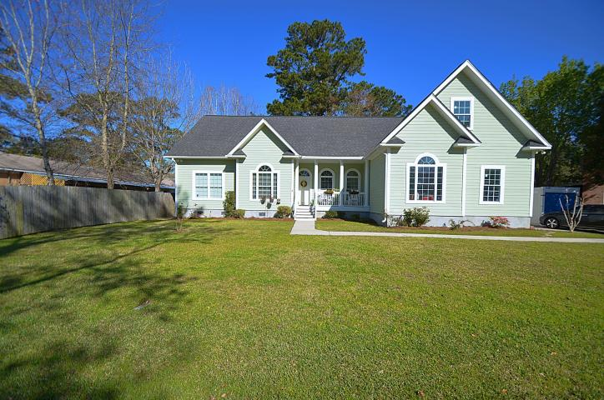
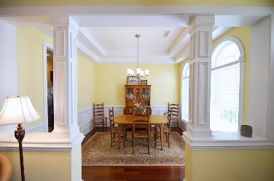
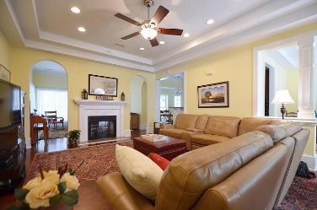
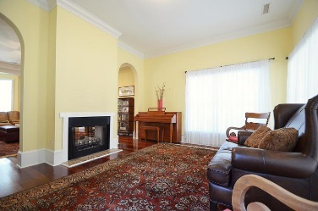
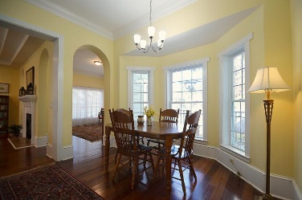
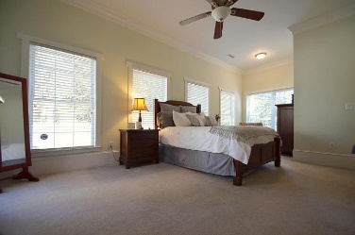
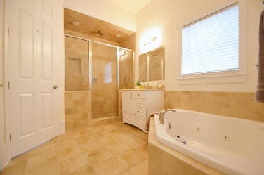
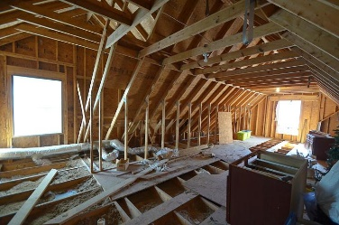
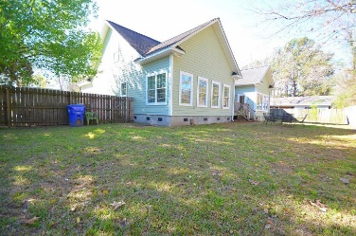



1854 Beechwood Road
Pierpont ~ Charleston, SC 29414 ~ MLS# 18007076 ~ $379,000
Just Listed
+
Open House
Saturday, March 24th 11-1
Just Reduced!
Enjoy the huge open floor concept in this beautiful home. Large base moldings and crown throughout gives this home the Charleston charm. As you enter you are greeted into the foyer and the extra large living room, dining room, and study. The large eat in kitchen is a plus which looks out to a great sized backyard great for the family dog. The master bedroom is very large, with a beautiful tiled bathroom with walk in tiled shower and large jetted tub. The master closet is HUGE. The bonus feature of this home is the amount of storage in the walk up attic that can be converted into a bedroom, playroom, or movie theater. Bring your show cars for the high ceiling garage that can easily accommodate a lift. This home has it all. A must see in person to truly appreciate this one of a kind home!
Andrew Sorrentino
(843) 371-6218
andrew.sorrentino@agentowned.com
Kelly Rozier
(843) 209-3129
kelly.rozier@agentownedrealty.com
The AgentOwned Realty Co | 902 Savannah Hwy | Charleston, SC 29407
Real Estate • Mortgage • Insurance
www.AgentOwned.com

