Slide 1

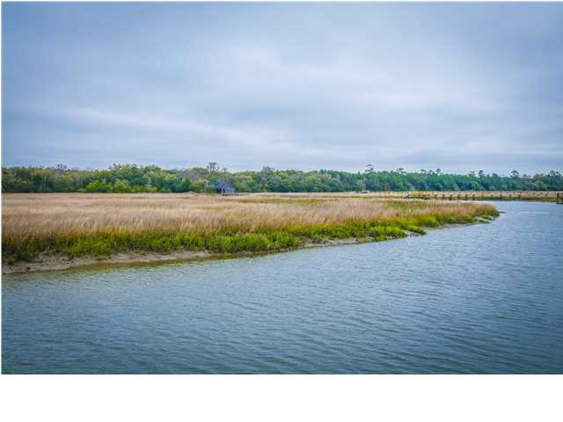
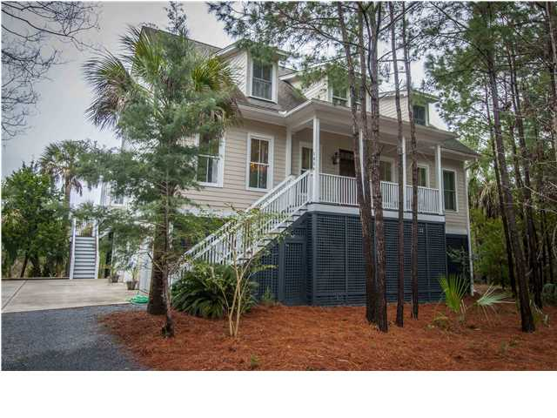
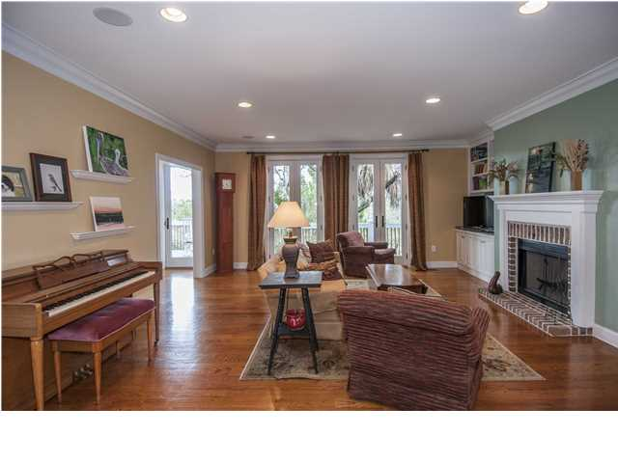
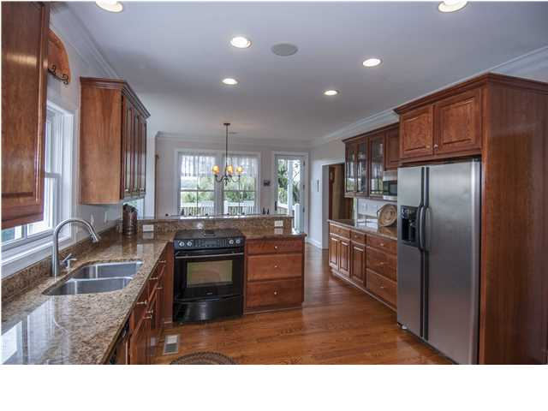
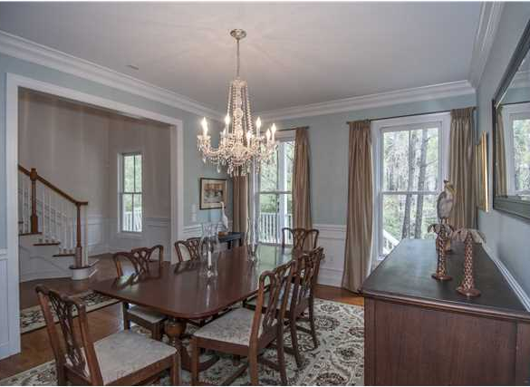
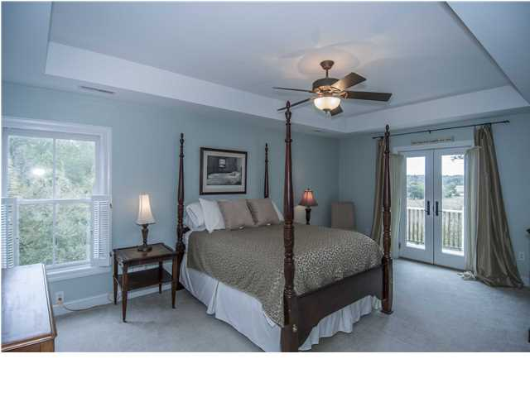
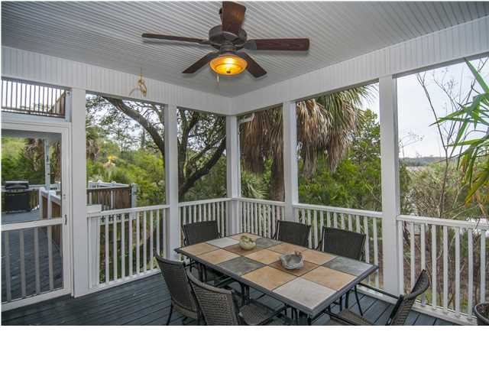
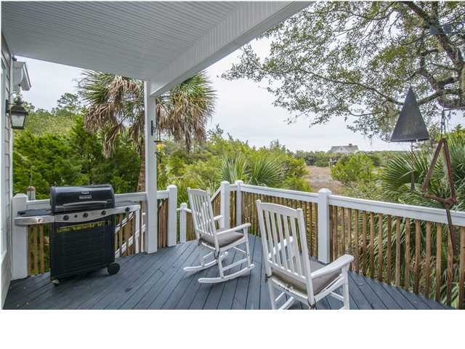
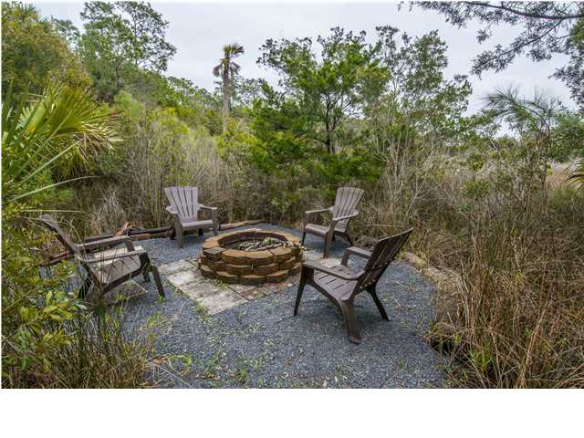
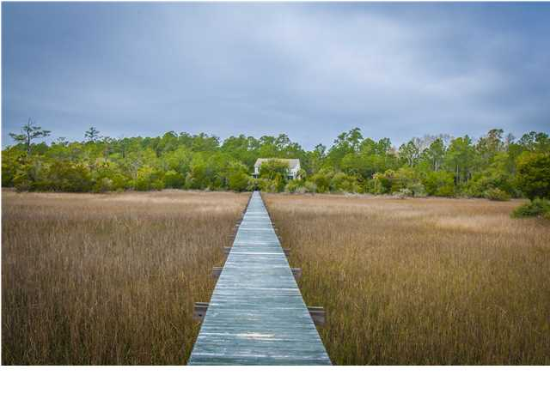
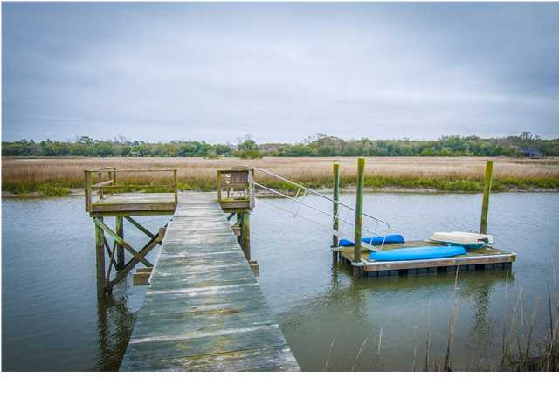

Longpoint Deep Water Agent Open House Wednesday, April 23, 2014 11am-1pm Luncheon & Drawing
1854 Peaceful Way
Mount Pleasant ~ MLS# 1407488 ~ $1,125,000
Drawings for Two $50 Gift Certificates to Boathouse Restaurant
DEEP WATER DOCK on Boone Hall Creek! You cannot find a better waterfront property at this value. This is a unique opportunity to live in a quiet country setting with space and privacy yet still very close to shopping, quality schools, and town. The home sits on an estate-sized lot (1.5ac total / .71ac high ground) overlooking the Cotton Dock at Boone Hall Plantation. Across the street is the woodlands of Palmetto Islands County Park. This home was custom built in 2005 for the current owners and features hardwood floors, granite counters, custom Cherry cabinets, built-in bookcases and surround sound, a gas fireplace, and amazing views from nearly every window. There is a full bedroom and bath on the first floor plus an office. Large kitchen has plenty of cabinets and a breakfast area overlooking the water and marshes. There is also a walk-in pantry / laundry room. Wainscoting in the formal dining room. The Master Suite has a balcony with a Million dollar view, large bath and walk-in closet. Enjoy the privacy and serenity of a property that stretches across more than 250' of waterfront and the only neighbor in sight is off in the distance. You can sight cast to tailing redfish from your dock or roast oysters over the backyard fire pit. Grill your fresh catch on the covered deck and then serve dinner on the screened porch. This is a special kind of place that truly embodies the spirit of the Lowcountry. *Note: Peaceful Way is actually not part of Longpoint Subdivision so NO HOA FEES.
Matthew DeAntonio
Mobile 843-532-6288
matt@charlestonresidential.net
Laurie Langford
Mobile 843-224-8522
realestatecharleston@hotmail.com
Carroll Realty Inc.
103 Palm Blvd | Isle of Palms, SC 29451
1-800-845-7718 | (843) 886-9600

