Slide 1
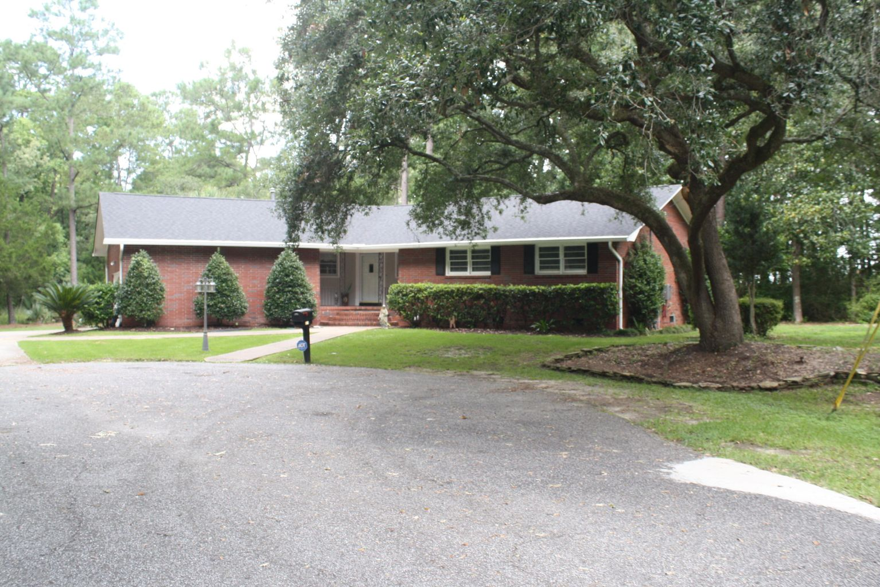


Open House Saturday, July 24th from 11 to 3
1854 Hutton Court
West Ashley Plantation - Charleston, SC 29407
MLS# 21019054 - $499,000
4 br, 2.5 BA, 2416 sq ft, marshfront, large .8 acre lot with large parking area for boat or RV. 2 car garage, Frog, roof and AC 2 years old. New kitchen cabinets, countertops, marble floor and refrigerator. New wood floors in family room with wooden log fireplace, partial fence, separate dining, frog, screened porch, gas Renai tankless water heater, central gas heat & electric AC.
Paul Bazemore
M 843-524-6900
randybazemore99@gmail.com
Paul Bazemore Realty & Associates
4832 Hwy 162 Unit B
Hollywood, SC 29449
www.bazemorerealty.com

