Slide 1
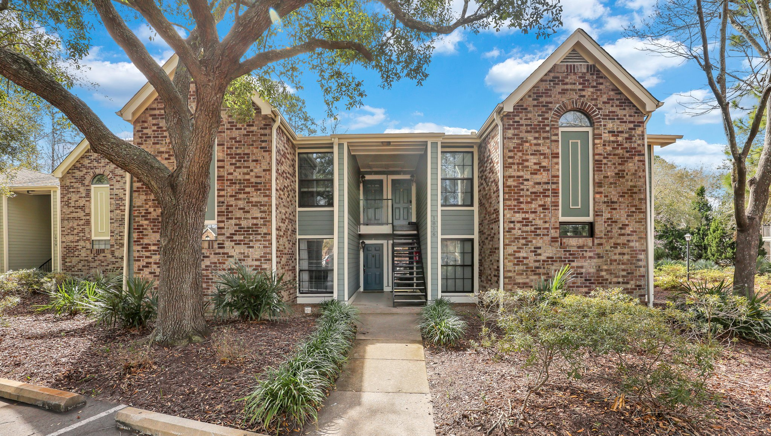
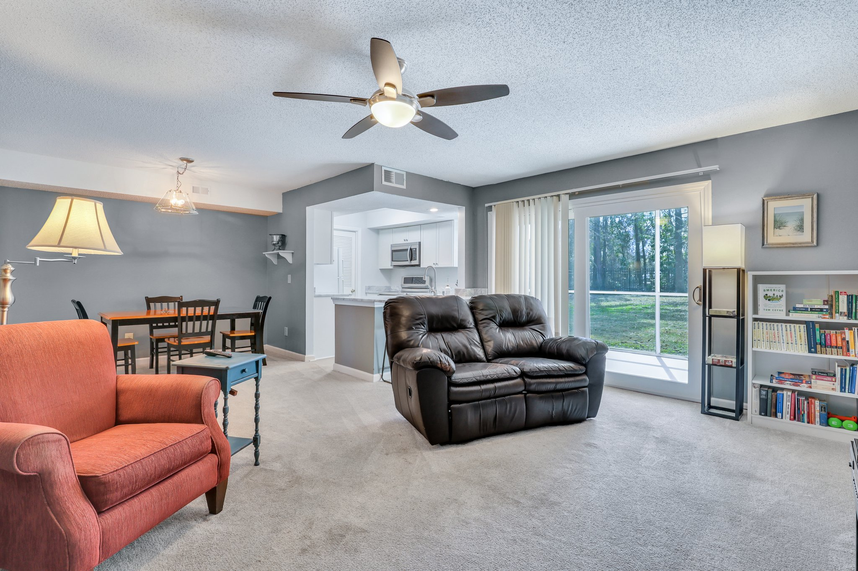
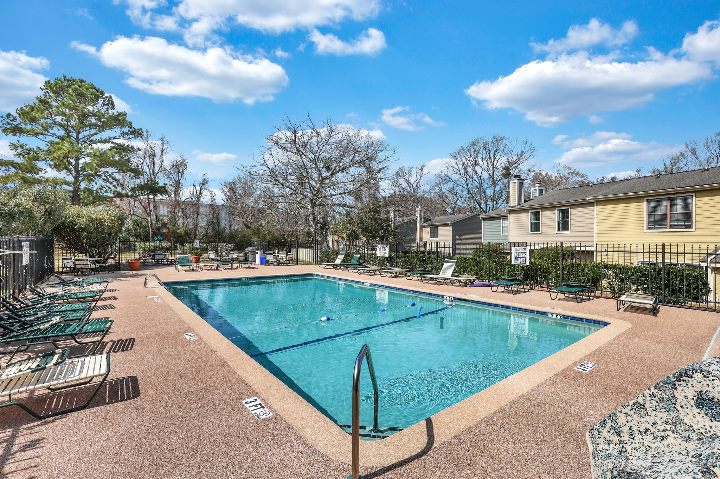
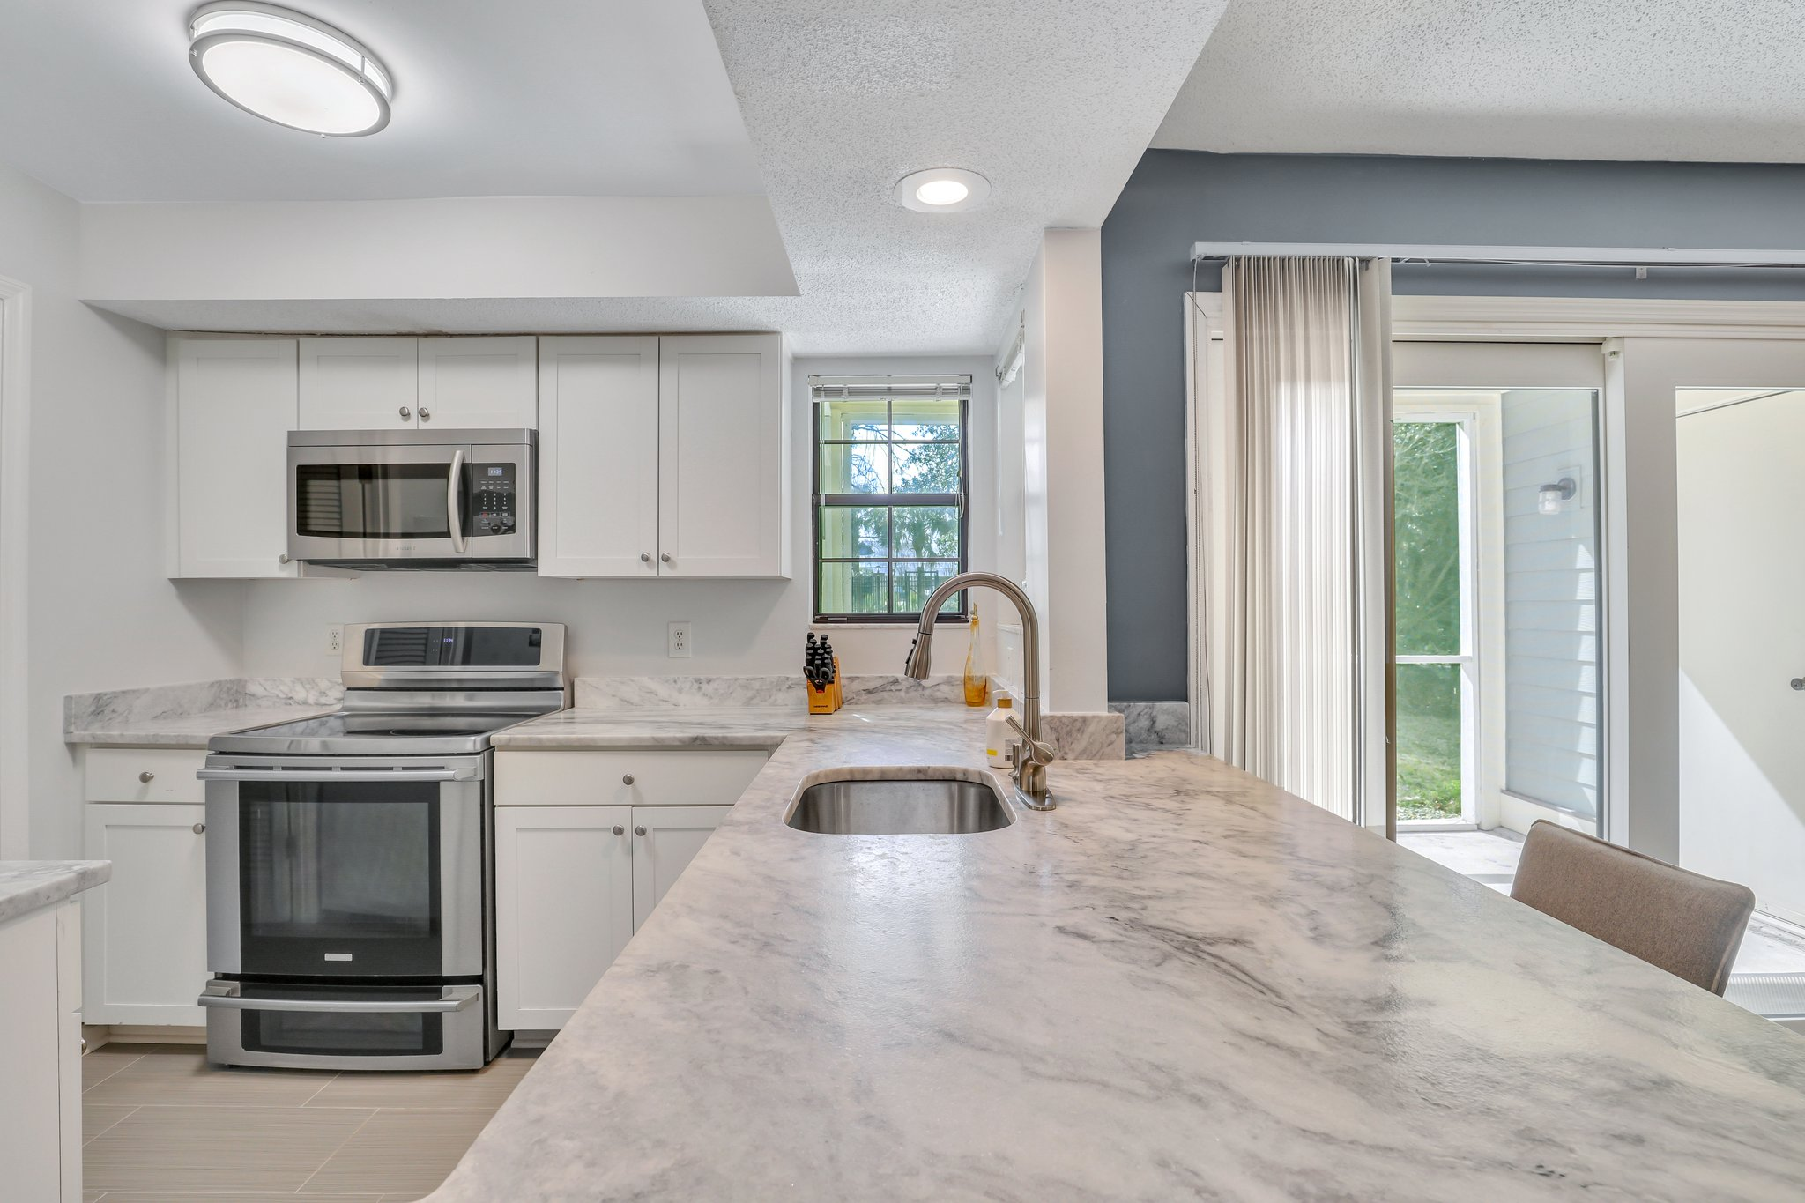
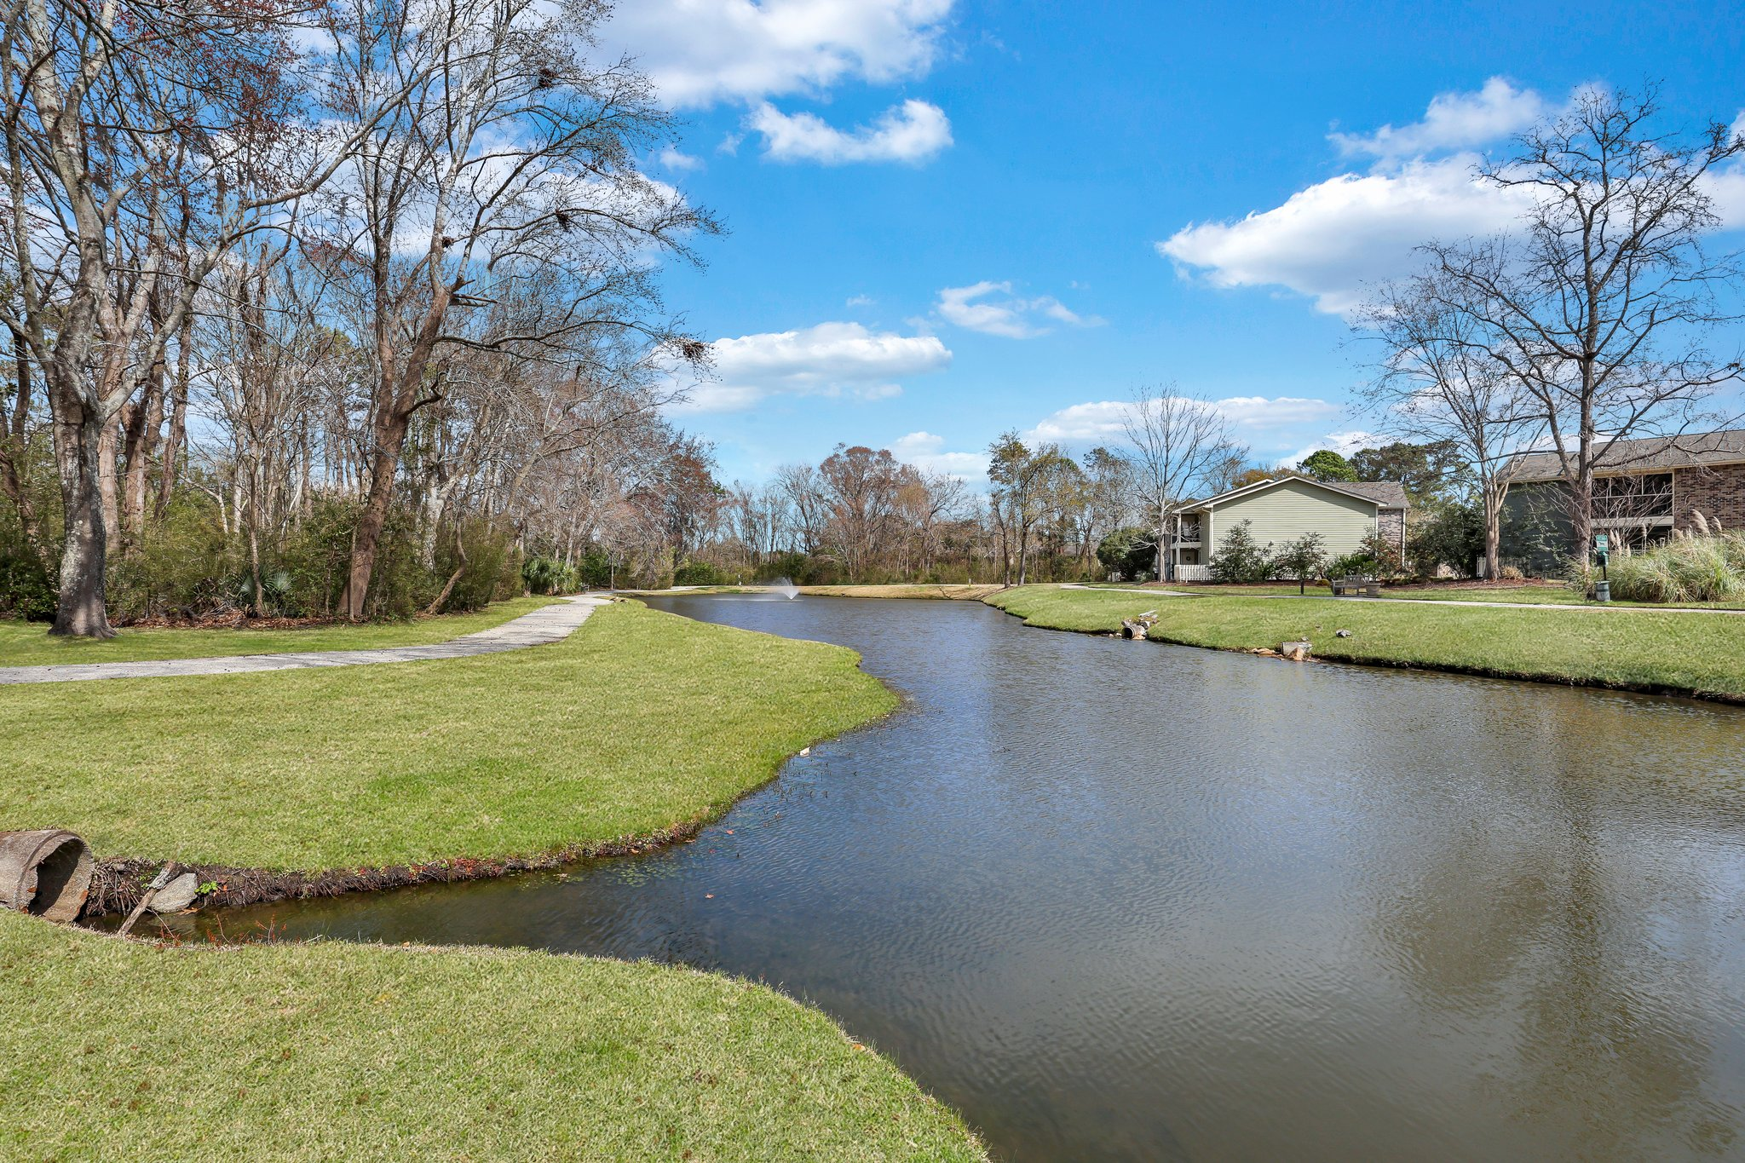
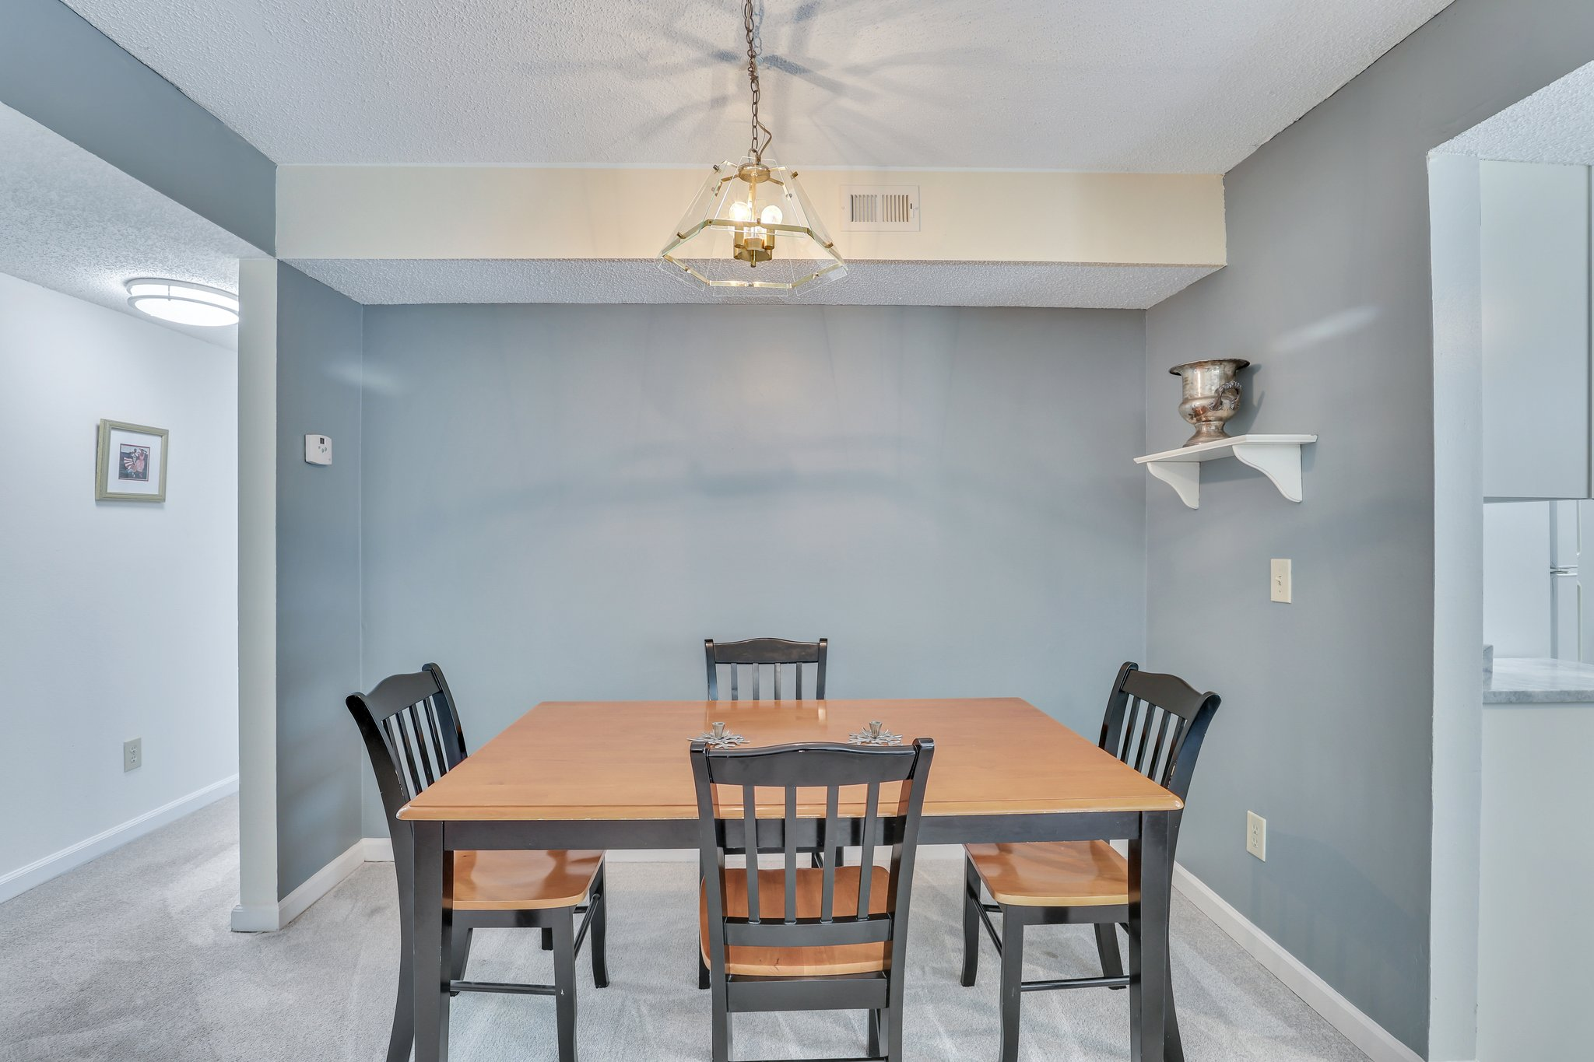

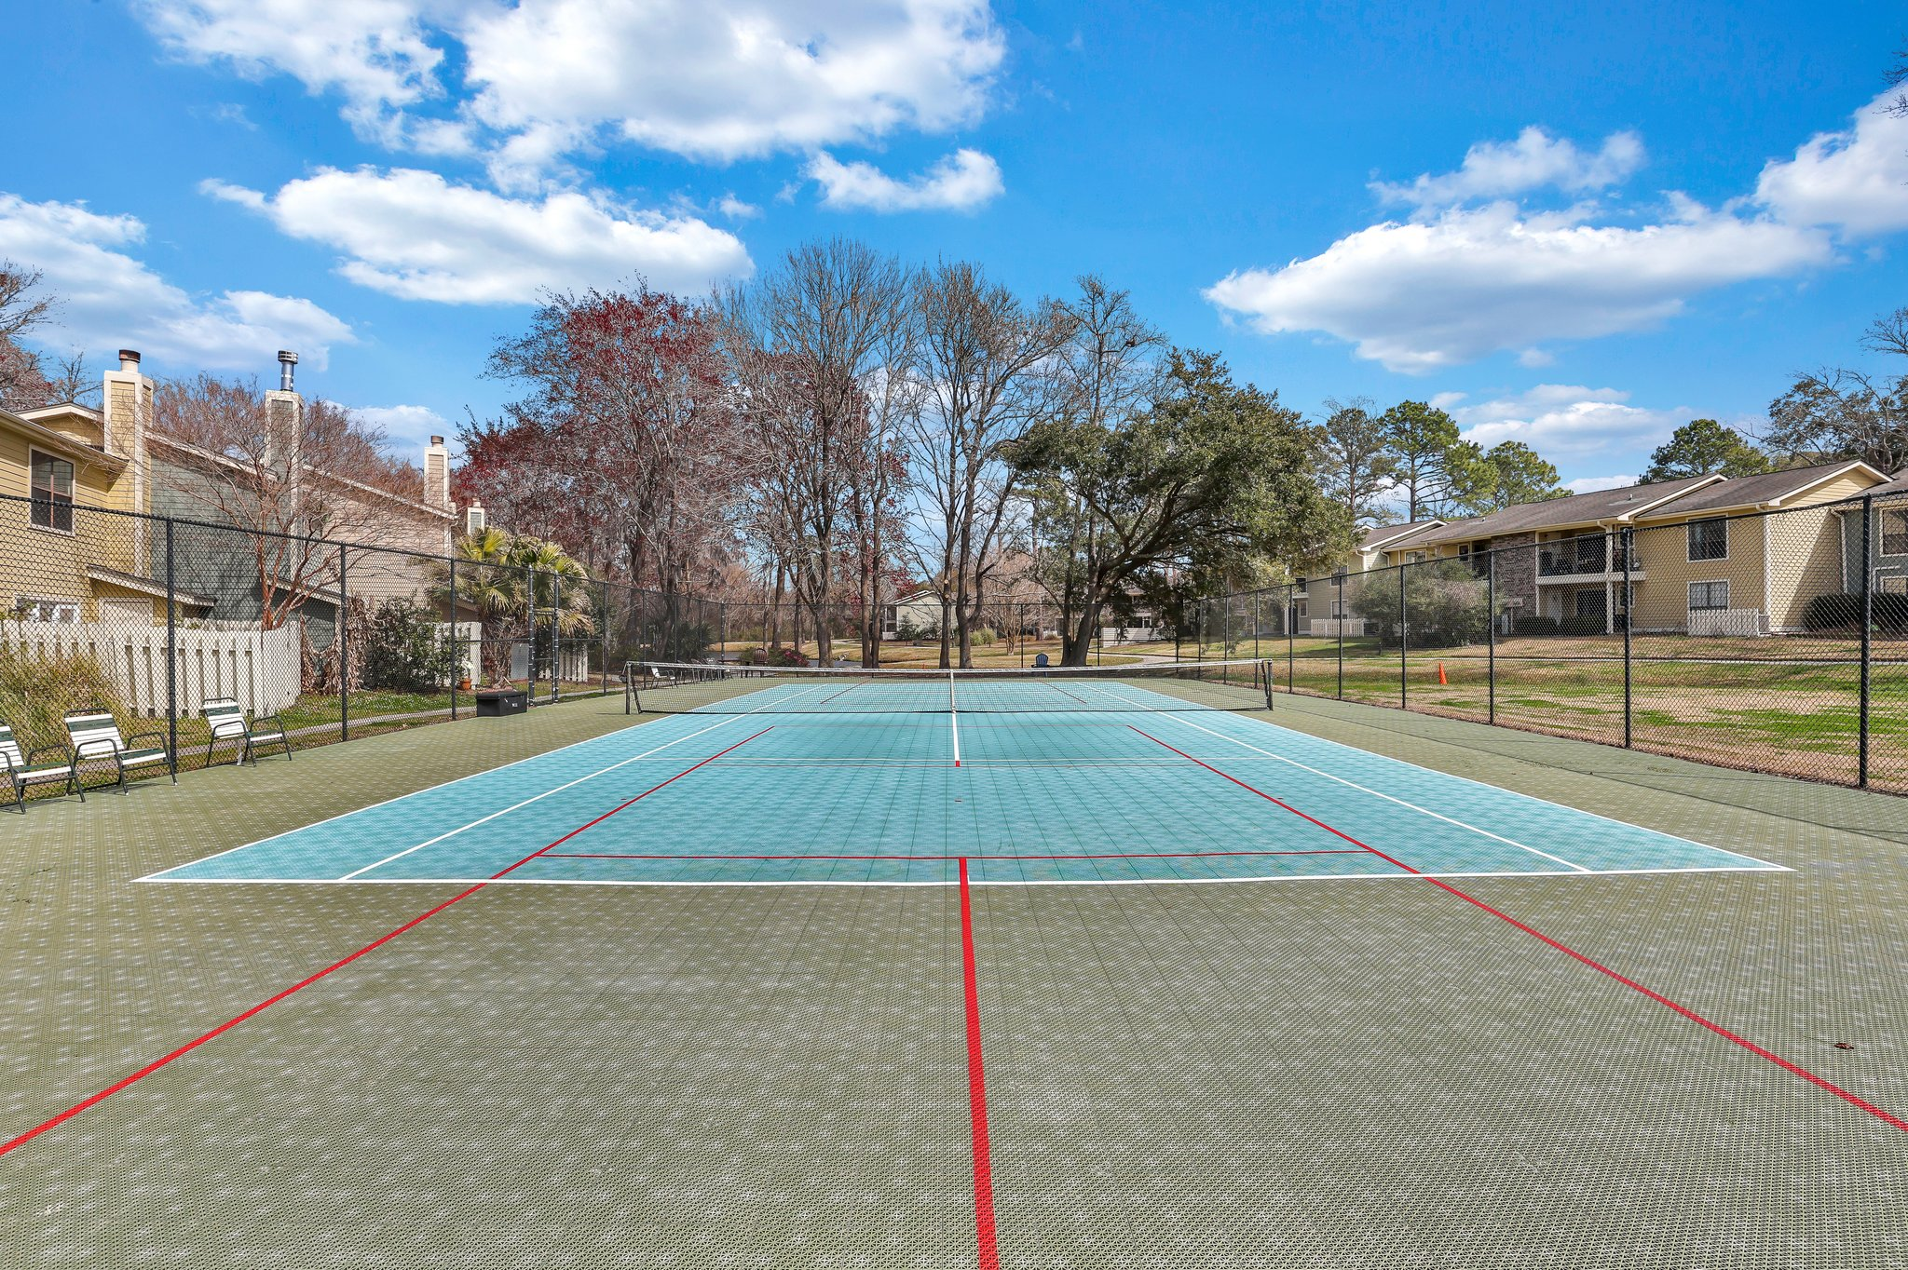
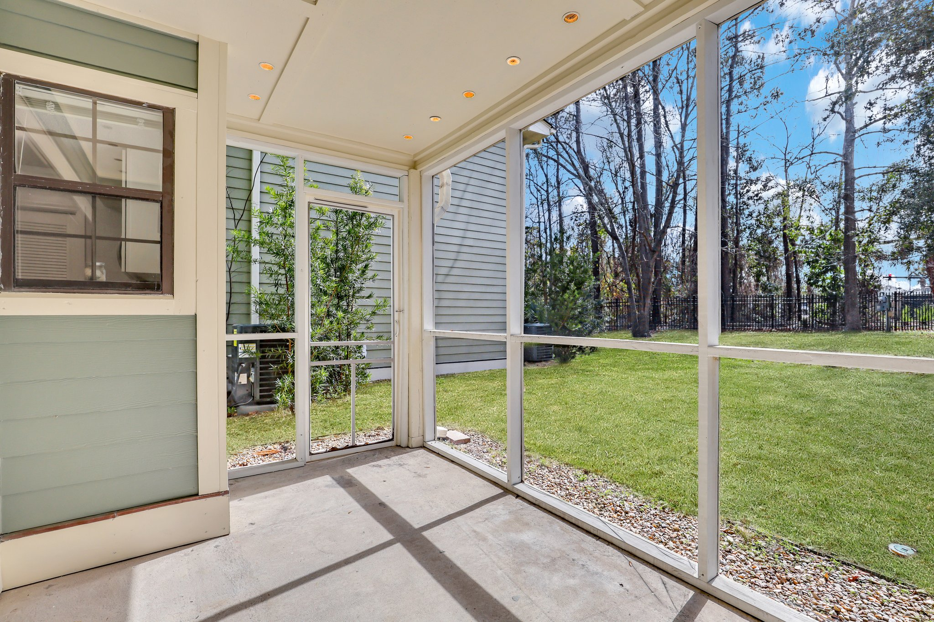
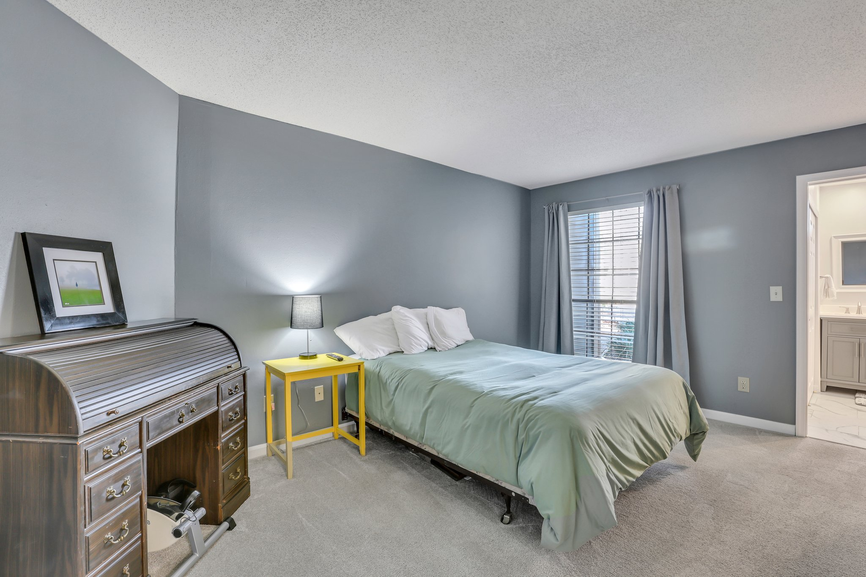
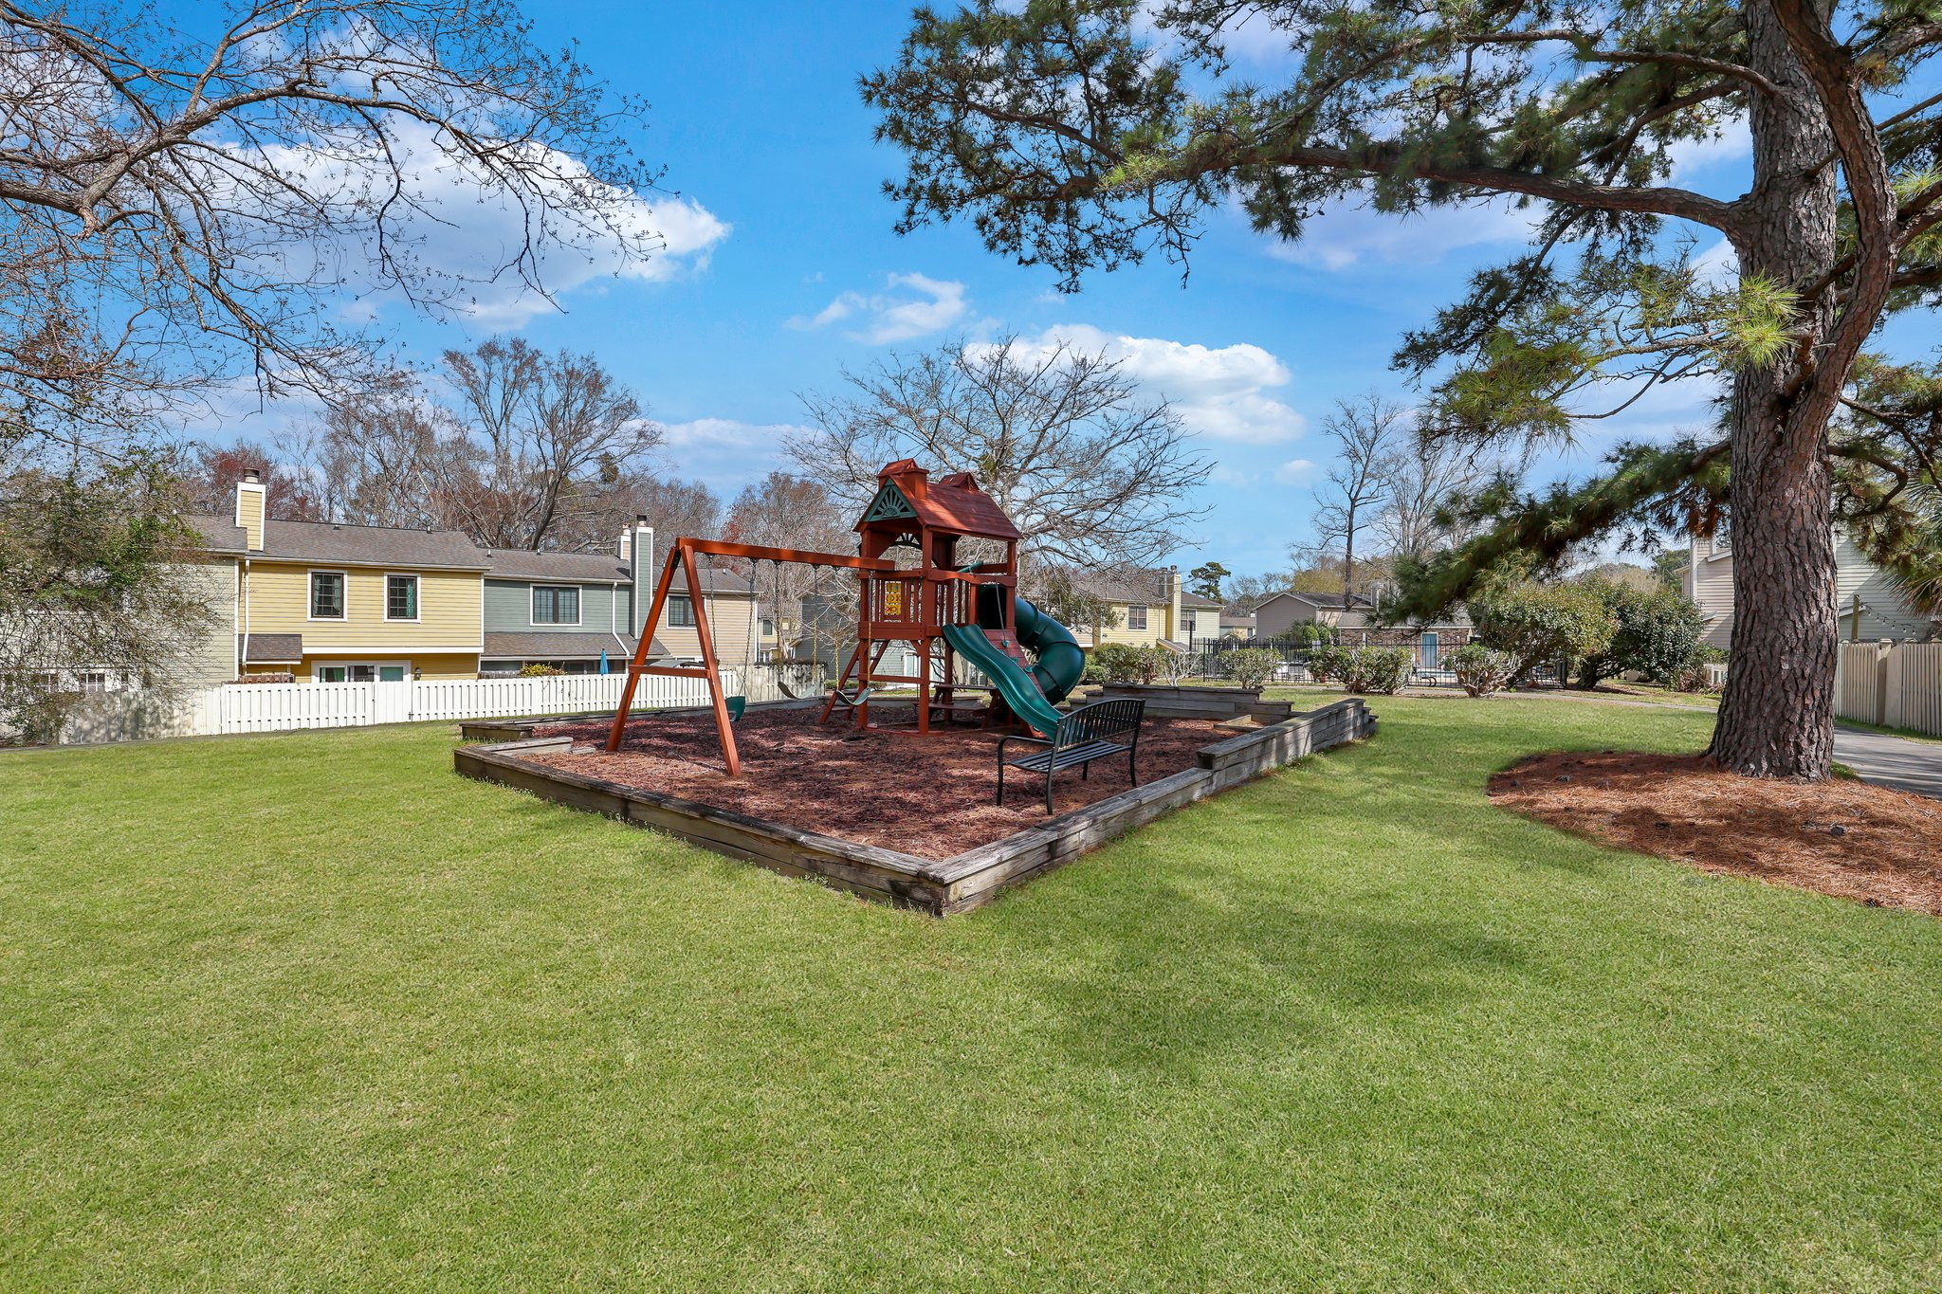
1st Floor Condo in Montclair
Fully Renovated Bathrooms & Updated Throughout!
1856 Montclair Drive A
Mount Pleasant, SC 29464
MLS# 24005191 | $375,000
1856 Montclair Drive A
Mount Pleasant, SC 29464
MLS# 24005191
$375,000
Finest Unit in Montclair- 1st Floor, No Steps, fully updated Bathrooms and updated Kitchen, just steps from the main pool and a semi-private green area out back. Welcome to Montclair! Conveniently located on 17 and the IOP Connector (close to the beach) and across from the finest shopping at Mt P Town Center. The complex features 2 pools, clubhouse that is rentable for parties, tennis courts, playground, walking trails, gazebo & ponds. The unit has been updated with new- carpet, paint, kitchen flooring & countertops. The primary bedroom is spacious and has a double door closet in the BR and BA. The BA was fully transformed into a beautiful oasis w/ walk-in shower w/ bench, sliding glass doors & niche. A new vanity featuring double sinks finishes the transformed bath. The second bedroom is large enough for a King bed and also features a double door closet. The hall bath has also been completely renovated and features a fully tiled shower, new flooring & beautiful vanity with great storage including slide-out electrical outlets. The kitchen was updated with a single level countertop featuring a leathered granite, plus new floors and some updated appliances. A laundry room provides extra storage and a washer/dryer that convey. Out back through the slider door you'll find a screened in porch, perfect for a morning coffee, overlooking the semi-private green space. There is also a storage closet that houses a new water heater. First floor, beautifully updated, amazing amenities all minutes from world class shopping, dining & beaches- this is truly an amazing property, come see what 1856-A Montclair Dr can do for you!
Peter H Derry | PHD Properties | 843-367-5399 | peter@phdproperties.realestate

