Slide 1
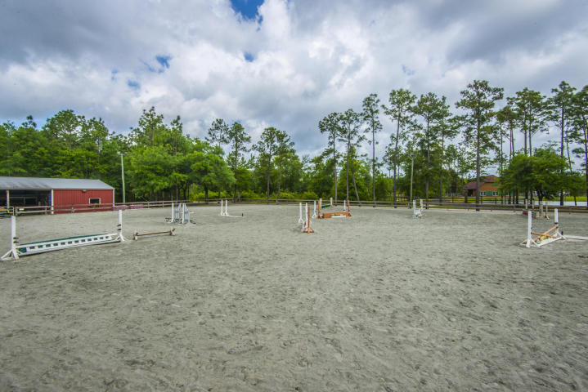
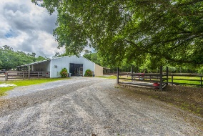
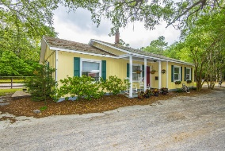
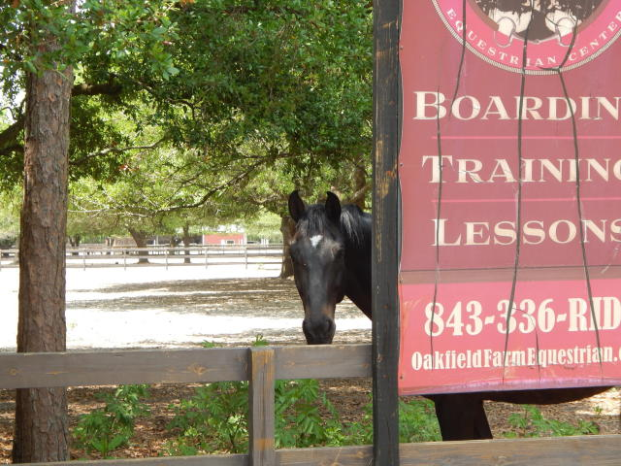
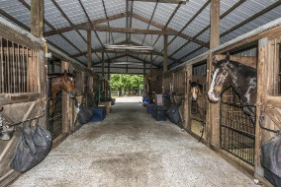
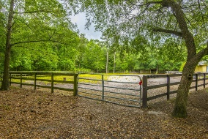
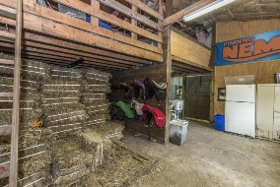
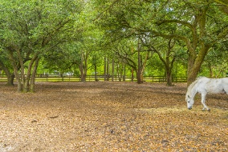
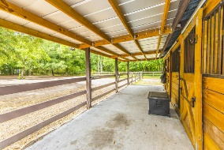
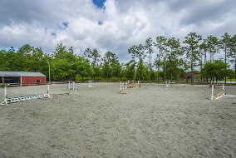
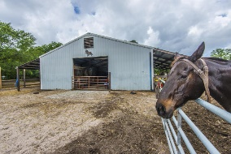
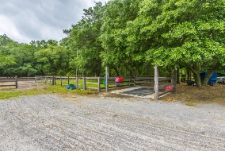

1859 Hoover Road
Huger, SC 29450 ~ MLS# 17010997 ~ $849,000
Oakfield Equestrian Center!
Oakfield Equestrian Center is a fabulous working horse farm and boarding/lesson center with an incredible show ring and judging stand. The Show Ring is a deep base of granite dust, the best material available. The property features two barns and 16 stalls. The main barn has eight fully equipped stalls, four additional stalls and a feed and tack storage room. The show stall barn has an additional four stalls and a separate tack and feed room. All stalls are covered and the main barn has a separate wash area, as well. The Center backs directly up to the Francis Marion National Forest and the Tuxbury Trail for exercise and recreational riding. This is a rare opportunity to own a working equestrian center with access to miles of trails, as well.
Carolina One Real Estate
2713 Highway 17 North
Mt. Pleasant, SC 29466
Terry Hamlin
(843) 830-3946
terry@thamlinproperties.com

