Slide 1
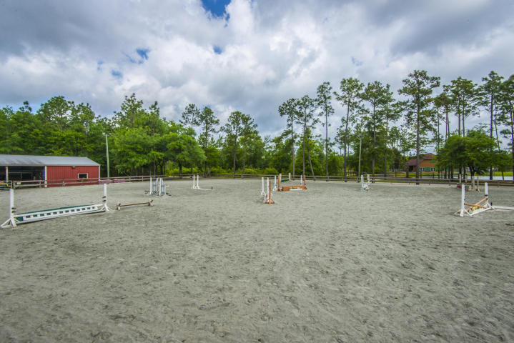
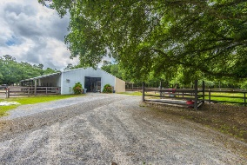
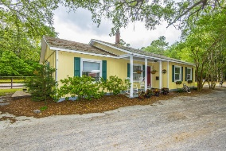
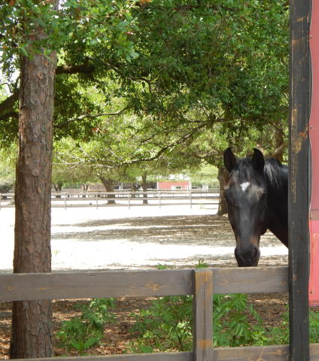
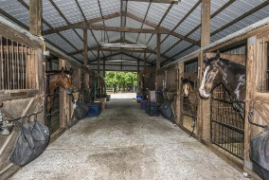
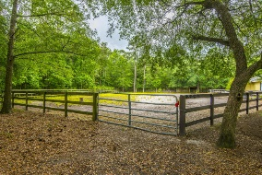
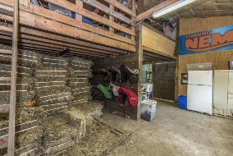
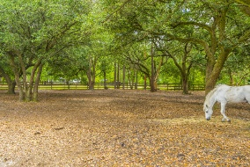
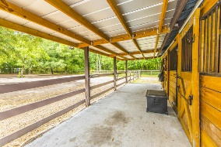
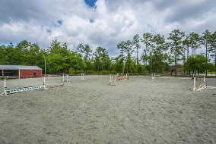
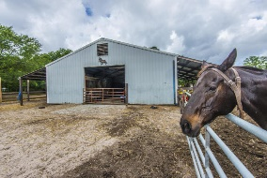
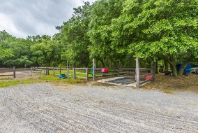

1859 Hoover Road Huger, SC 29450 ~ MLS# 17010997 ~ $647,000
Oakfield Equestrian Center!
Pssst…
Make an offer!
Reduced Another $50,000!
Must Sell By Year’s End!
Oakfield Equestrian Center is a fabulous working horse farm and boarding/lesson center with an incredible show ring and judging stand. The Show Ring is a deep base of granite dust, the best material available. The property features two barns and 16 stalls. The main barn has eight fully equipped stalls, four additional stalls and a feed and tack storage room. The show stall barn has an additional four stalls and a separate tack and feed room. All stalls are covered and the main barn has a separate wash area, as well. The Center backs directly up to the Francis Marion National Forest and the Tuxbury Trail for exercise and recreational riding. This is a rare opportunity to own a working equestrian center with access to miles of trails, as well. Please see Supplement Info, also.
Carolina One Real Estate
2713 Highway 17 North
Mt. Pleasant, SC 29466
Terry Hamlin
(843) 830-3946
terry@thamlinproperties.com

