Slide 1
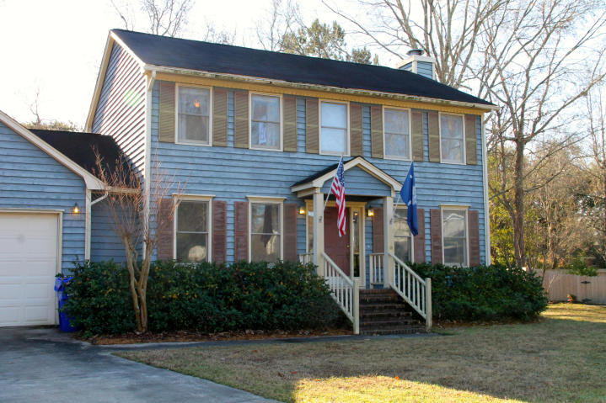
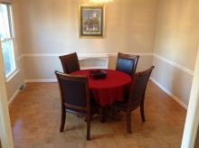
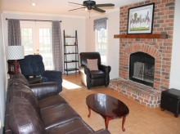
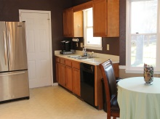
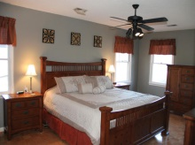
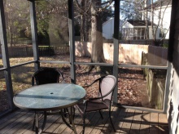
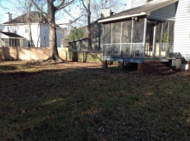


1861 Cat Tail Row Rice Hollow · West Ashley · MLS# 15000442 · $285,000
$10,000 Allowance
Great potential at a bargain price! Sellers say SELL! Offering $10,000 allowance for you to put the touches on this home that make it your own. Conveniently located close to downtown Charleston, shopping, restaurants, Boeing, I-26 and I-526. Quiet cul de sac lot with large fenced backyard. Spacious eat-in kitchen with bay window. Formal dining room boasts chair rail and crown molding. Great room has crown molding and cozy fireplace with brick surround. Huge Master and two additional bedrooms located upstairs. 2 car garage and outside shed provide lots of storage. New HVAC upstairs. Termite bond. Low HOA fees at only $75 per year. Rice Hollow is in the original zone for Orange Grove School.
Katherine Mappus
(843) 478-5731
kat@thetraceygroup.com
www.KatMappusRealEstate.com

