Slide 1
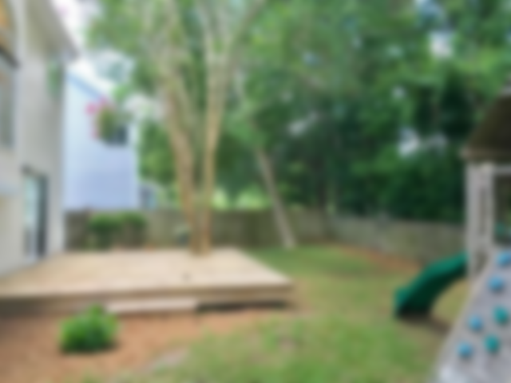
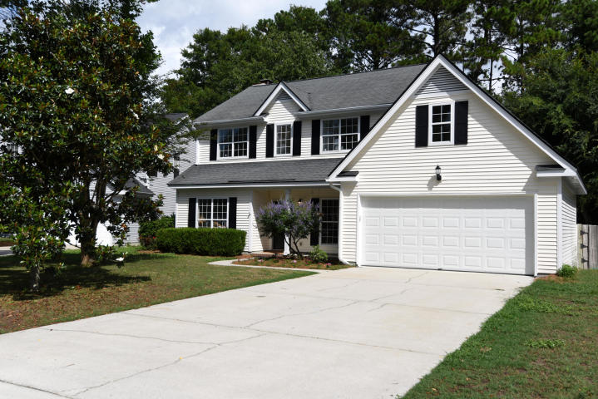
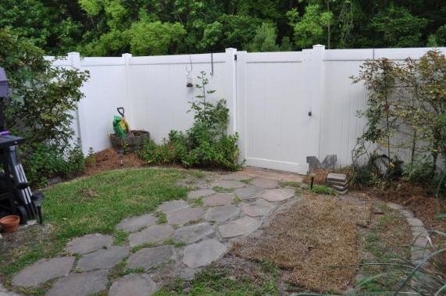
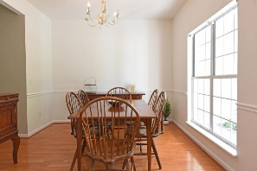
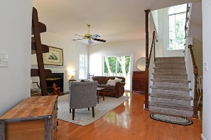
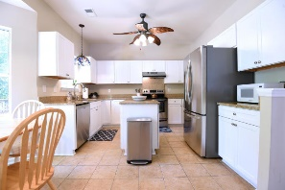
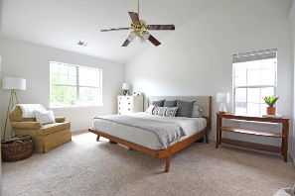
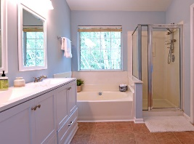
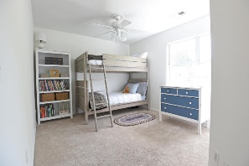
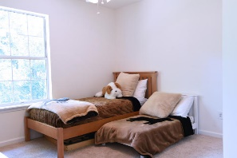
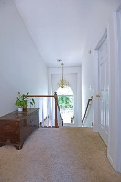
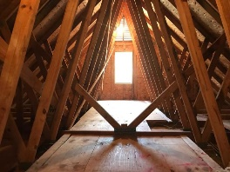
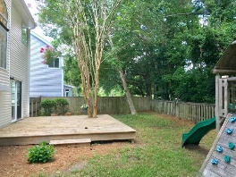

Inside IOP Connector/Unbelievable Price!
1862 Falling Creek Circle
Sweetgrass
Mount Pleasant, SC 29464
MLS# 19018080
$399,999
3 Bed | 2½ Bath | 2,021sf
Want 2000+ sq ft and to be in inner Mount Pleasant near the beaches? How about a private backyard? Walk or bike to Seaside Farms or Towne Centre's restaurants, shops and much more! A two-story foyer welcomes you to this spacious home. Downstairs you'll find a large office/bonus room (potential 4th bedroom?), a formal dining room, a large family room and huge eat-in kitchen. The kitchen boasts granite counter tops, stainless appliances, and freshly updated cabinets/doors/hardware. Coming in from the two car garage is the laundry room/mud room, and a 1/2 bath sits between the kitchen and dining room. Upstairs is a huge Master bedroom and updated bathroom, along with 2 guest rooms and an updated guest bath. Home is freshly painted throughout and ready for new owners!

