Slide 1

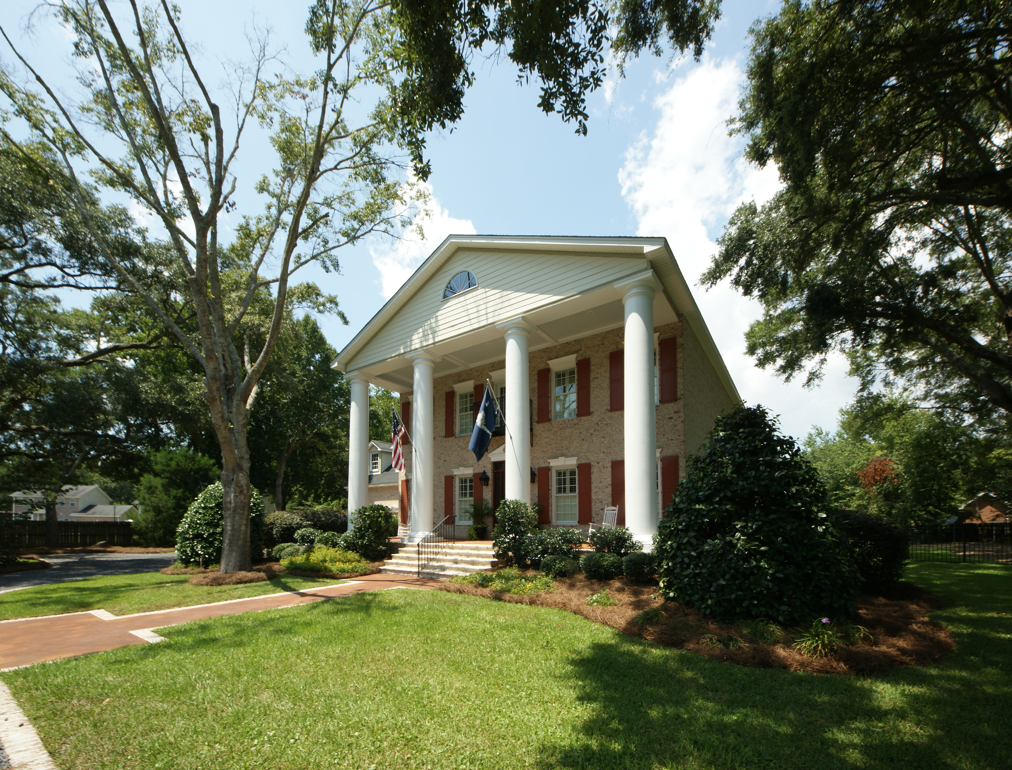
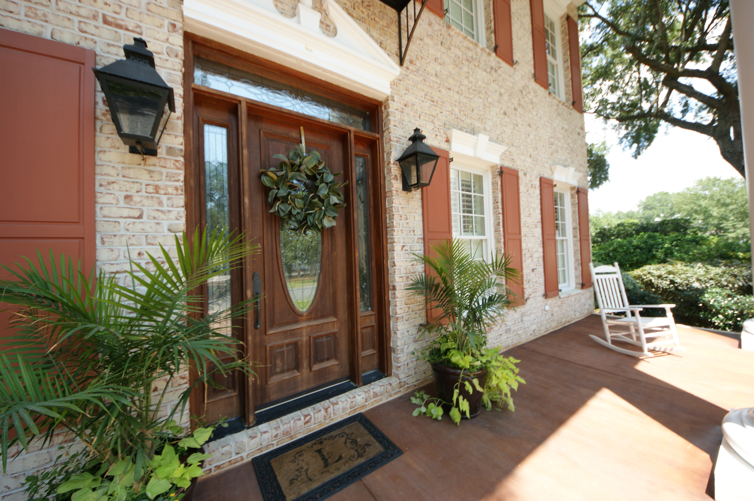
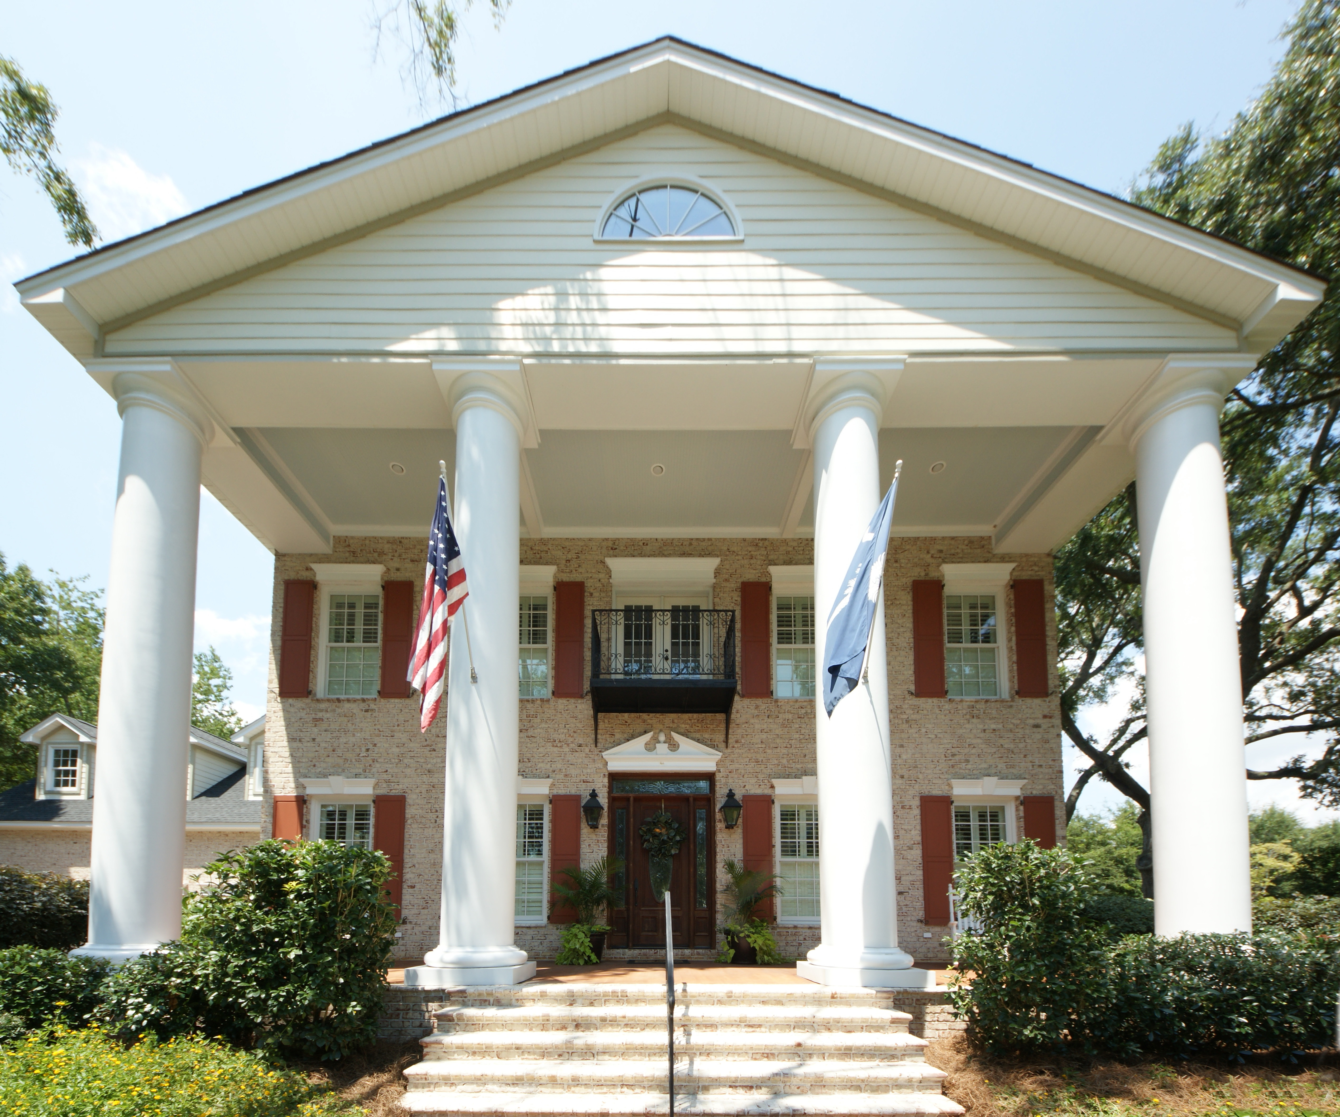
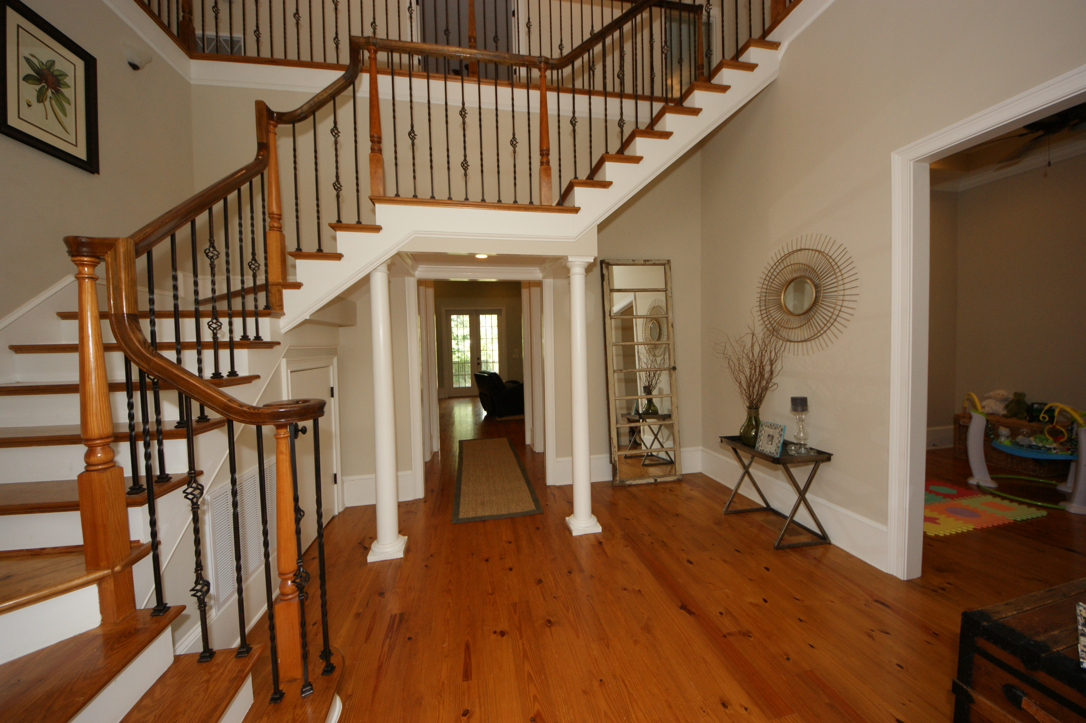
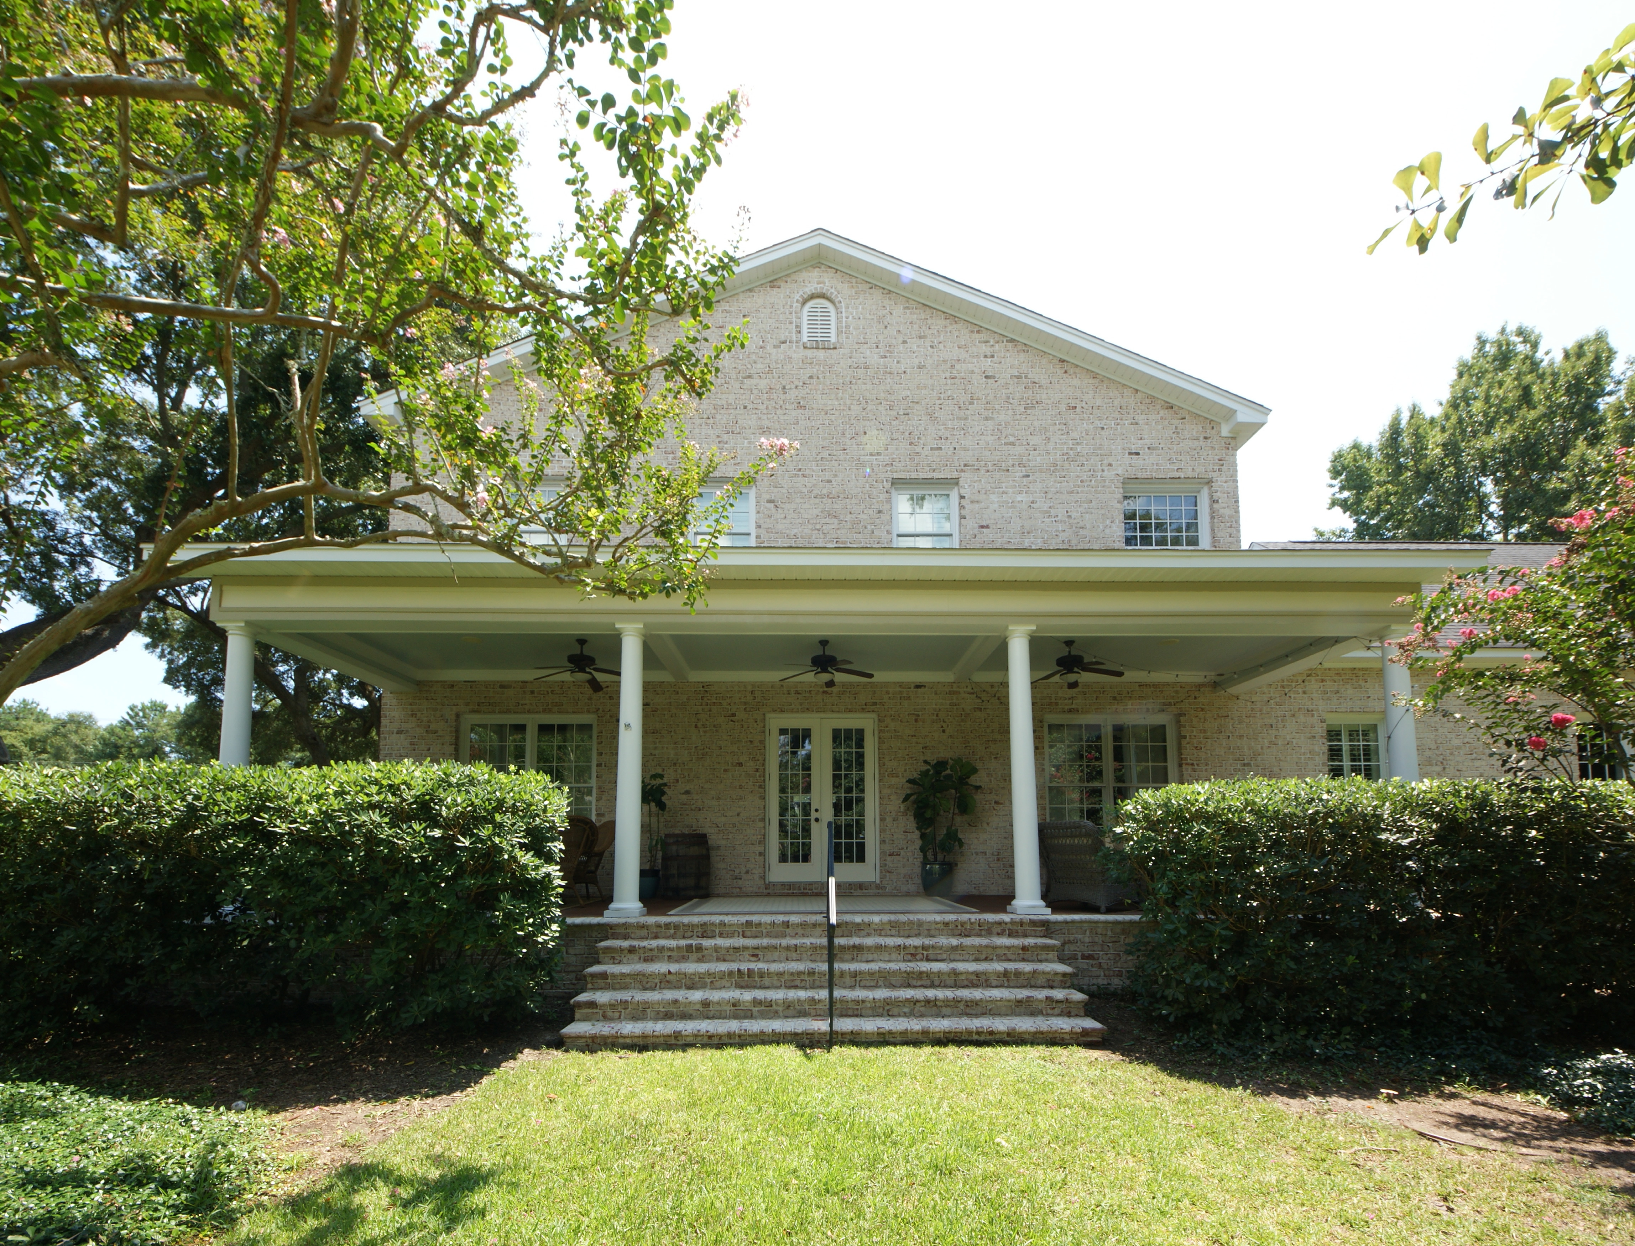
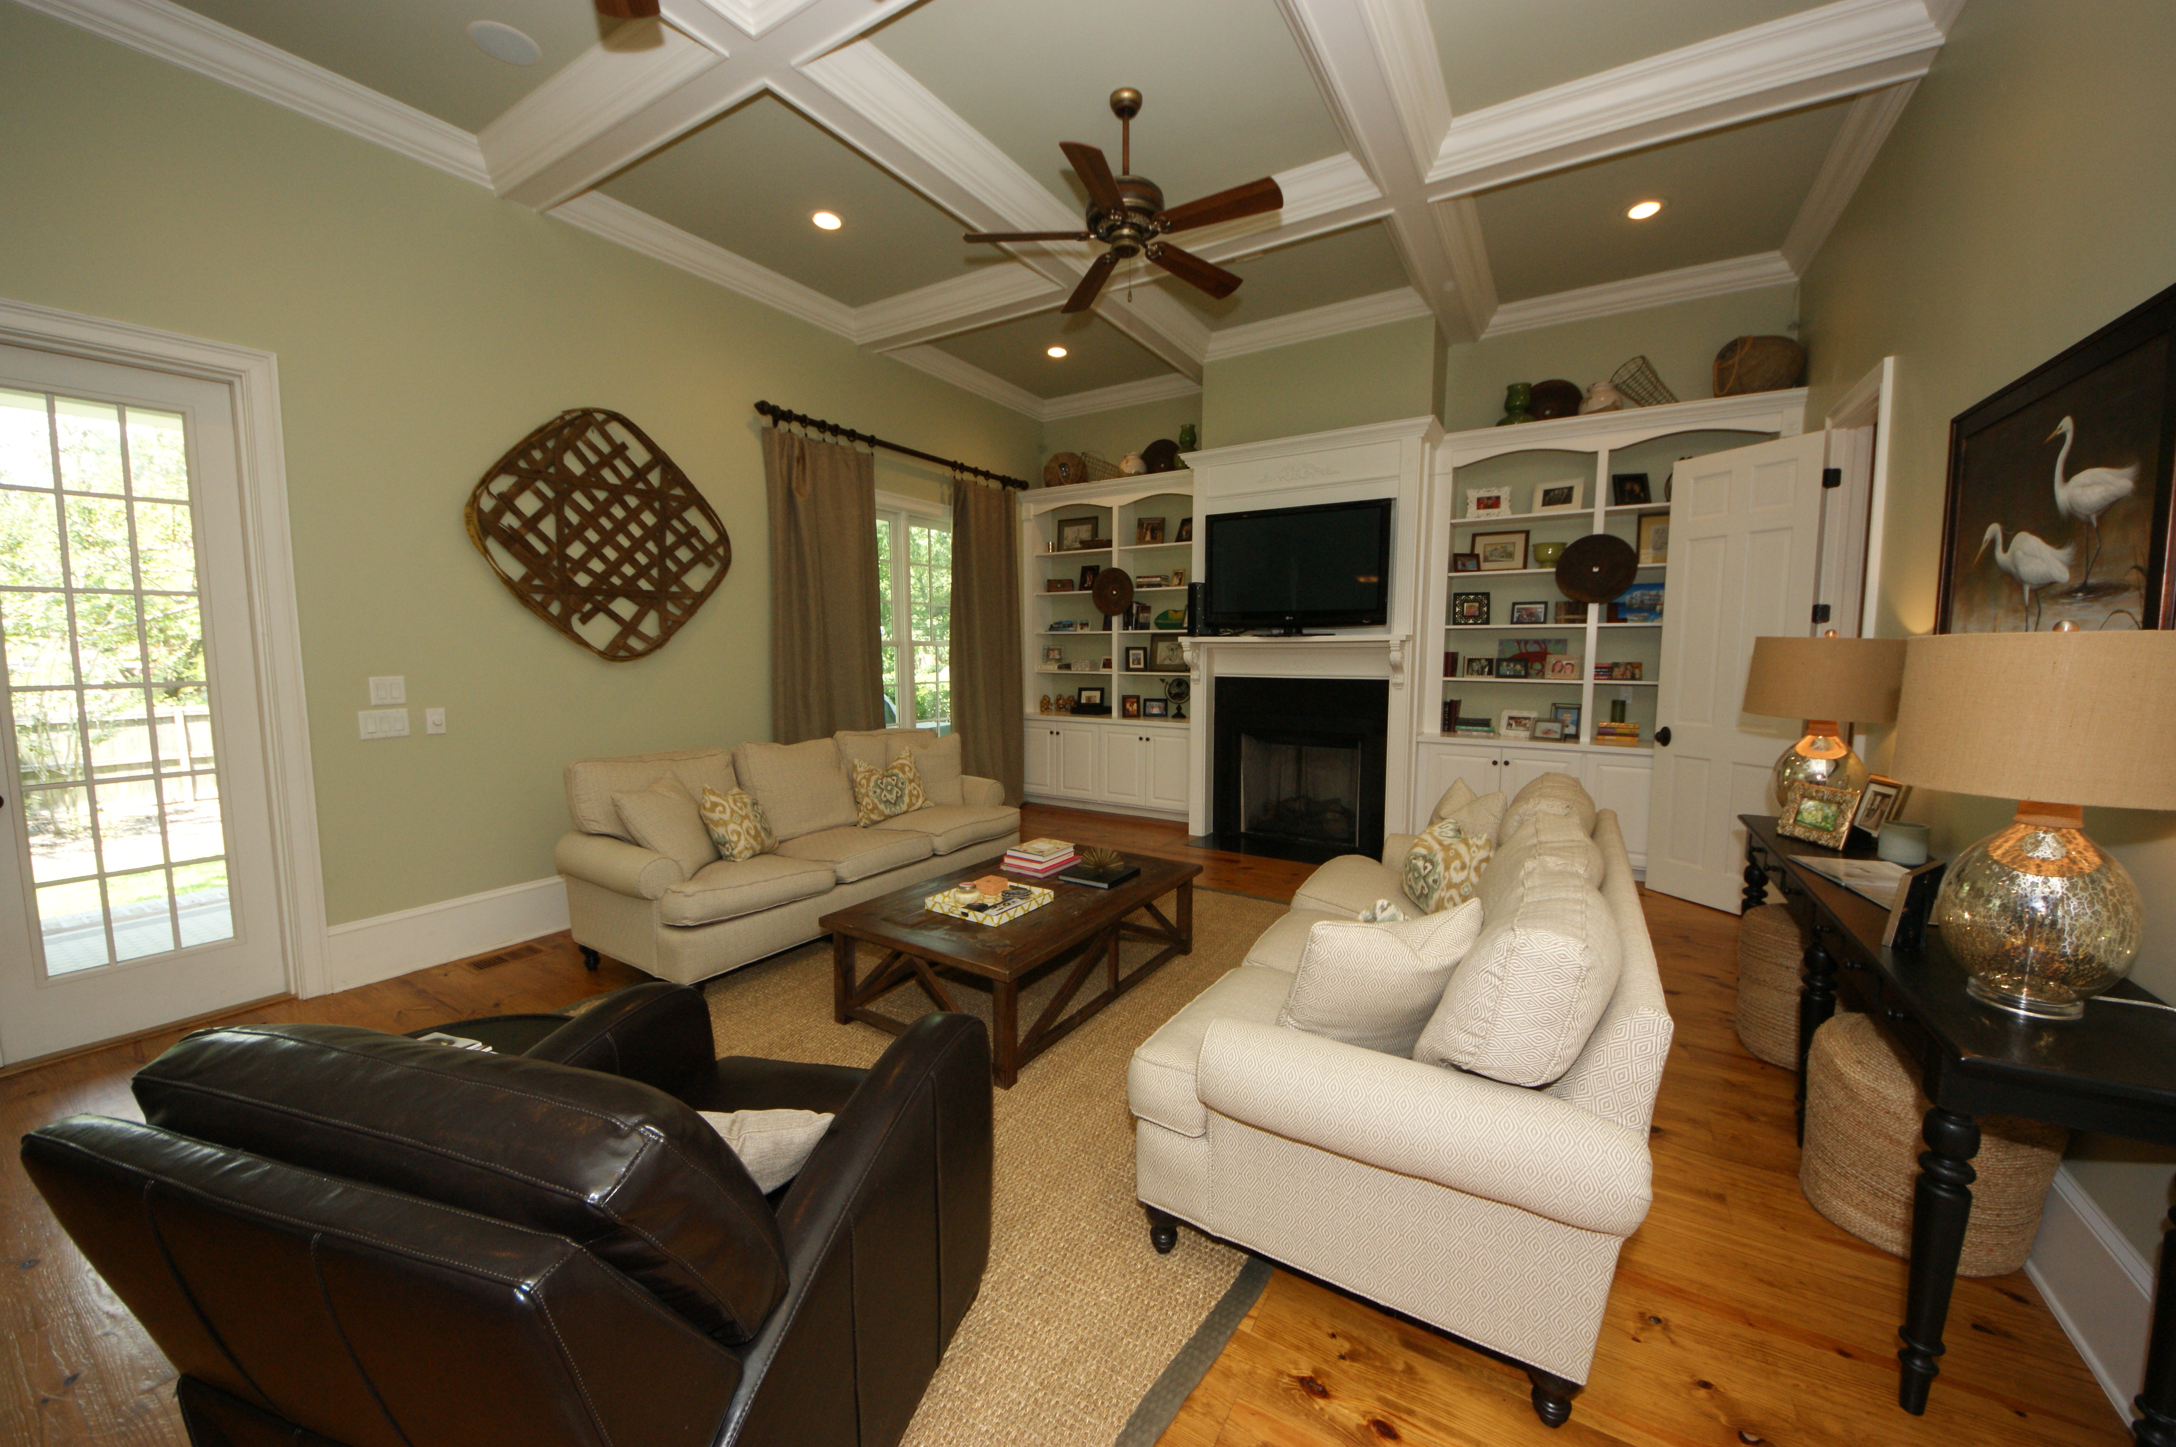
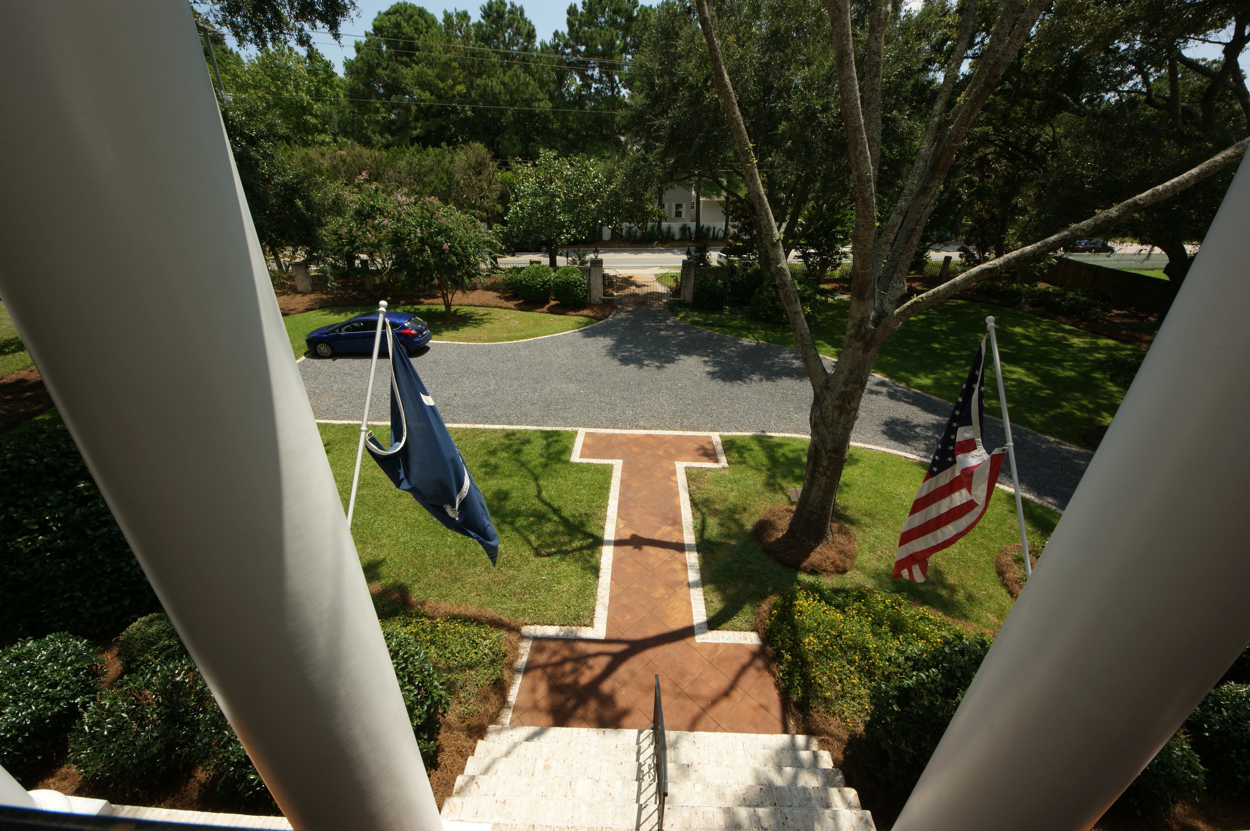
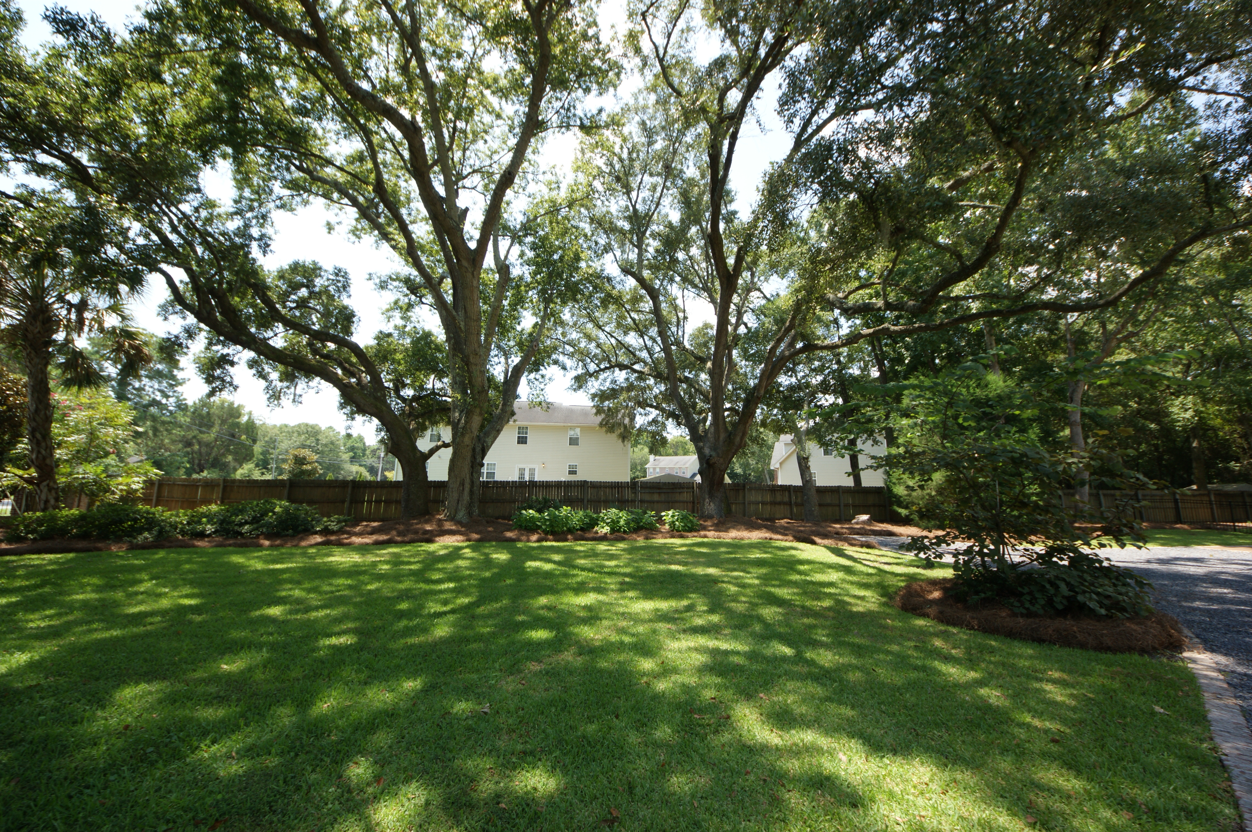

Southern Estate Broker Preview and Luncheon Thursday August 27th from 11-2
1866 Rifle Range Road
Mount Pleasant
MLS# 15021787
$1,150,000
5 Bedrooms | 6½ Baths
Join us for
Barbecue Lunch
Live Music
Drawing for THREE $50 Gift cards from Southern Seasons
Robin Iriart
Mobile 843-568-7720
Office 843-284-8834
Rickrobin@comcast.net
Gatehouse Realty, LLC
708 S. Shelmore Blvd, Ste. 102
Mt. Pleasant, SC 29464
www.gatehousecharleston.com

