Slide 1

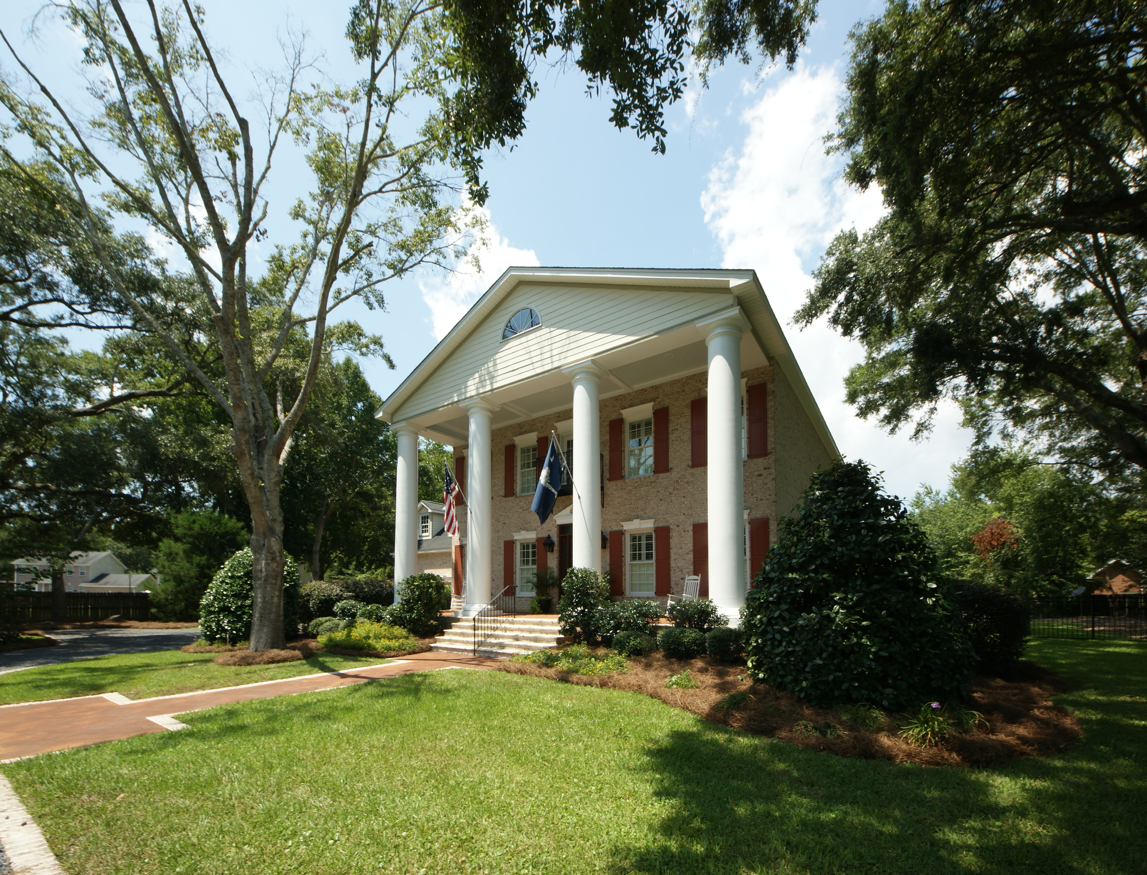
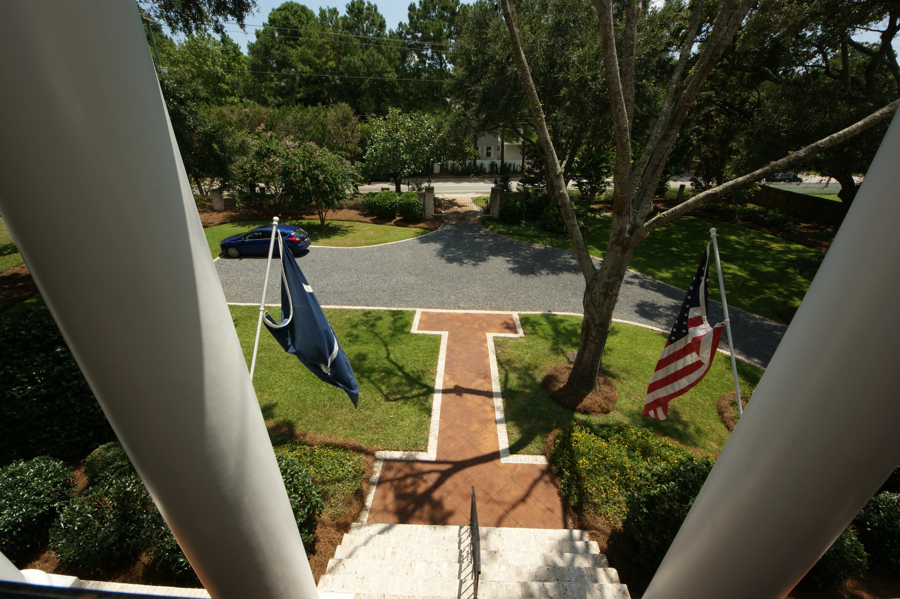
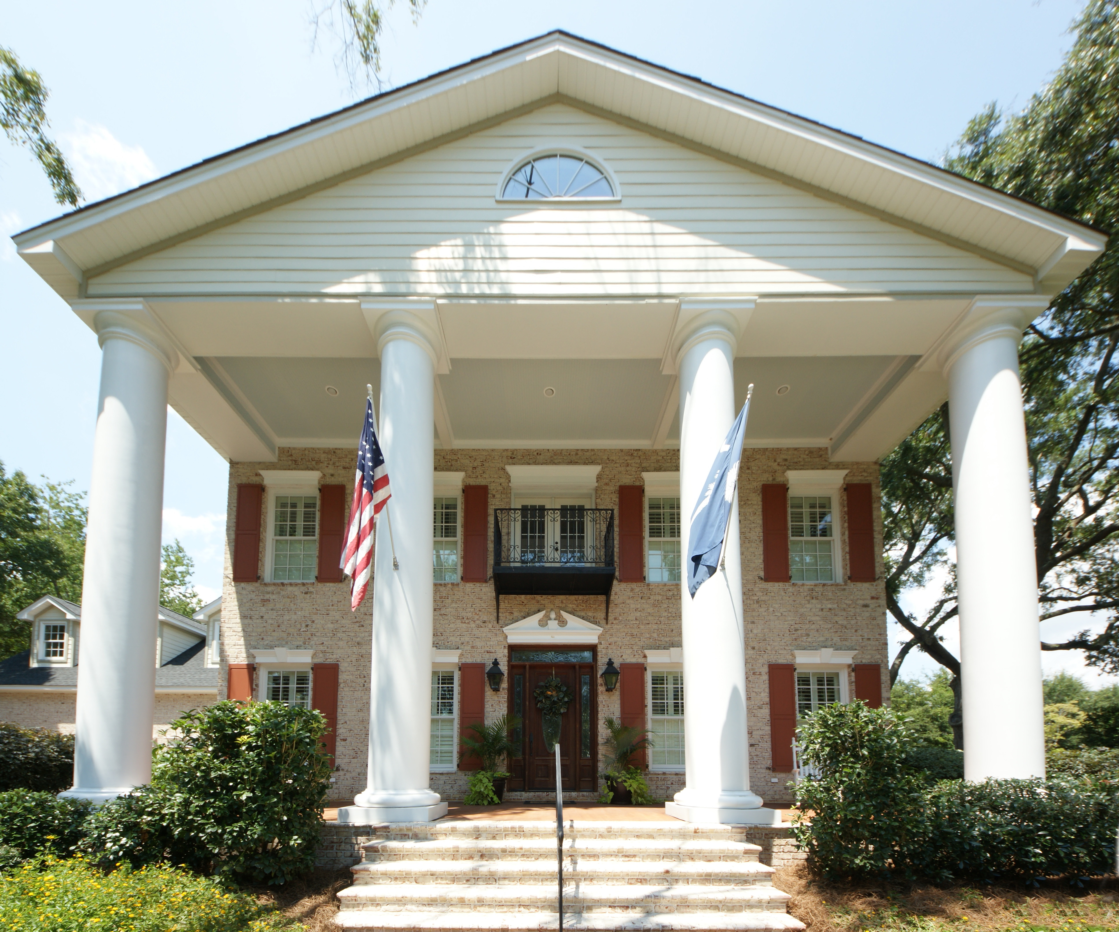
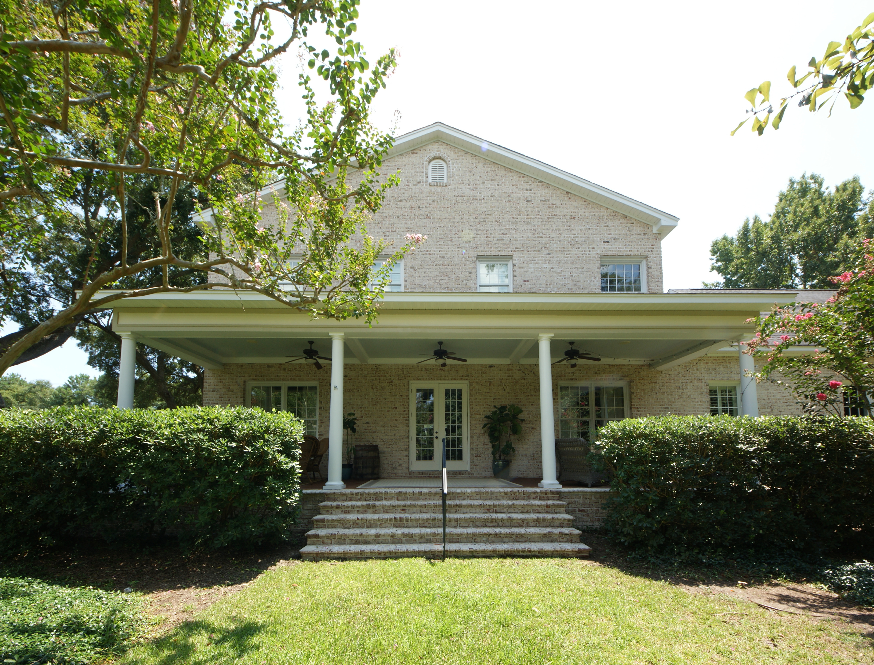
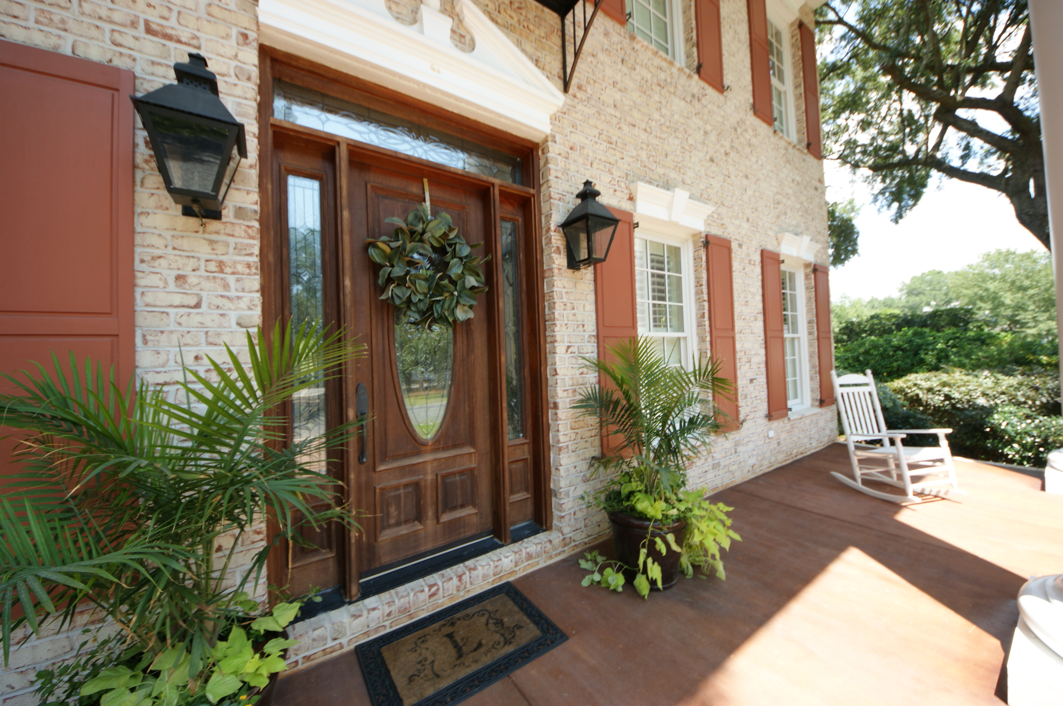
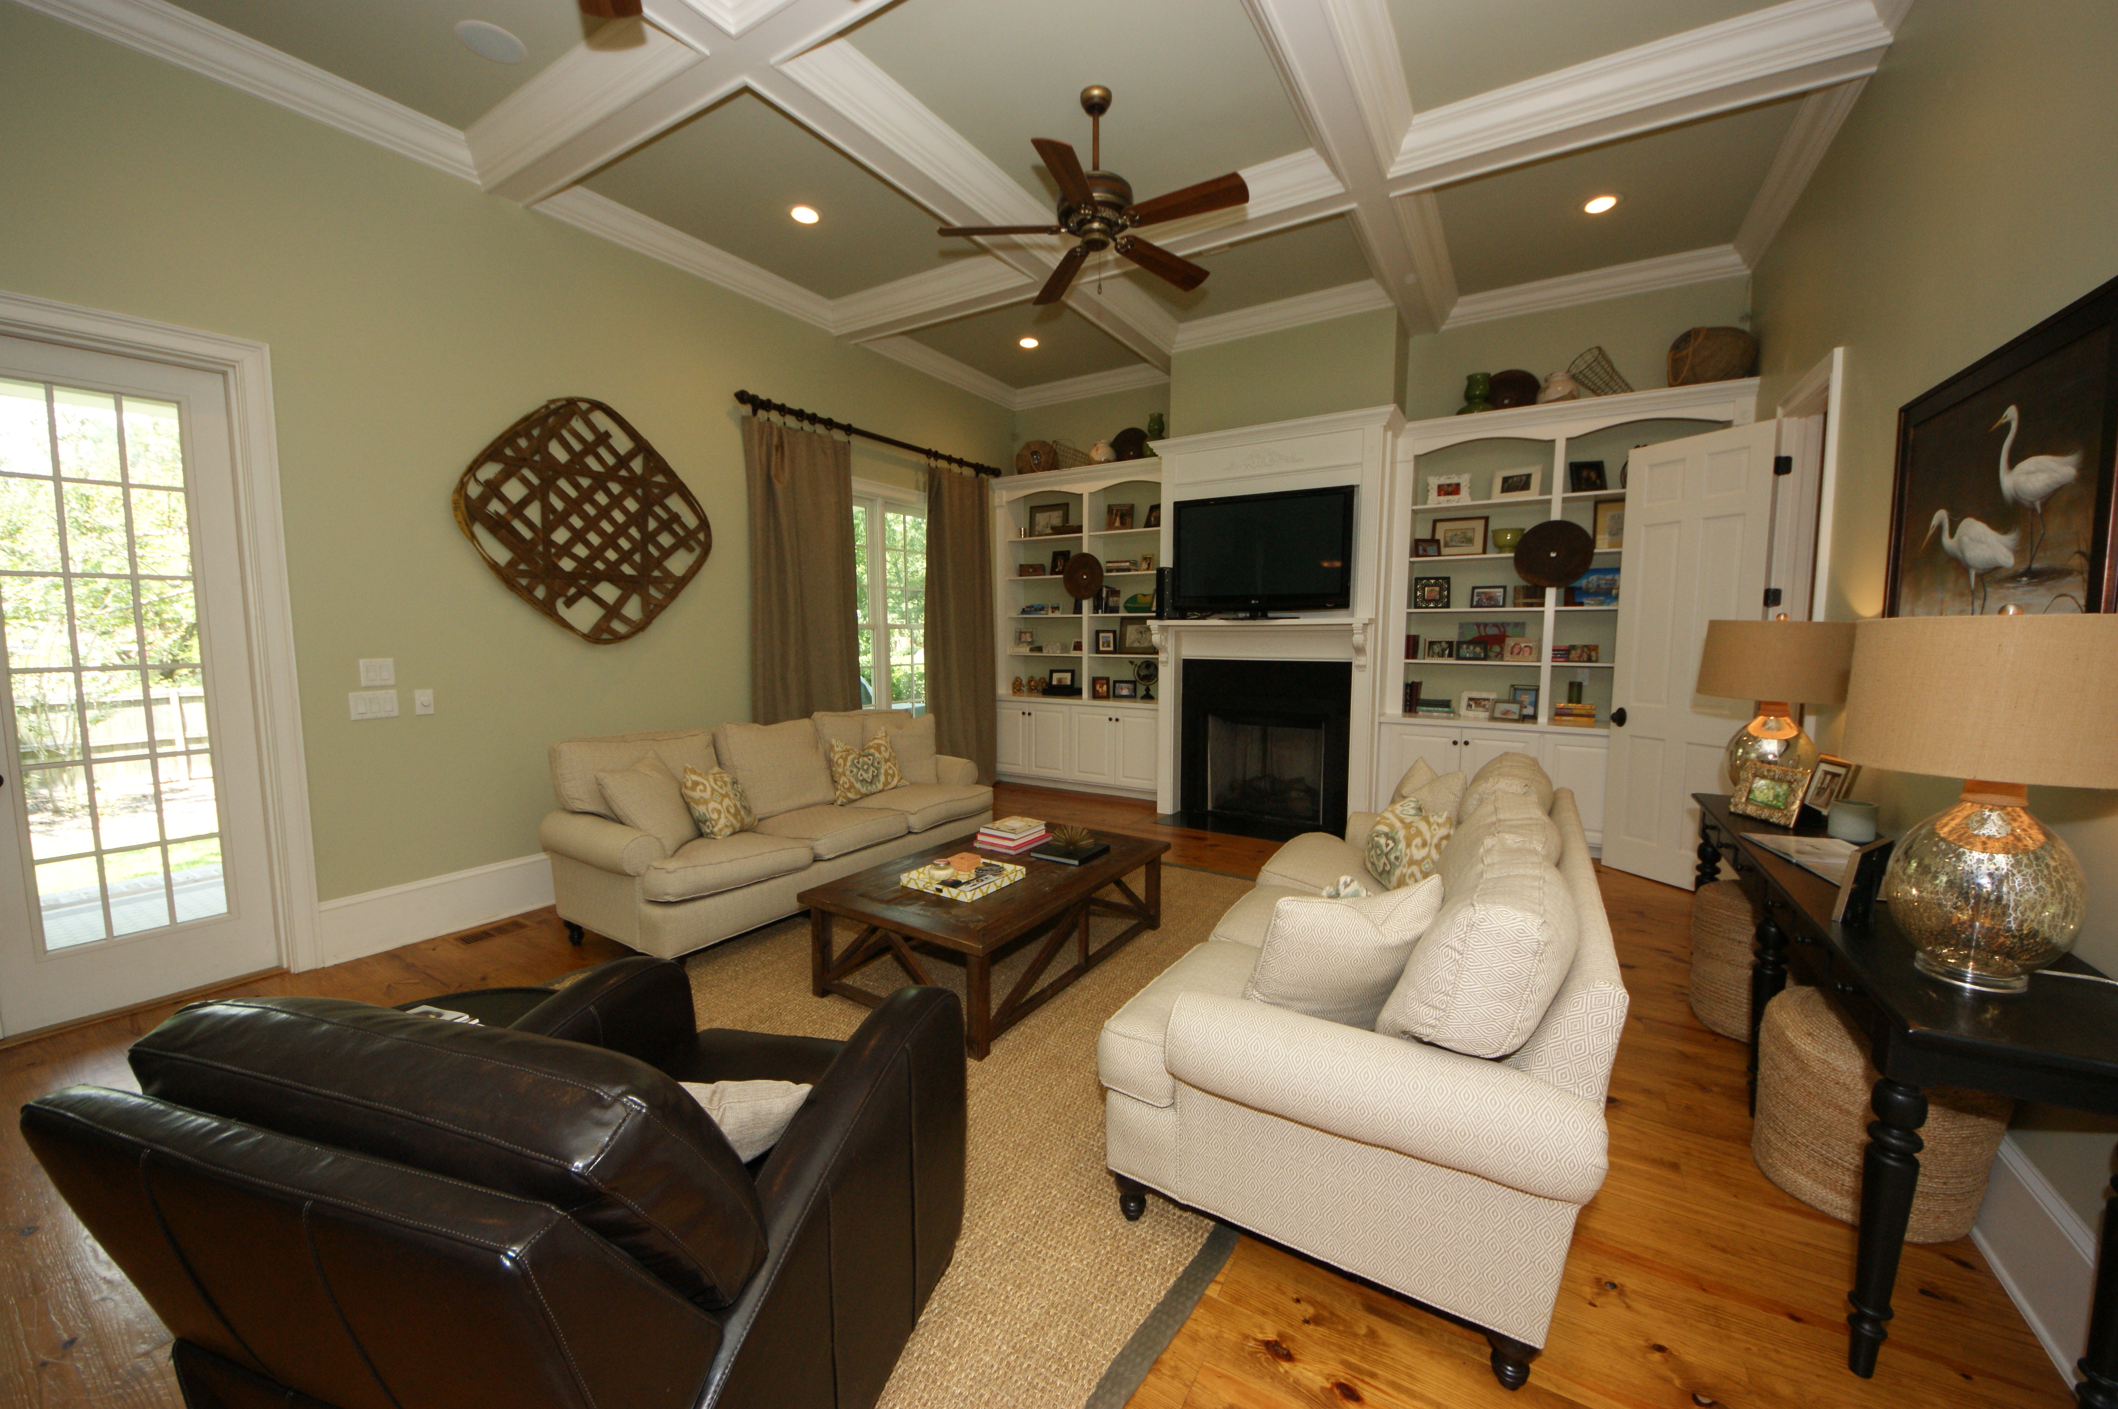
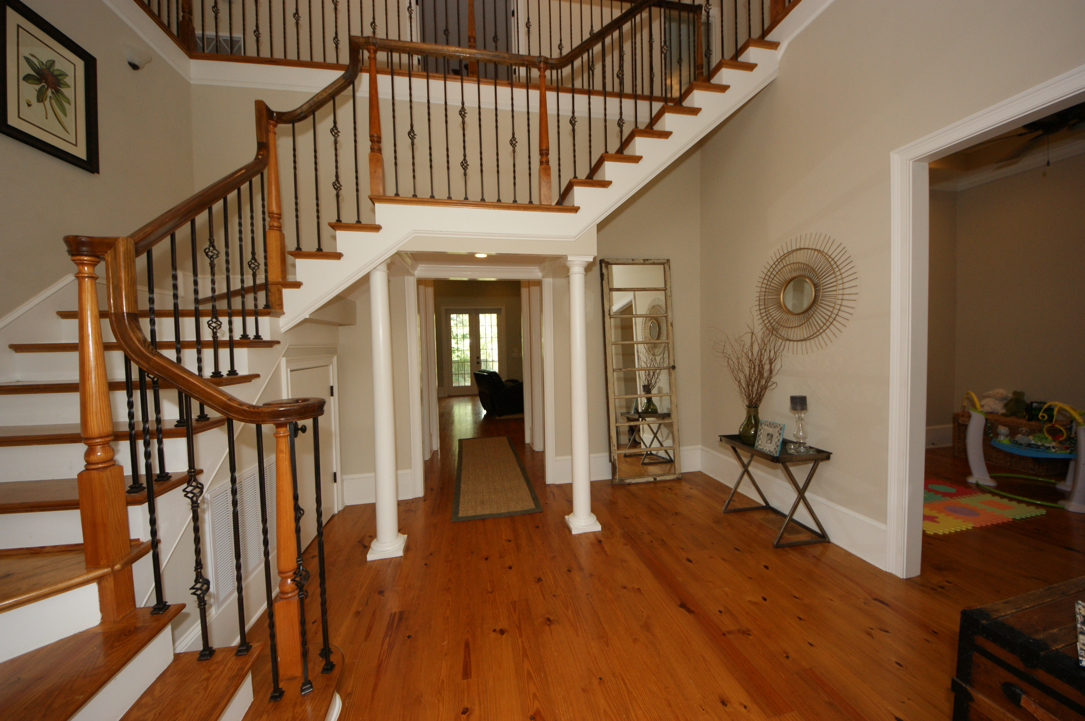
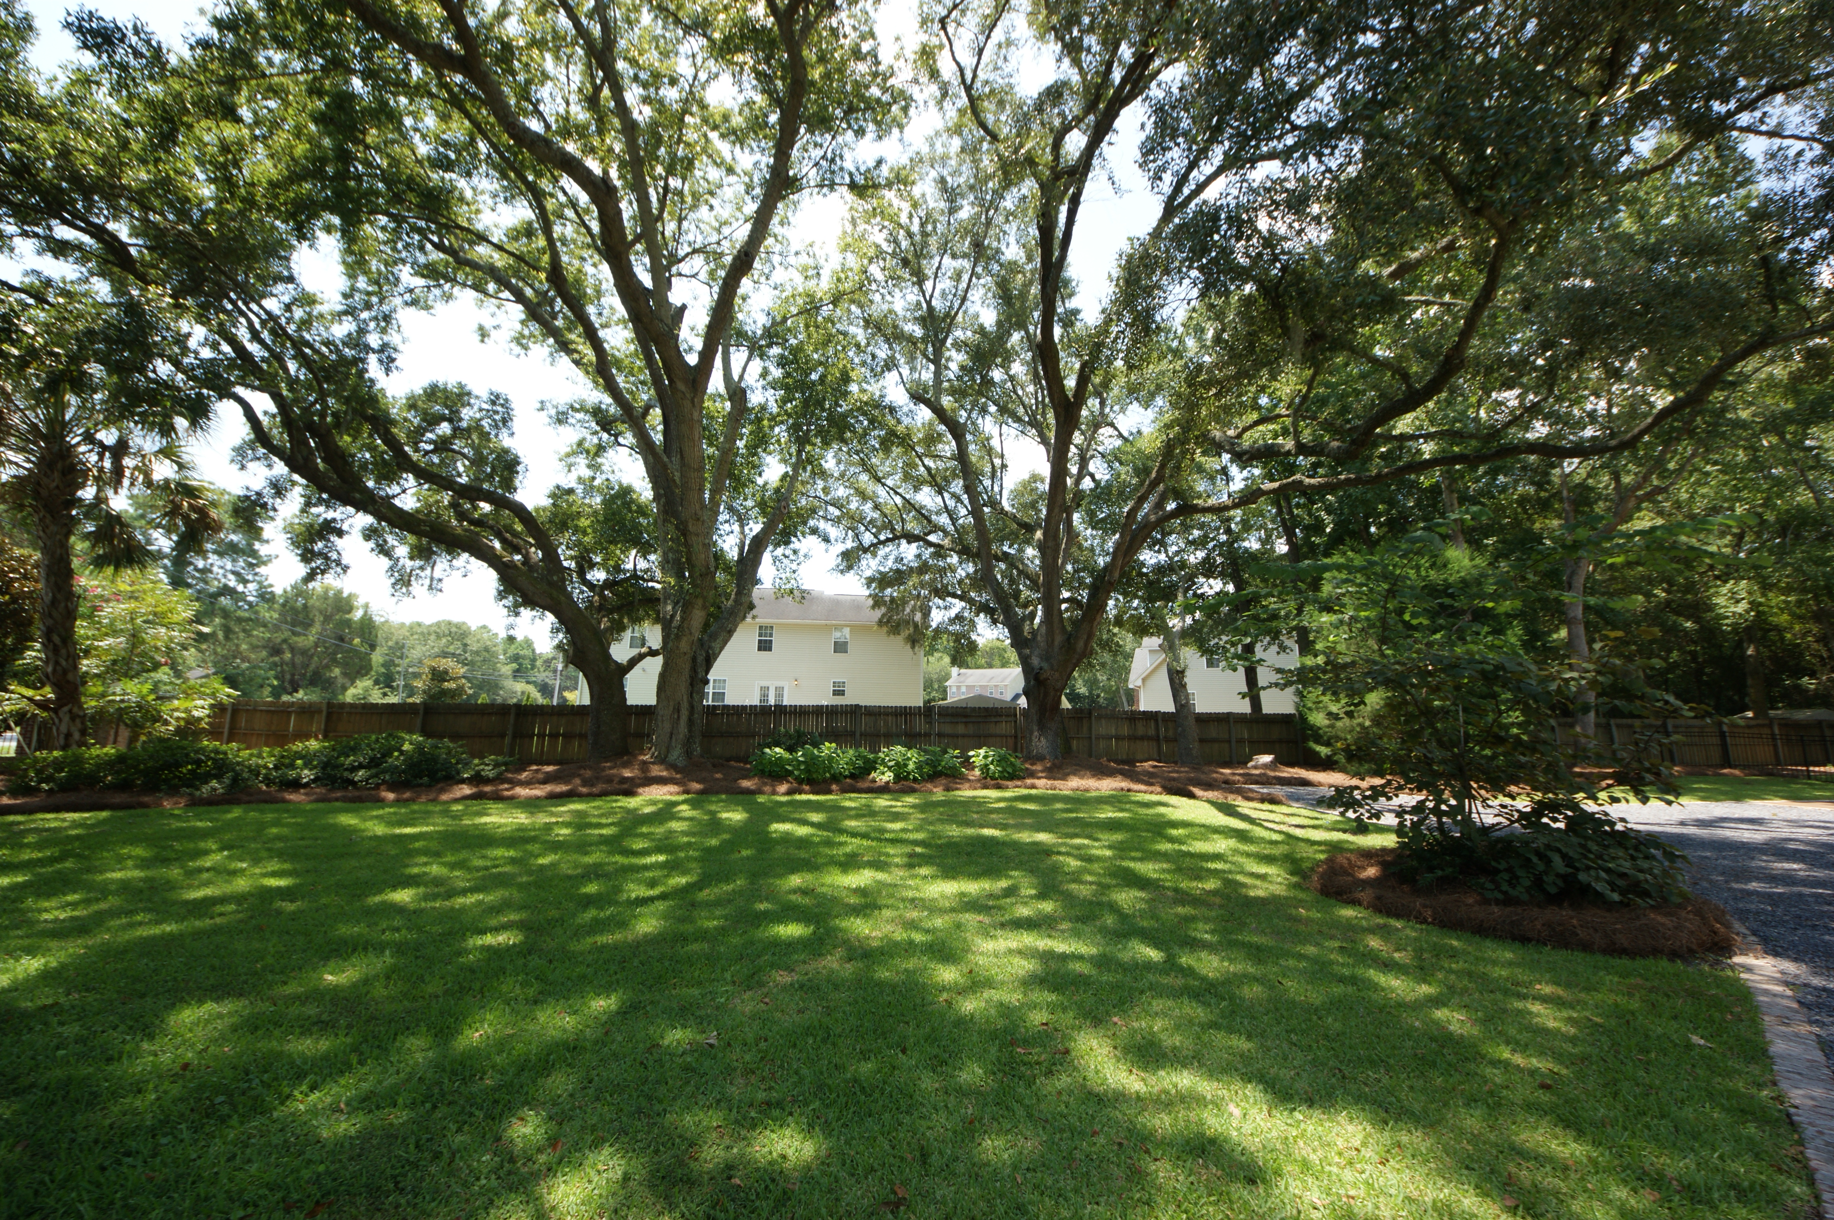
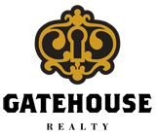
Mount Pleasant Estate Reduced $70k
1866 Rifle Range Road
Mount Pleasant
MLS# 15021787
$874,500
5 Bedrooms | 6½ Baths
STUNNING Executive Estate! Welcome home to this exquisite custom built home on a large lot in the heart of Mount Pleasant. Beautiful, well-manicured landscaping is the first thing you'll notice as you enter through the gate to this magnificent property adorned by classic Carolina Gas Lanterns! Expect to be even more impressed as you come into this nearly 5000 sq. ft. home, where quality details and custom features abound. Large open foyer, gorgeous hardwood floors, crown moldings, coffered ceilings, plantation shutters and surround sound are just a few of the things you notice as soon as you walk thru the front door. Great home for entertaining friends and family. You will enjoy the beautiful cabinetry, high-end appliances, and gas cooktop in this state of the art kitchen. Off of the kitchen is a beautiful back porch looking out onto the large fenced back yard. The bedrooms are all extremely spacious, each with it's own full bath with cast-iron tubs, beautiful custom tile, granite counters, and large walk-in closets. MUST SEE! A truly unique property!!
Robin Iriart
Mobile 843-568-7720
Office 843-284-8834
Rickrobin@comcast.net
Gatehouse Realty, LLC
708 S. Shelmore Blvd, Ste. 102
Mt. Pleasant, SC 29464
www.gatehousecharleston.com

