Slide 1
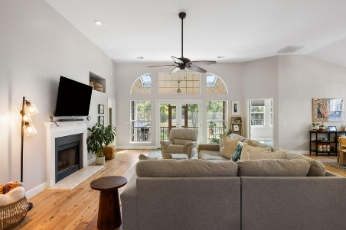
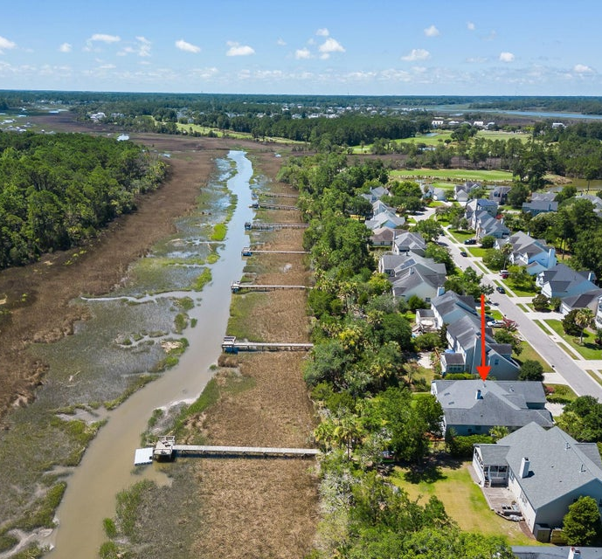
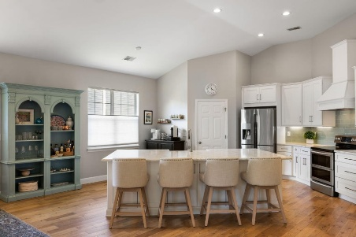
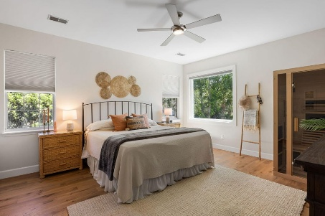
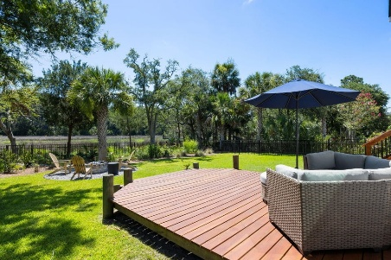
1869 Palmetto Isle Drive Rivertowne Country Club | Mount Pleasant, SC 29466 MLS# 25018369 | $950,000
Darrell Creek Elevated Home With Elevator & Salt Pool
Marsh Front, Move-In-Ready, Updated Home On Tidal Creek!
Beautiful, updated, marshfront 3 bedroom, 2 bath home with shared dock on tidal creek. Great location inside Rivertowne Country Club, walking/biking distance to neighborhood amenities including the clubhouse, pool, tennis courts, and basketball court. Enter the home through the foyer and note the abundant natural light, beautiful hardwood floors and stylish custom lighting that start here and continue through the rest of the home. The vaulted ceiling and numerous windows throughout the open concept family room, kitchen, and dining area create a sense of light and space. The gourmet kitchen includes a large island with ample storage, built-in farmhouse sink, and breakfast bar; white Shaker-style cabinetry; stone countertops with tile backsplash; and stainless steel appliances.
Full-light French doors with large sidelights and transom lead from the family room to the screened porch and offer scenic views of marsh and wetlands beyond the back yard. An office off the family room features a wall of windows that maximize these views. The primary suite is also located at the rear of the home, overlooking the marsh, and includes a large en suite bathroom with double-sink vanity, garden tub, separate shower, and walk-in closet. Towards the front of the house are two additional bedrooms and a shared full bath. The home's solar energy system allows for extremely low electricity costs. Electricity charges for the last 12 months totaled $102! Improvements made by the current homeowners include the following: installed new garage door opener, added new floater on dock, installed a large picture window in primary bedroom, sealed all decks, installed new vanity in primary suite, and added black aluminum fencing, enclosing the newly landscaped back yard. Great location. Easy bike or golf cart ride to shops and restaurants. Excellent Mount Pleasant schools!
VIEW LISTING
Andrea Rogers
(843) 532-3010 | andrearogers1@gmail.com | www.andrearogersrealtor.com
AgentOwned Realty Preferred Group | 1400-G Palm Blvd | Isle Of Palms, SC 29451

