Slide 1
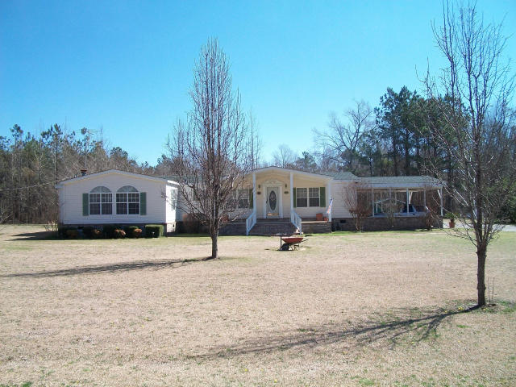
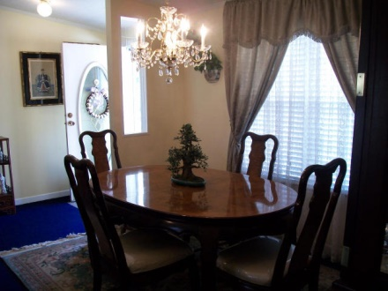
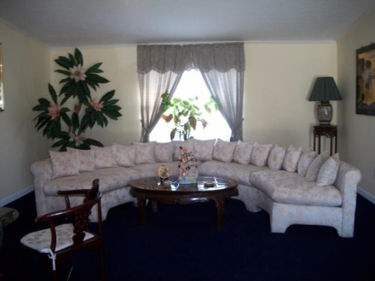
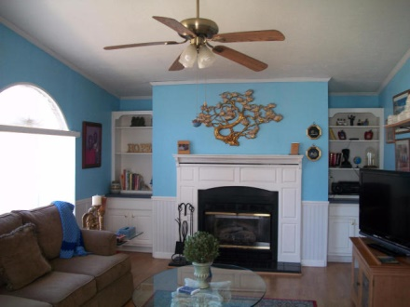
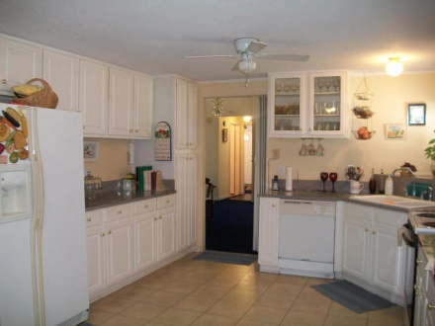
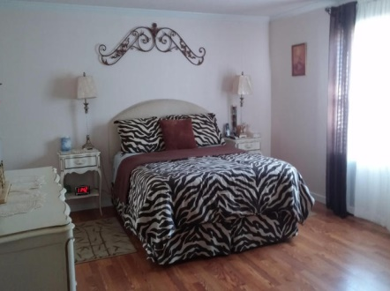
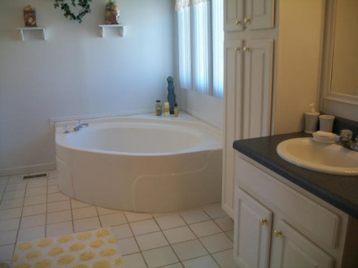
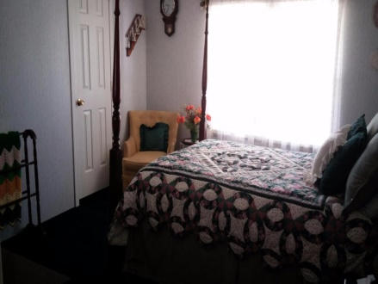
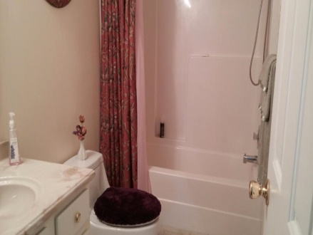
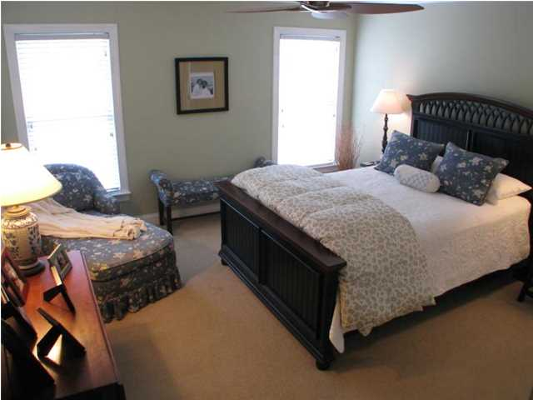
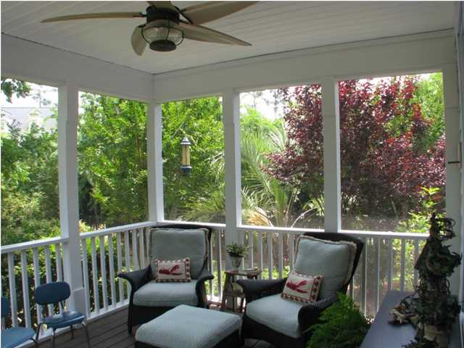
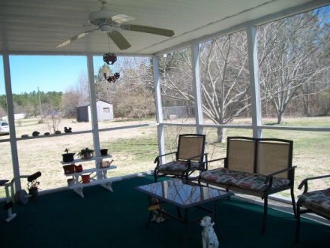
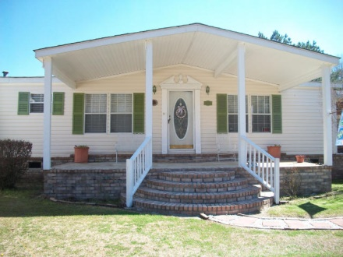


1871 Camden Road
Holly Hill, SC 29059
MLS# 15005864
$120,000
4 Bedrooms | 2 Baths | 2,200 sf
Immaculate MOVE-IN ready home. As you enter into your new home you will enjoy the spacious living room/dining room with plenty of space for formal or family dining. Open kitchen features built in microwave, range, dishwasher, refrigerator, plenty of cabinets and counter space, pantry and laminate flooring. Eat in kitchen is a good size. The gas fireplace in the family room will warm you up on chilly evenings. Large master bedroom has laminate flooring and walk-in closet. The master bathroom has double vanities, stand up shower, separate garden tub, and ceramic tile floor. Crown molding and 2'' custom blinds throughout. The comfortable screened porch provides a lovely view of the back yard. There is a 2+ carport with immediate access to the home so you won't get wet in the rain.
Move in ready home
Debbie Toombs
843-345-7895
debbie.toombs@cbunited.com
www.cbunited.com

