Slide 1
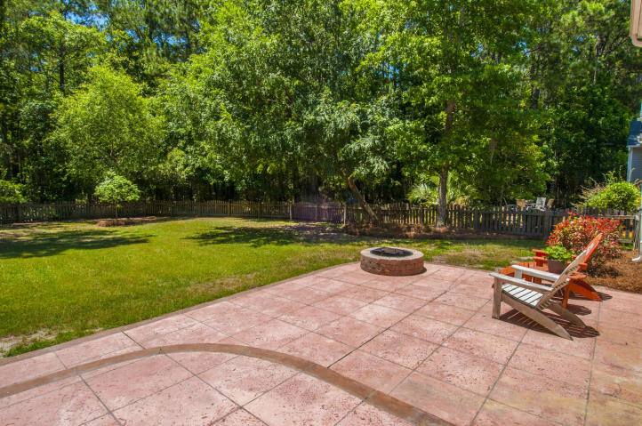
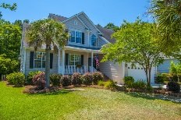
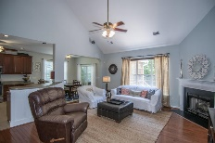
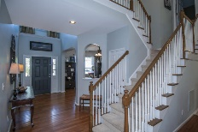
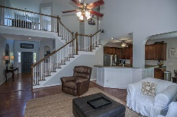
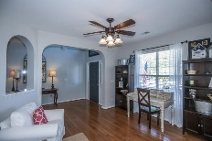
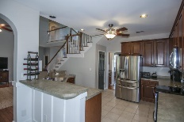
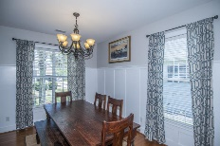
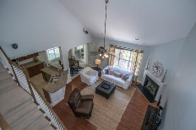
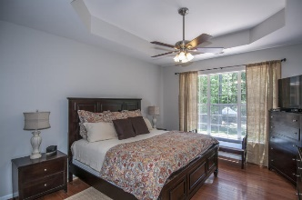
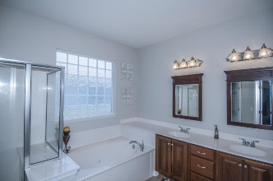
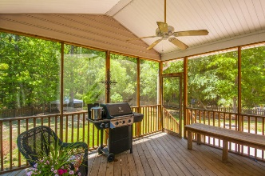
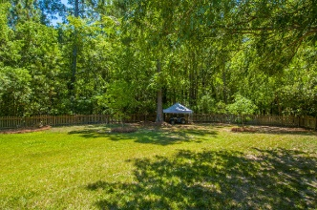
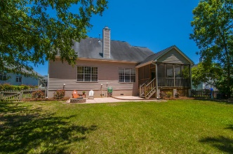


1872 Great Hope Drive Mount Pleasant, SC 29466 ~ MLS# 16014353 ~ $450,000
Just Listed in Rivertowne Country Club!
5 bedroom on almost 1/2 acre
$50,000 Price Reduction
Dreaming of more than the tiny lots that new developers now offer? At almost 1/2 an acre this property is one of the largest lots in Rivertowne Country Club-Palmetto Isle. You can have your own fenced-in private back yard with a large protected wooded buffer behind. Out front the large covered porch welcomes you inside. Upon entering you step into the vaulted foyer. The gathering room is to the left and the dining room is just beyond and features custom trim-work. Ahead is the two story family room which is open to the eat-in kitchen, lending itself to entertaining. The two story foyer and family room also allow for lots of natural light. Wood floors run throughout the downstairs with the exception of tile in the kitchen, master bath and laundry. The kitchen features all stainless appliances and a large bar top counter for casual seating. Underneath the bar you will also find the same custom trim as in the dining room. Off the kitchen is the screened porch with built in bench seating. The porch leads onto the stamped concrete patio which is also the perfect backyard spot for outdoor dining or entertaining. The master bedroom is conveniently located downstairs and offers a tray ceiling and a large adjoining en suite. The master bath has a large garden tub and separate shower as well as a double vanity. The master closet is extremely large providing plenty of room for storage. Upstairs are an additional 4 rooms. One of these rooms is currently used as an office and features a built in desk area. Of the remaining 3 rooms one is quite large and could also be used as a play room or media room. Don't forget to check out the garage which has been retrofitted with a full second story storage space. You will not find more storage in any other 2 car garage! Other features in this home are central vac, upgraded vinyl siding, landscape lighting, and a dedicated generator hook up. Firepit and washer and dryer can also convey with acceptable offer. Don't delay...make this your new home before it's gone! Rivertowne County Club offers many neighborhood amenities such as the newly redone pool and pavilion and playground, miles of walking trails, beautiful country club and award winning golf course! Rivertowne is also convenient to shopping, dining, schools and the Wando River. It's only a 15-20 min. drive to the beaches and 25 minutes to downtown Charleston. A 1 year AHS home warranty is to be provided by the seller with acceptable offer.
Melodie Smith (843) 408-5067 M
melodie.smith@carolinaone.com www.melodiesmithrealestate.com

