Slide 1

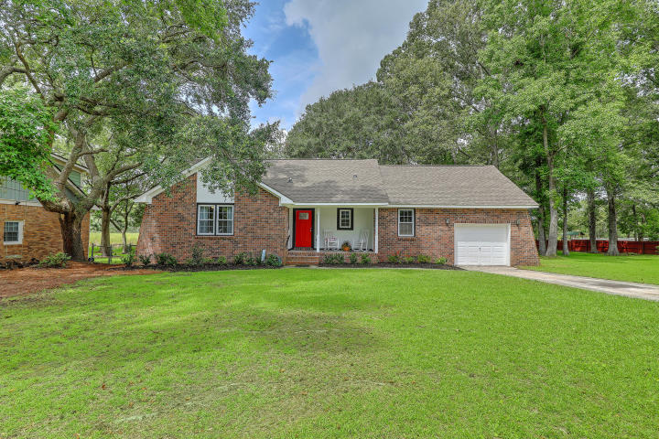
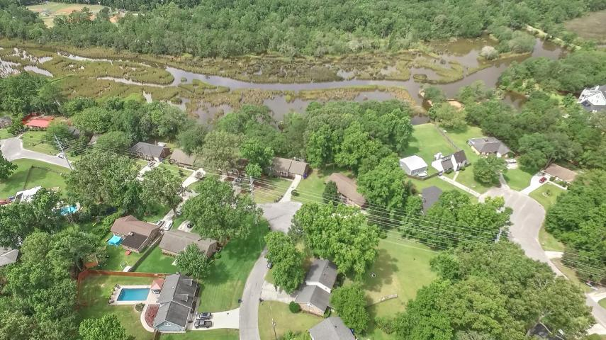
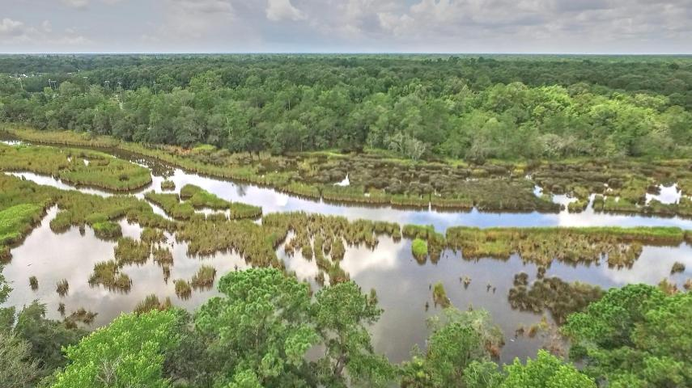
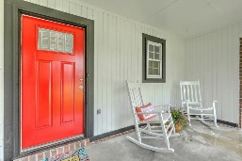
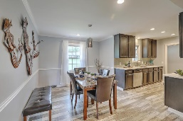
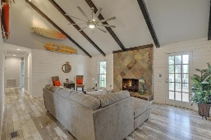
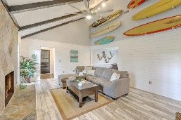
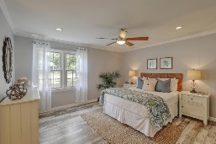
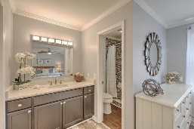
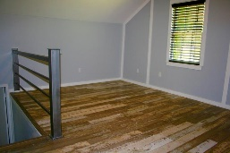
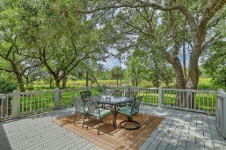
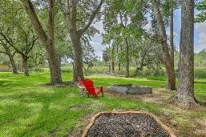
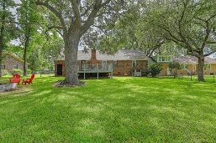
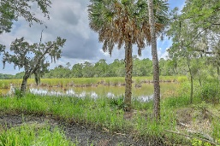
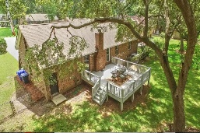


Open House This Weekend! Saturday & Sunday from 12-3
1878 Cestus Lane
Church Creek | Charleston
MLS# 17019727 | $300,000
Wow! Beautiful, completely renovated waterfront home on huge .48 acre lot lined w/mature oaks, palmettos & amazing views! Spend endless summer nights on your new 20x20 deck overlooking the peaceful, navigable tidal creek as the sun sets over the nature preserve across the marsh. Features include: New, high quality flooring throughout**Great Room w/vaulted ceiling, floor-to-ceiling stone fireplace & newly installed shiplap**Updated kitchen w/quartz counters &subway tiled backsplash**Master en suite with custom tiled shower & new vanity with quartz counter**Guest bath also w/new custom tiled shower, vanity & quartz counter**FROG which can be used as office, media or craft room or 4th bedroom**New 5 ton Heil HVAC! Can't ask for much more this close to downtown Charleston! APPRAISAL IN HAND! Docks in place on neighboring properties on both sides. and NO HOA! This home is truly a water lover's paradise! Paddleboard, kayak or canoe in your own backyard and public boat ramp is close by. Where else can you get waterfront at this price?!
Desiree Maurer Office - (843) 416-2000
Mobile - (843) 327-9010 desiree.maurer1@gmail.com
www.yourcharlestonhousesearch.com
Keller Williams Realty 496 Bramson Ct Ste 200 Mt. Pleasant, SC 29464

