Slide 1
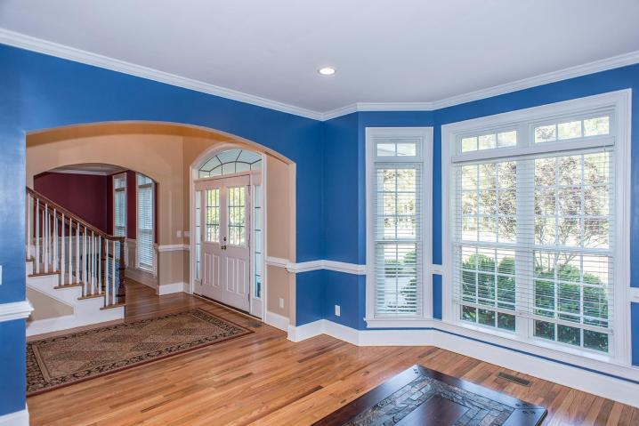
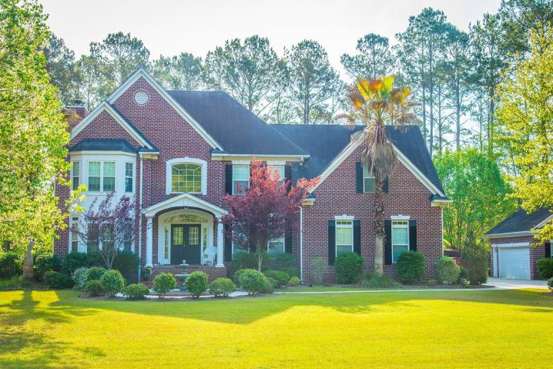
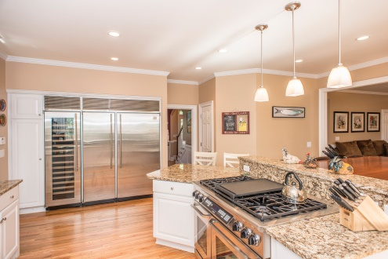
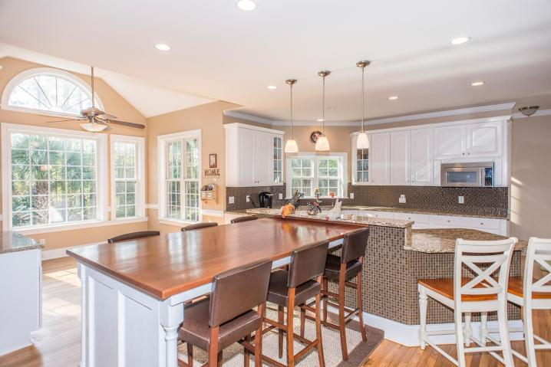
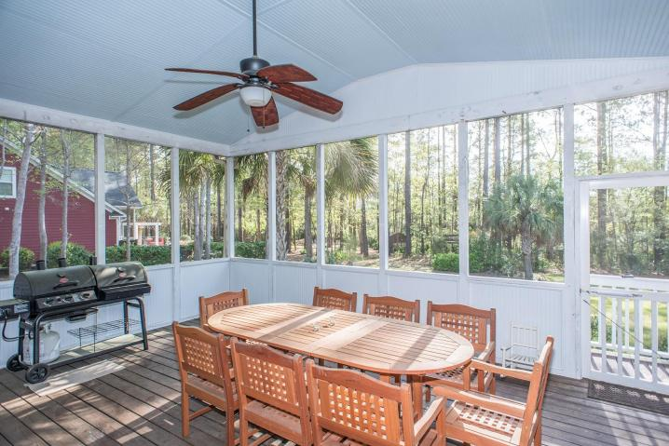
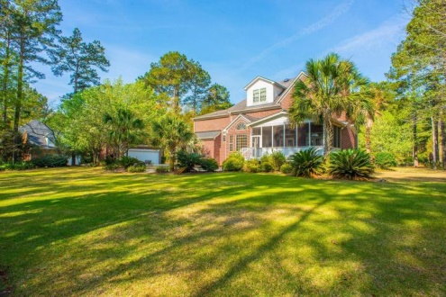
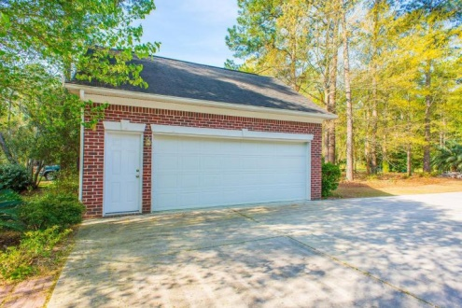

Luxurious Lowcountry Living
Featuring Gourmet Kitchen · Detached Garage with Workshop
$750,000
4 Bedroom
3½ Bath
4,005 Sq Ft
1879 Cherokee Rose Circle
Dunes West
Mount Pleasant, SC
MLS# 15009059
Grand home on large private estate lot in Dunes West. Home features a true chefs kitchen with top of the line appliances including a 60'' stainless refrigerator/freezer, a 120 bottle wine cooler, a 6 burner gas range with dual ovens. The main floors shines with freshly refinished wood floors and large freshly painted bright rooms. The family room opens to a large screened in porch looking onto a very private back yard backing up to woods and tidal marsh. The second floor features new carpet, four bedrooms and three baths. The third floor features a 5th bedroom or could serve for other uses. The home also features an attached 3 car garage as well as a large 2 car detached garage that is a handyman's paradise. Please don't miss this wonderful updated home.
Frank Thornhill, Realtor®
(843) 224-7997
fthornhill@hanlandevelopment.com
www.hanlangroup.com
Hanlan Consulting and Development
241-243 East Bay St · Charleston, SC 29401

