Slide 1
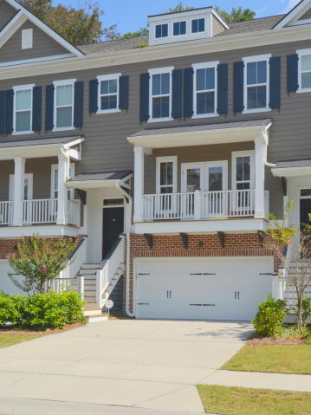
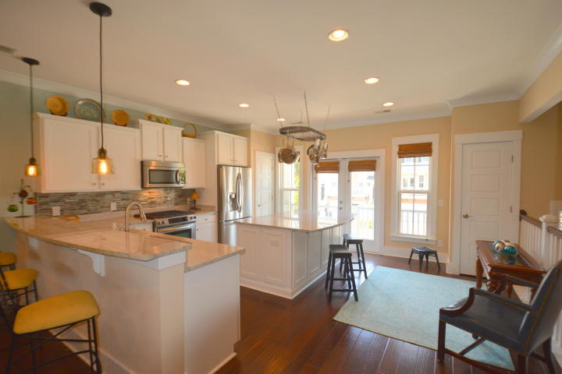
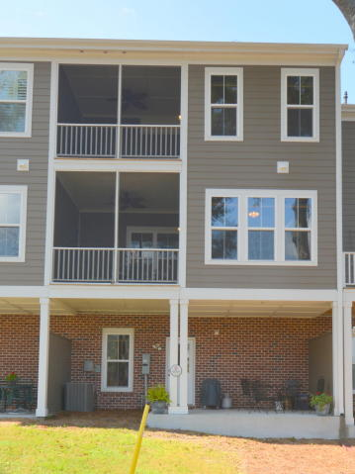
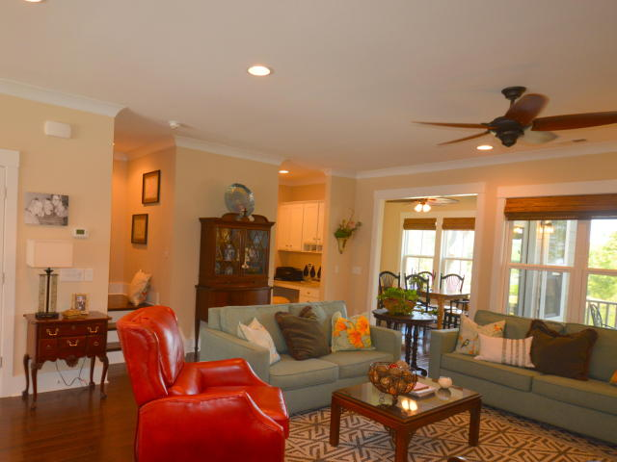
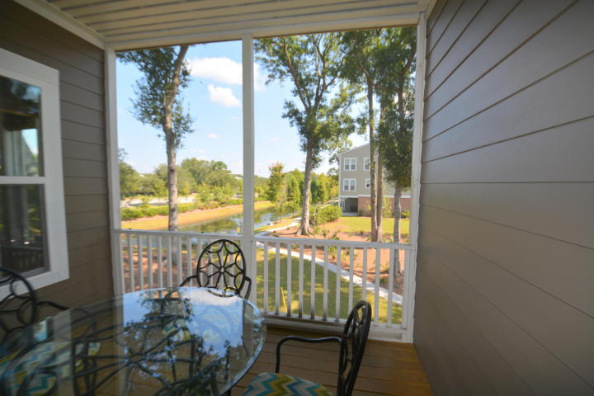
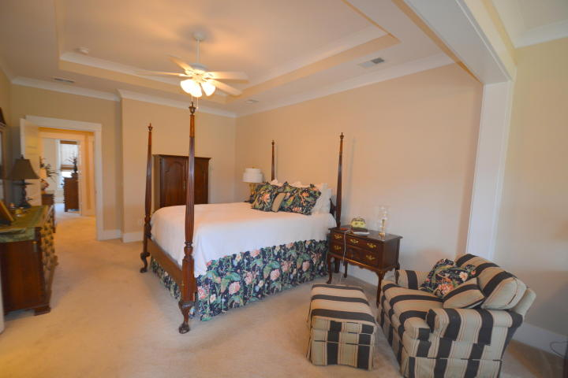
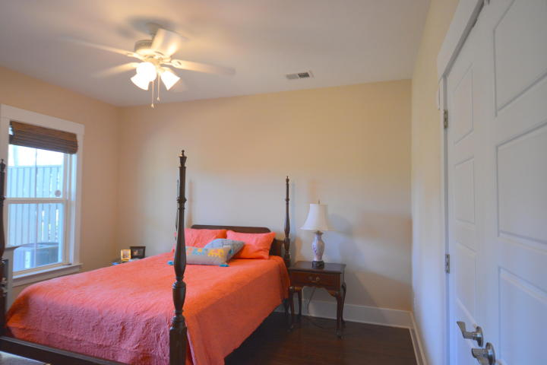
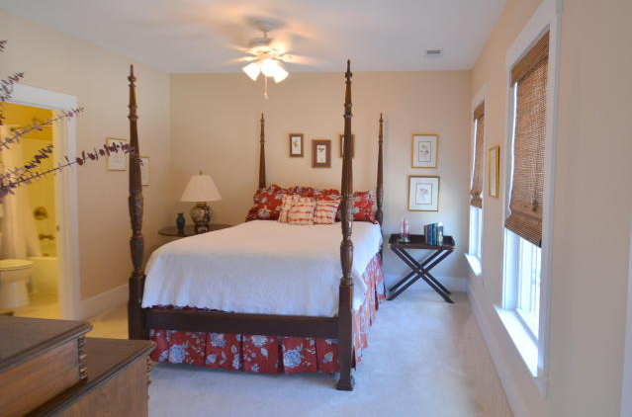
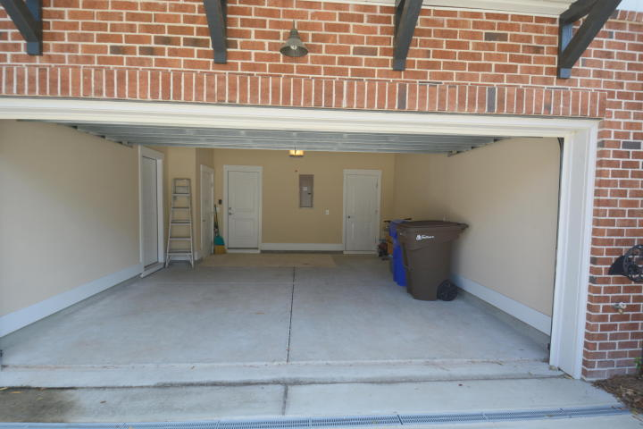
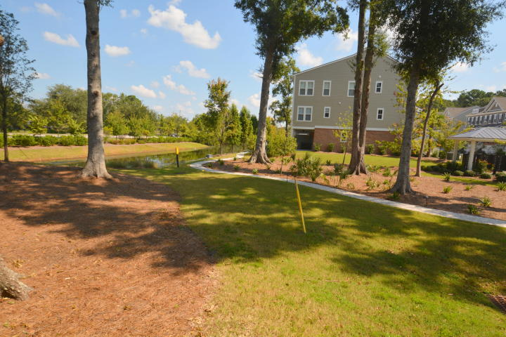


Open House ~ Sunday 2-5
Hosted by Talbert Barger 843-885-8597
Buy.......Build.....Begin
1882 Carolina Towne Court
Carolina Walk | Mount Pleasant | MLS# 17025510 | $563,900
Luxury Town Home across the street from Mount Pleasant Towne Center. Minutes from the Beach! This 3 bedroom, 3 and one half bath Luxury Town Home is located in Carolina Walk. It was expertly designed by Pulte Homes and then upgraded by my client. The covered front entrance opens to a wide foyer. We walk up the open, extra wide stairway, to reach the main floor. Here we find a large, open, gourmet kitchen with island, soft close cabinet drawers, granite counter tops, Energy Star Kitchen Aid appliances, two pantries, an energy efficient French door opening to the front porch. The kitchen also has a bar separating it from the very large Great Room with custom lighting, designer ceiling fan. This flows to a separate dining room with a door to the enclosed screened porch. Also on this level we find a custom alcove and a half bath.
The top floor contains a very large guest bedroom with its own bathroom. Again, custom cabinets with granite counter tops and a walk-in closet for this bedroom. The master bedroom suite is unbelievable. The bedroom is oversized and has a separate sitting room. From here we have a door to the private screened in porch accessible only from the Master Bedroom. In the Master Bathroom we have two separate, high vanities, each with multiple drawers and granite counter tops. This bathroom also has a double long walk in shower and a very large walk in closet. There are ceiling fans in the master bedroom, sitting area and porch. The view from the porch is of the pond and lovely common areas with walking trails. We also have a large laundry room with sink and granite counter top.
On the first floor, we find a large two car garage with two separate storage areas, the entrance to the lower floor of the home and the bottom of the elevator shaft. Inside we find an entry foyer, custom laundry room, a large bedroom with an outside door to the covered patio and back yard. We also find a full custom bathroom with tub (notice the hotel style shower rod and custom high cabinets with granite counter tops).
This great Town Home also has a Rinnai Tank-less gas hot water system, Energy Star rated appliances, Energy Star Anderson Vinyl Windows, Energy efficient doors, Over-sized base boards, custom trim work, two laundry rooms, the laundry room on the top floor has a granite counter top sink and cabinets, Zoned for the Number 1 STEM Middle School in the County, custom mosaic backsplash in the kitchen, a custom Pot Rack over the island, HERS rated for energy efficiency and so much more.
Bob Ramella, Broker
CRS, CDPE, RCC, e-Pro
(843) 330-8300
bob@bobramella.com | www.bobramella.com
Keller Williams Realty Charleston | 496 Bramson Ct Ste 200 | Mt. Pleasant, SC 29464

