Slide 1
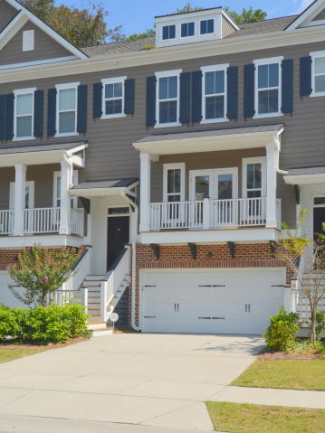
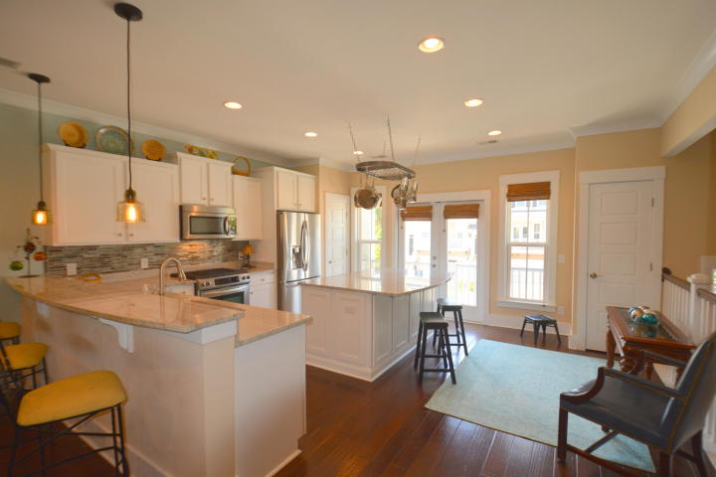
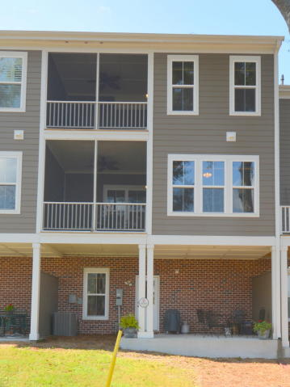
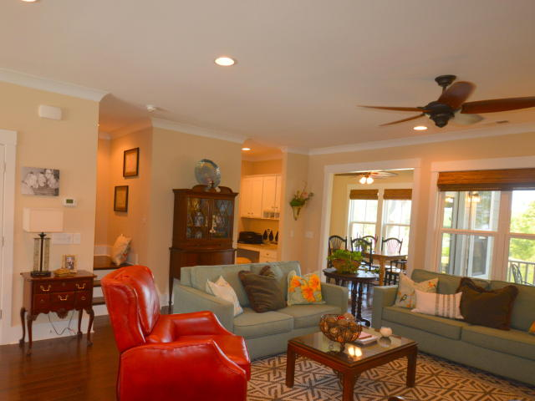
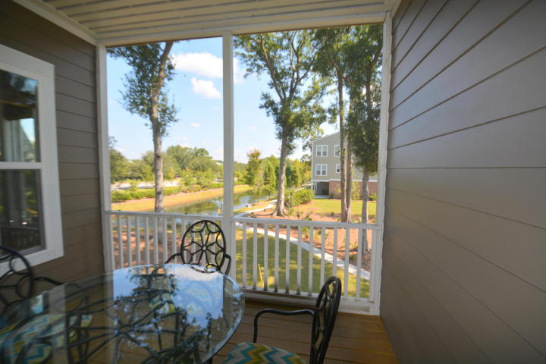
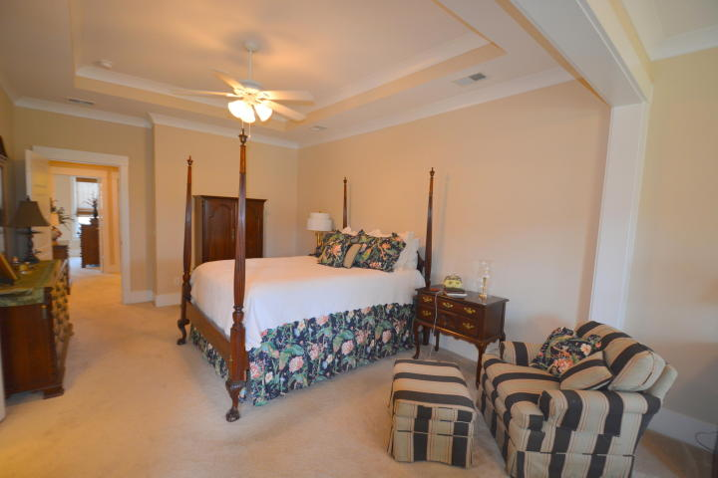
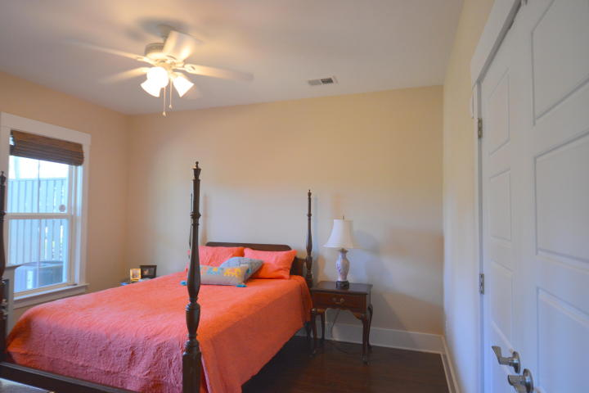
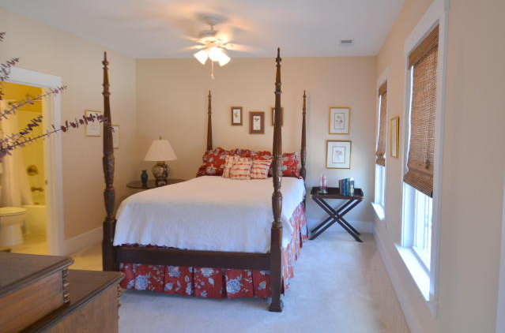
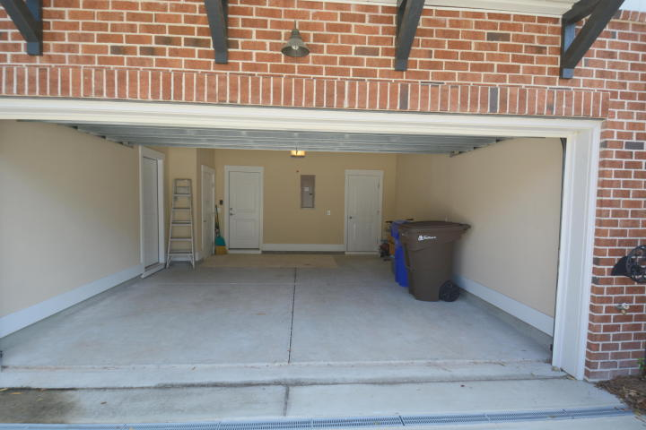
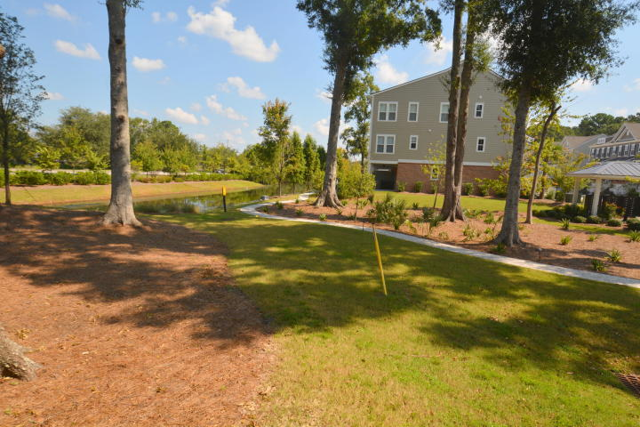


Agent/Broker Open House ~ Wednesday 10/25 ~ 11:30-1
Light Lunch Served ~ Register To Win A $50 Gas Card
If we get a ratified contract by Thanksgiving that results in a successful closing by Christmas,
the buyers’ agent will earn a $2,000 bonus with BIC approval.
Buy.......Build.....Begin
1882 Carolina Towne Court
Carolina Walk | Mount Pleasant | MLS# 17025510 | $599,000
Luxury Town Home across the street from Mount Pleasant Towne Center. Minutes from the Beach! This 3 bedroom, 3 and one half bath Luxury Town Home is located in Carolina Walk. It was expertly designed by Pulte Homes and then upgraded by my client. The covered front entrance opens to a wide foyer. We walk up the open, extra wide stairway, to reach the main floor. Here we find a large, open, gourmet kitchen with island, soft close cabinet drawers, granite counter tops, Energy Star Kitchen Aid appliances, two pantries, an energy efficient French door opening to the front porch. The kitchen also has a bar separating it from the very large Great Room with custom lighting, designer ceiling fan. This flows to a separate dining room with a door to the enclosed screened porch. Also on this level we find a custom alcove and a half bath.
The top floor contains a very large guest bedroom with its own bathroom. Again, custom cabinets with granite counter tops and a walk-in closet for this bedroom. The master bedroom suite is unbelievable. The bedroom is oversized and has a separate sitting room. From here we have a door to the private screened in porch accessible only from the Master Bedroom. In the Master Bathroom we have two separate, high vanities, each with multiple drawers and granite counter tops. This bathroom also has a double long walk in shower and a very large walk in closet. There are ceiling fans in the master bedroom, sitting area and porch. The view from the porch is of the pond and lovely common areas with walking trails. We also have a large laundry room with sink and granite counter top.
Frankly, there are far too many features to highlight here. Do yourself a favor and go see this one out before it’s gone!
Bob Ramella, Broker
CRS, CDPE, RCC, e-Pro
(843) 330-8300
bob@bobramella.com | www.bobramella.com
Keller Williams Realty Charleston | 496 Bramson Ct Ste 200 | Mt. Pleasant, SC 29464

