Slide 1
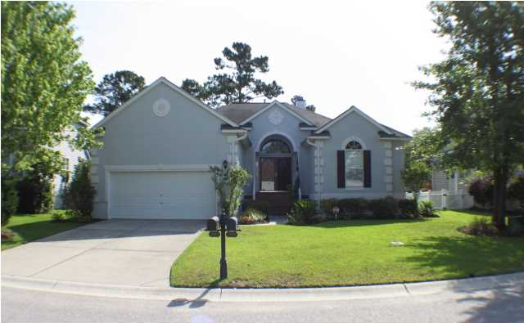
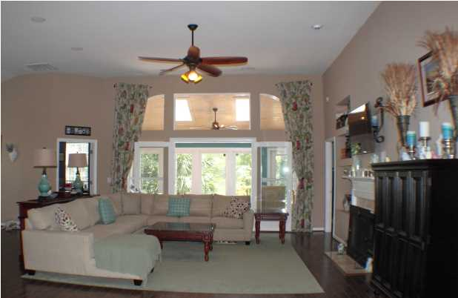
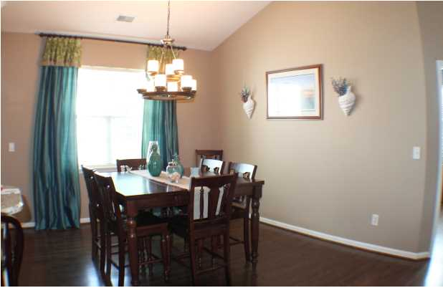
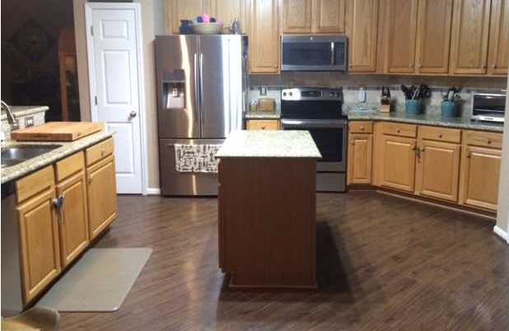
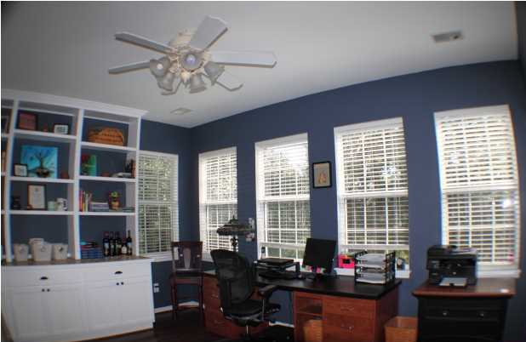
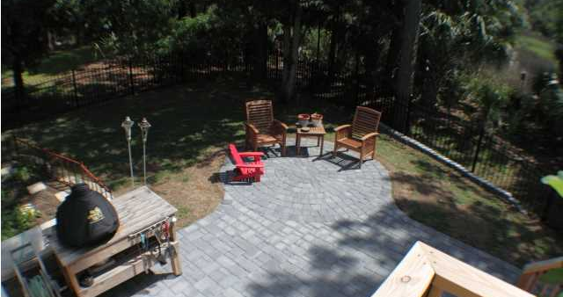
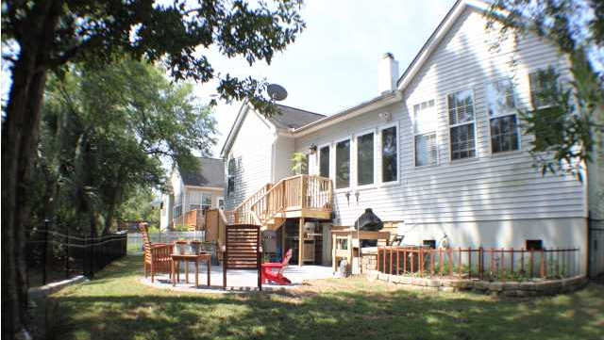
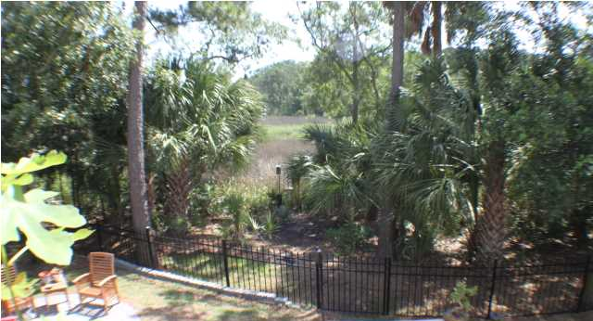

Just Reduced in RiverTowne!
1889 Palmetto Isle Dr
Mount Pleasant, SC
MLS# 1414570
$424,000
3 Bedrooms | 2 Baths | 2,380 sf
This single story home has an open floor plan with private and tranquil backyard views of the Low Country marshlands and tidal creek. This open concept home boasts a large foyer upon entering the home. The foyer merges into a large great room with 12-foot high ceilings, which flows into a built in sunroom overlooking the tidal marsh. RiverTowne has many amenities with the community pool, playground, and tennis courts. There are also separate fees for a golf membership and use of the Country Club.

