Slide 1
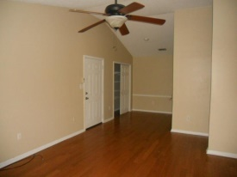
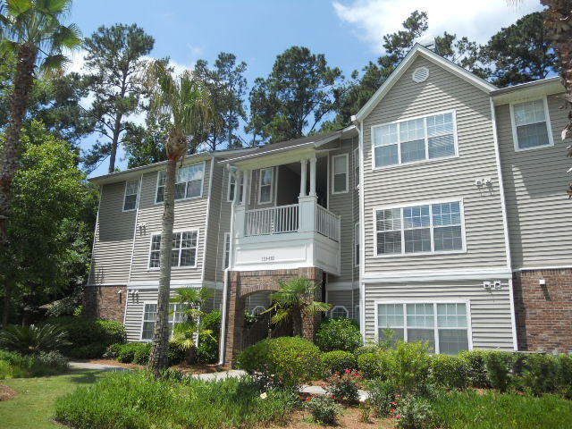
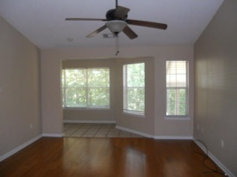
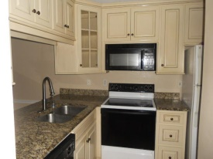
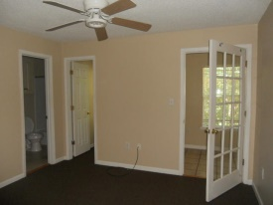
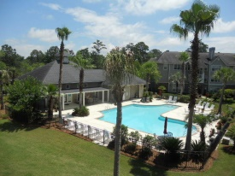
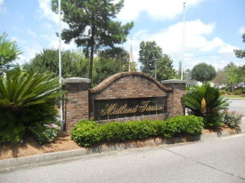

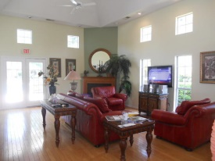


Condo Overlooking Pool
188 Midland Parkway #110
Midland Terrace
Summerville, SC 29485
2+ Acres!
MLS# 15015191 | $89,000
2 Bed | 2 Bath
Gorgeous 2 bedroom 2 bath condo. This condo has many upgrades Black & White appliances, 42 inch almond cabinets, granite counter tops, laminate wood floors, ceramic tile and carpet in bedrooms. Eat in Kitchen flows into the living area with an attached sunroom that has a french door accessing the master bedroom. Great opportunity for your primary residence or investment property in a community that is well maintained with club house and swimming pool.
Connie White, Broker
C: 843-532-3356
conniesyouragent@gmail.com
Charleston Homes
111 Spring Hall Dr
Goose Creek, SC 29445

