Slide 1
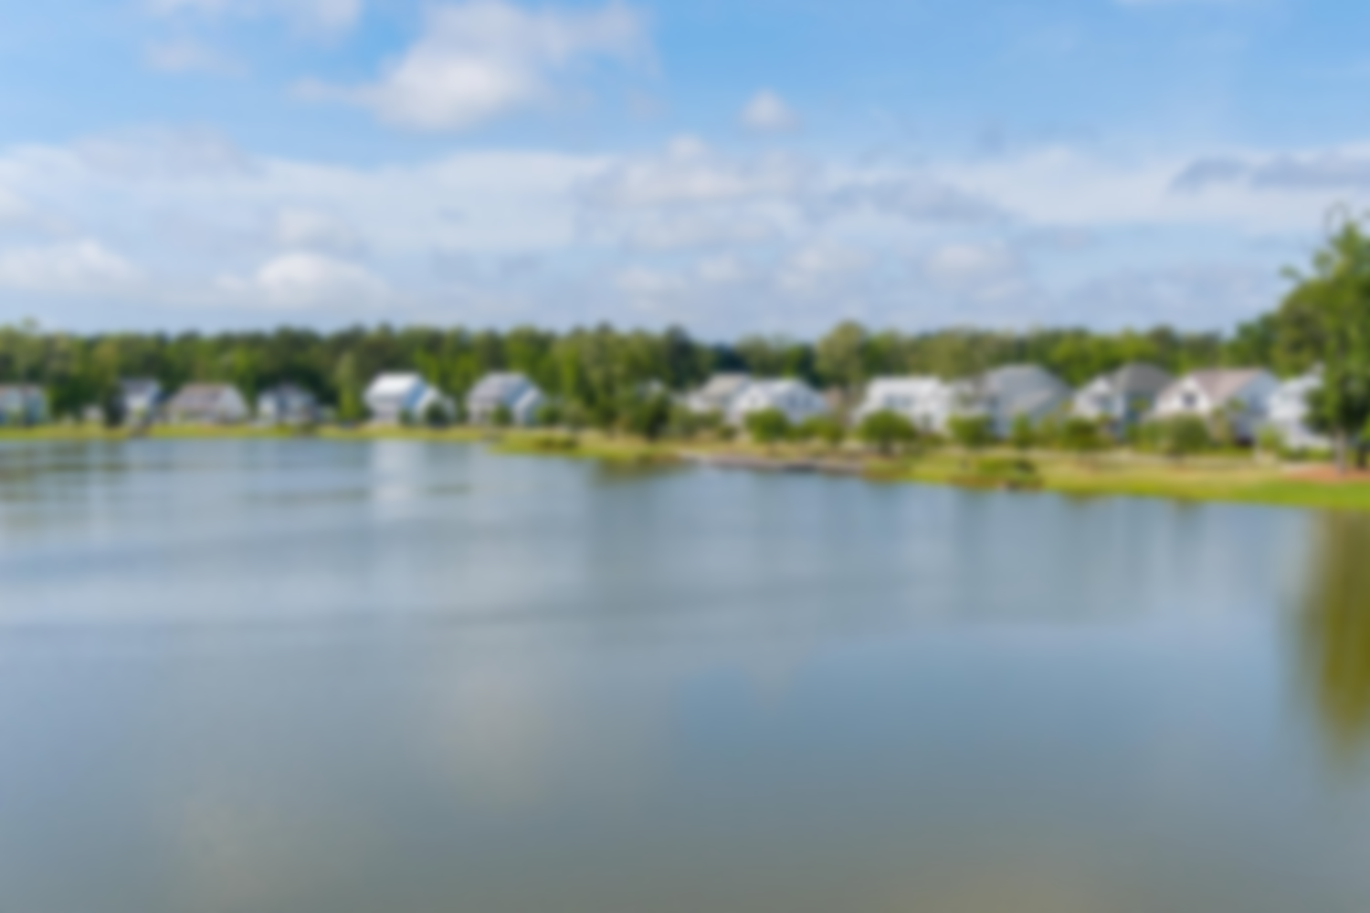
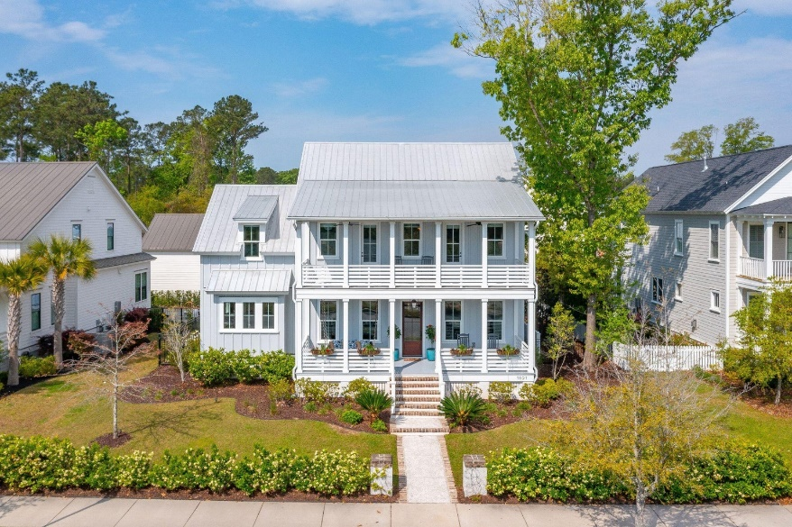
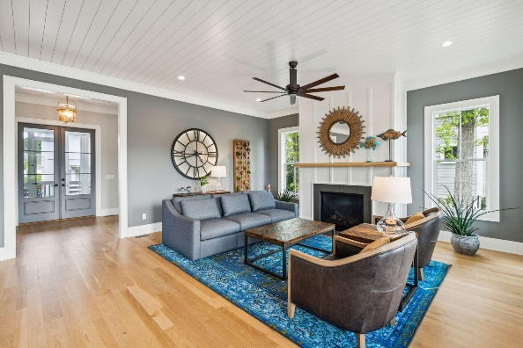
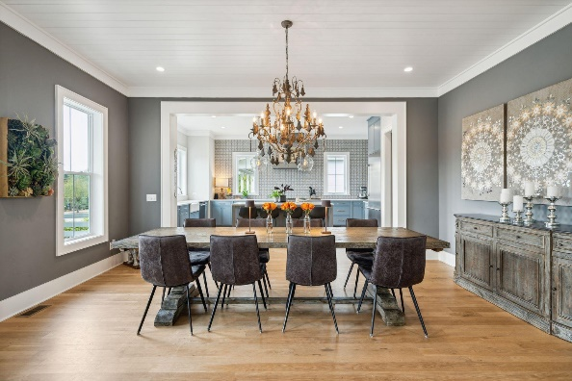
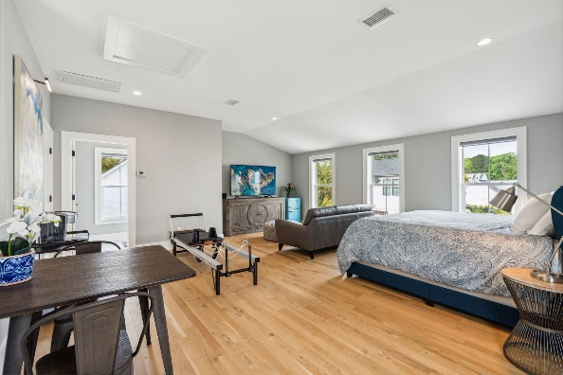
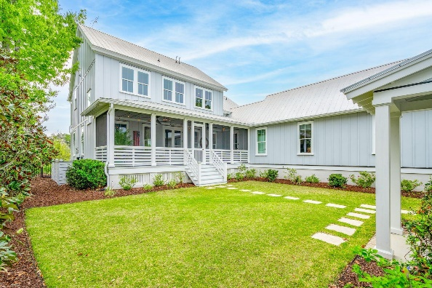
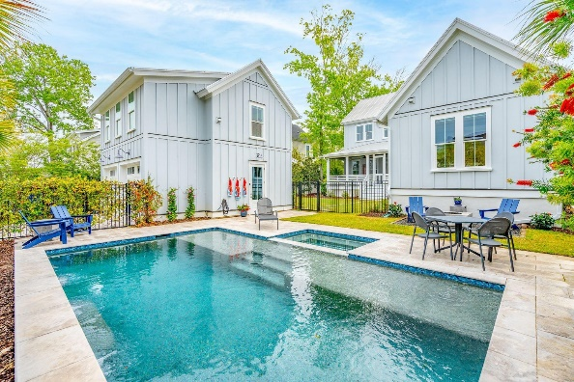
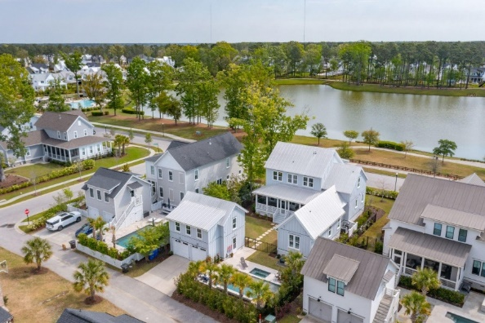


Custom Lakefront Riverside at Carolina Park
1891 Bolden Drive
Carolina Park
Mount Pleasant, SC 29466
MLS# 24008678 | $1,950,000
Welcome to luxury lakefront living at 1891 Bolden Drive in highly sought after Riverside at Carolina Park! *TOTAL SQUARE FOOTAGE: 3971* One of only a few custom homes in the neighborhood built by Structures, one of Charleston's most acclaimed builders, the home was carefully crafted and meticulously executed, both inside and out, to take full advantage of the exceptional panoramic views of stunning 20-acre Bolden Lake and Park. Featuring over 1,000 square feet of covered porches, start your day soaking in the sunrise over Bolden Lake, while enjoying your morning coffee on one of two oversized front porches featuring a custom swing bed, copper gas lantern and lush flower boxes. End your day enjoying a cocktail or mug of tea on the rear screened-in porch, watching stunning Carolina sunsets set just beyond the beautifully landscaped yard and sparkling saltwater pool and spa.
Luxurious amenities and meticulous attention to detail continue outside to the impressive outdoor oasis. Off the screened porch, a fenced grass courtyard populated with flowering perennials as well as mature magnolia and oak trees leads to the heated 15' x 25' saltwater pool with a triple water feature on a 15' stone feature wall, a separate spa, propane firepit and leathered marble pool deck. This thoughtfully designed area is fully enclosed with a 5' fence and surrounded by mature hedges and palm trees, ensuring both safety and privacy in this elegant and timeless serene space.
The front and back yards include landscaping lighting, an all-natural cedar oil mosquito misting system and a full irrigation system that also extends to the potted plants, organic garden beds and mature blueberry bushes. Electronic keypads on the main house, FROG and garage offer easy access, even remotely, while a 50A Tesla charger benefits electric vehicle owners.
This property offers not only a luxurious lifestyle, but also the convenience of modern living. Riverside at Carolina Park offers an endless array of amenities, including the Lake Club, just down the street, featuring a resort-style pool, picnic pavilion, and firepit overlooking scenic Bolden Lake. Residents also have access to a playground, tennis and pickleball courts, an open-air pavilion, dog park, the Great Lawn, miles of walking trails, as well as the new Riverside crabbing dock. The nearby Bend shopping development, easily accessed by a quick golf cart or bike ride, includes restaurants, coffee shops, boutiques, a wine bar, hair and nail salons, and yoga and dance studios, among other local businesses. A fantastic regional library, top rated Mount Pleasant schools, hospital, fire station, pharmacies and grocery stores are also in the immediate area. This home is also only 20 minutes to the beaches of Isle of Palms and Sullivans Island and 25 minutes to Downtown Charleston and the Charleston International Airport.
Take virtual walkthrough
Virginia Landon 803-493-9202
virginialandon@kw.com
Keller Williams Realty | 496 Bramson Ct Ste 200 | Mt. Pleasant, SC 29464

