Slide 1
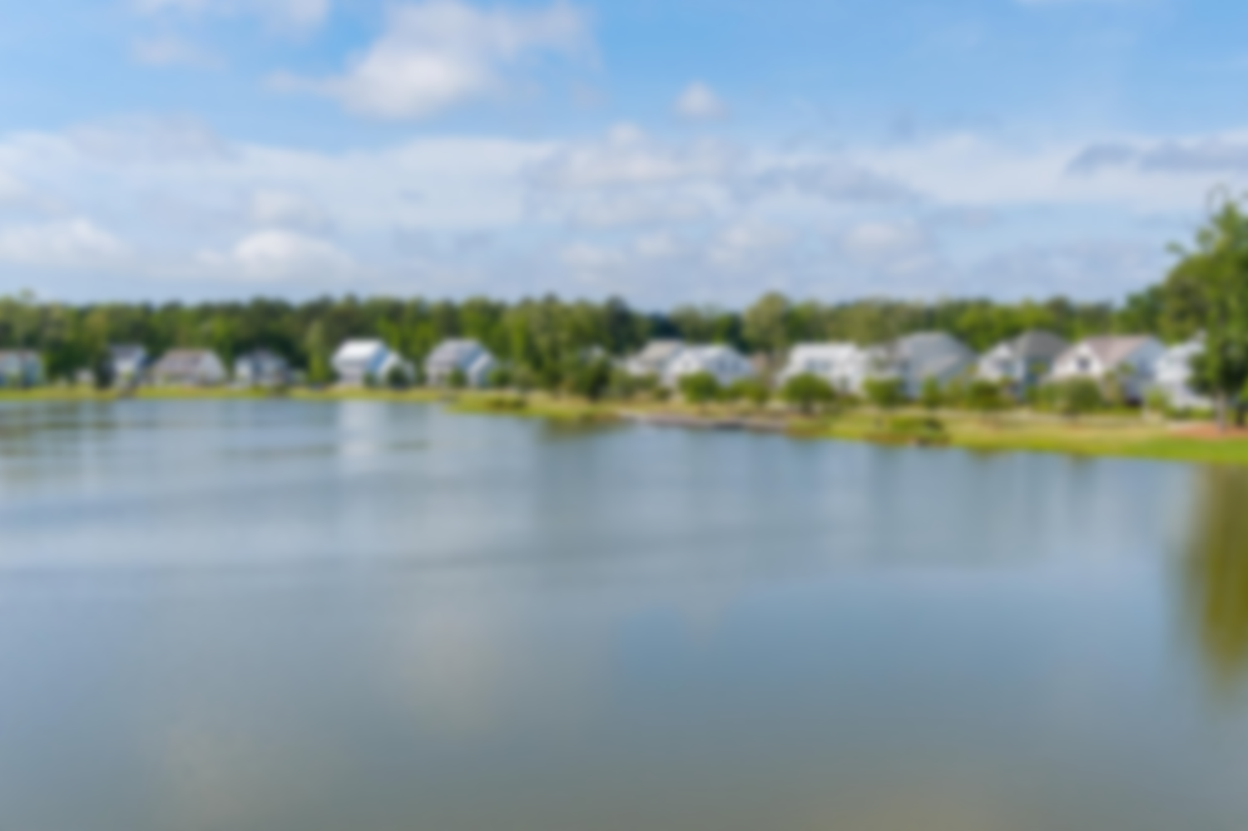
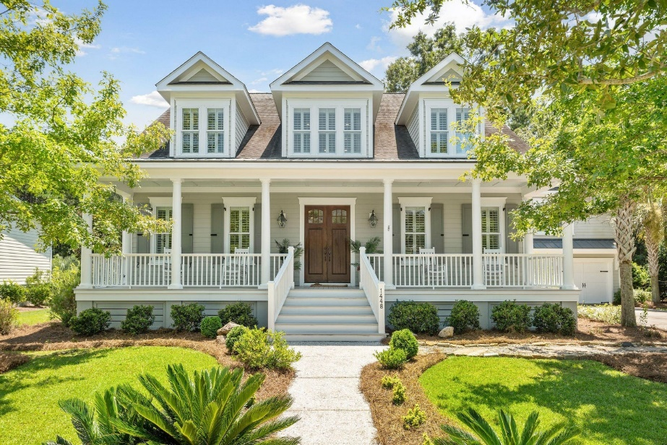
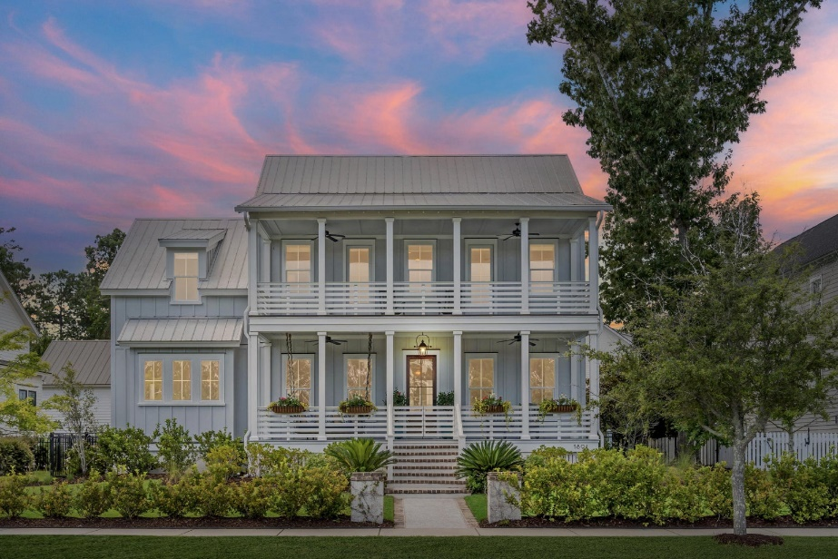
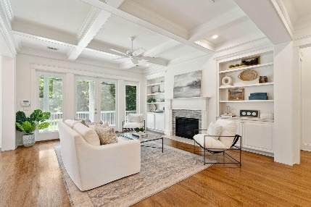
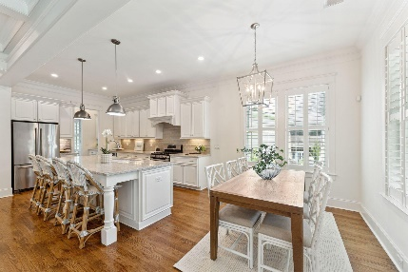
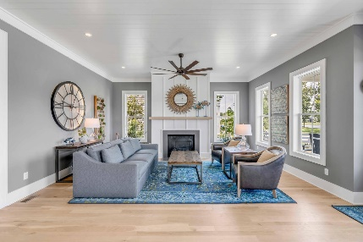
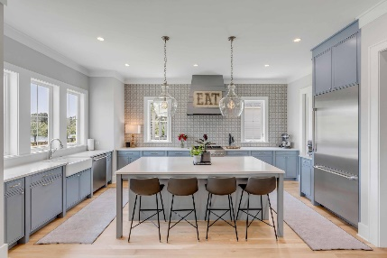
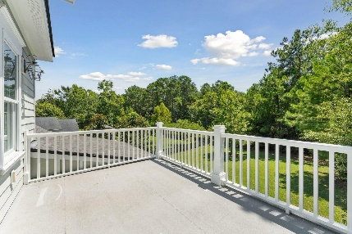
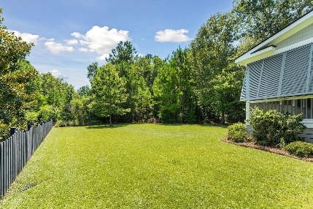
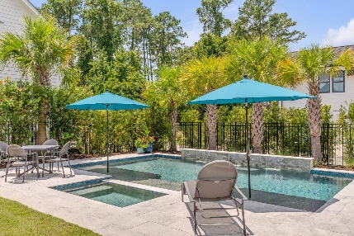
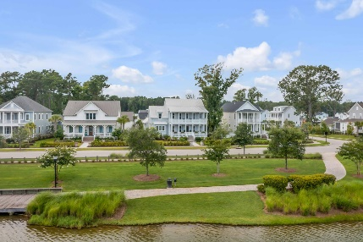

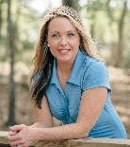
Dual Open Houses in Riverside at Carolina Park Sunday September 10th
1448 Gunnison Street
MLS# 23017995 | $1,550,000
Stop by between 1-4pm
1891 Bolden Drive
MLS# 23016449 | $2,189,000
Stop by between 3-5pm
This elegant home was expertly designed and evokes the true feel of the Lowcountry lifestyle with light-filled living spaces, upscale finishes, exceptional craftmanship, and tranquil outdoor living. Custom built by award-winning local builder, Cline Homes, this home is situated on a quiet street with mature trees and lush landscaping in the exclusive enclave of Riverside in Carolina Park. The sizeable private backyard is a sanctuary for nature and backs up to woods. This home offers an ideal location which is just a short walk, bike or golf cart ride, to local schools, amenities, restaurants and shopping.
Welcome to luxury lakefront living at 1891 Bolden Drive in highly sought after Riverside at Carolina Park! Custom built by Structures, one of Charleston's most acclaimed builders, the home was carefully crafted and meticulously executed, both inside and out, to take full advantage of the exceptional panoramic views of stunning Bolden Lake. Featuring over 1,000 square feet of covered porches, start your day soaking in the sunrise over Bolden Lake, while enjoying your morning coffee on one of two oversized front porches featuring a custom swing bed, copper gas lantern and lush, irrigated flower boxes. End your day enjoying a cocktail or mug of tea on the rear screened-in porch, watching stunning Carolina sunsets beyond the beautifully landscaped courtyard and sparkling saltwater pool.
Virginia Landon 803-493-9202
virginialandon@kw.com
Keller Williams Realty | 496 Bramson Ct Ste 200 | Mt. Pleasant, SC 29464

