Slide 1
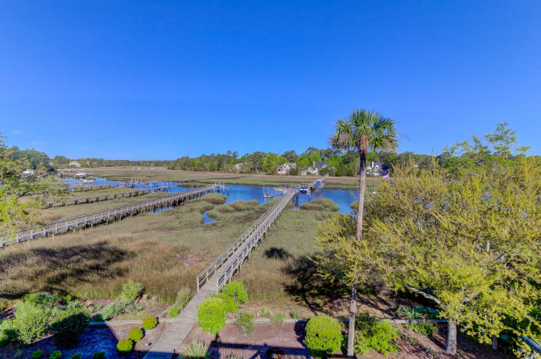
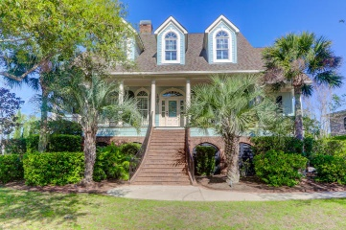
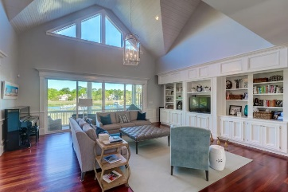
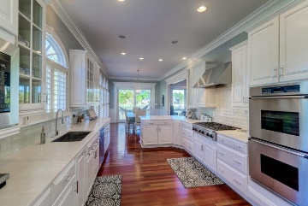
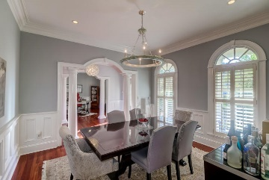
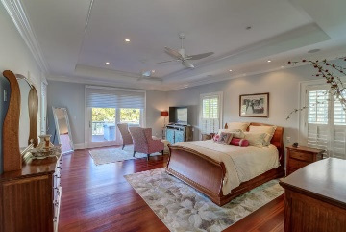
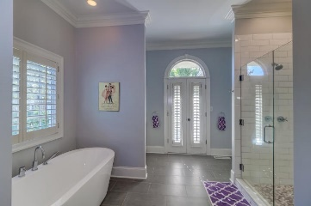
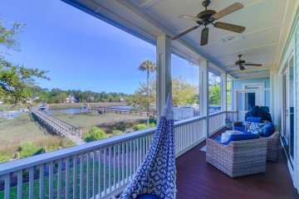
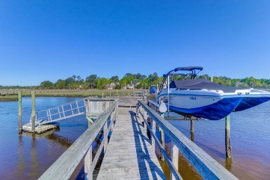


1892 N James Gregarie Road
Park West | Mount Pleasant, SC 29466 | MLS# 20010003 | $1,299,000
Deep Water Dock ~ Pool ~ Custom Home
Custom Home w/Panoramic Views of Toomer Creek
Absolutely Immaculate 2 story home in Tennyson of Park West situated on Toomer Creek with Panoramic, breathtaking views with private dock, floater and boat lift. The custom features abound from the beautiful stained glass entry door, crown moldings, wainscoting, stunning hardwood floors, plantation shutters and amazing views. The gourmet kitchen offers double ovens, and a gas cook top with all top of the line appliances. This home offers plenty of room to spread out. This 5 bedroom, 3.5 bath home has it's master on the 1st floor. The master suite has a private deck and a master bath that is perfect for spa-like relaxing and to get away from all the stresses! 1892 N. James Gregarie has the space and detail that will thrill any buyer.
Darlene Smith
Office - (843) 886-8110
Mobile - (843) 696-7824
darlenesmith@carolinaone.com
DarleneSmithTeam.com
Carolina One Real Estate
1503 Palm Blvd Ste
Isle of Palms, SC 29451

