Slide 1
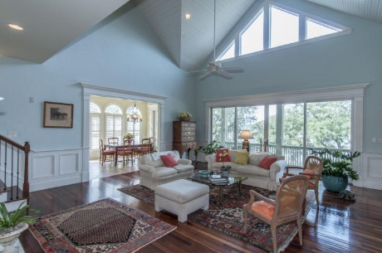
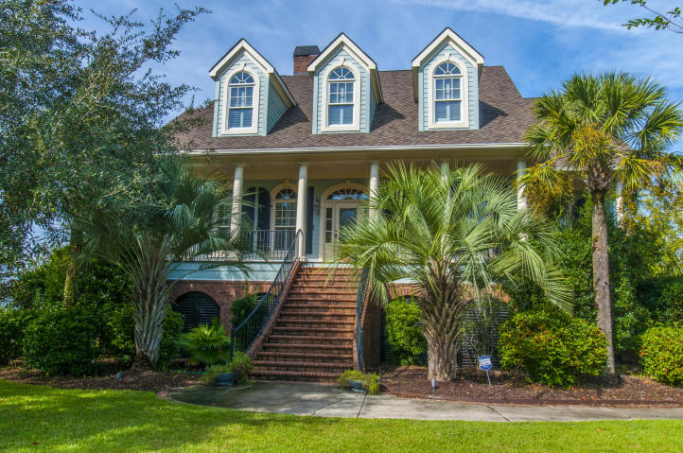
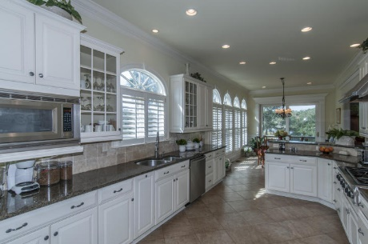
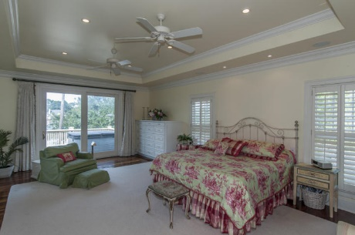
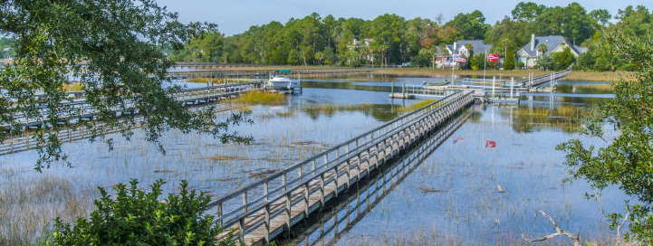
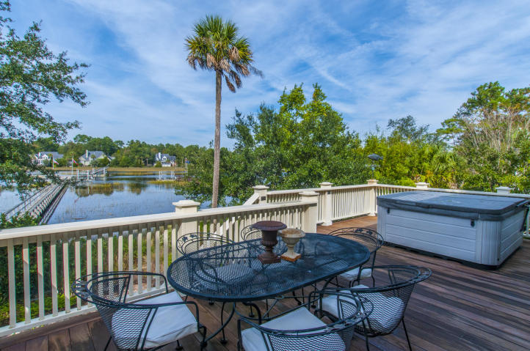


1892 N James Gregorie Rd, Park West, Mt Pleasant
Executive home on Toomer Creek with panoramic views and it's own private dock, floater and boat lift.
This beautiful custom home with an open floor plan is sure to please the most discriminating of buyers, entire rear of home overlooks Toomer Creek and surrounding through floor to ceiling glass. The gourmet kitchen features all stainless appliances and granite countertops. The large great room features, built-in cabinets, fireplace and hardwood floors. The huge screened porch and decks are ideal for entertaining family and friends. The first floor master bedroom with sitting room has a walk out deck, twin walk-in closets and a luxurious bath with oversized shower and jetted tub. The upstairs includes three spacious bedrooms, plus an office/media room with deck for relaxing in private while enjoying the views. Garage level game room that is not included in finished sq ft. Beautiful landscaped yard with full irrigation and lighting. Park west amenities include pool, tennis courts, club house plus the town of mount pleasant sports complex. Conveniently located near dining, shopping, schools, hospitals and beaches.
Asking $1,299,500
MLS# 15027773
4,070 SqFt
5 Bed/3½ Baths
This Home Is A Must See...
Don Dawson 843-514-0452 ddawson@carolinaone.com Carolina One Real Estate • 2713 Highway 17 North • Mount Pleasant, SC 29466
www.TeamDawsonSC.com

