Slide 1
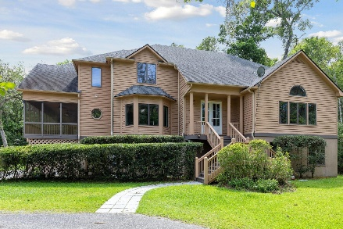
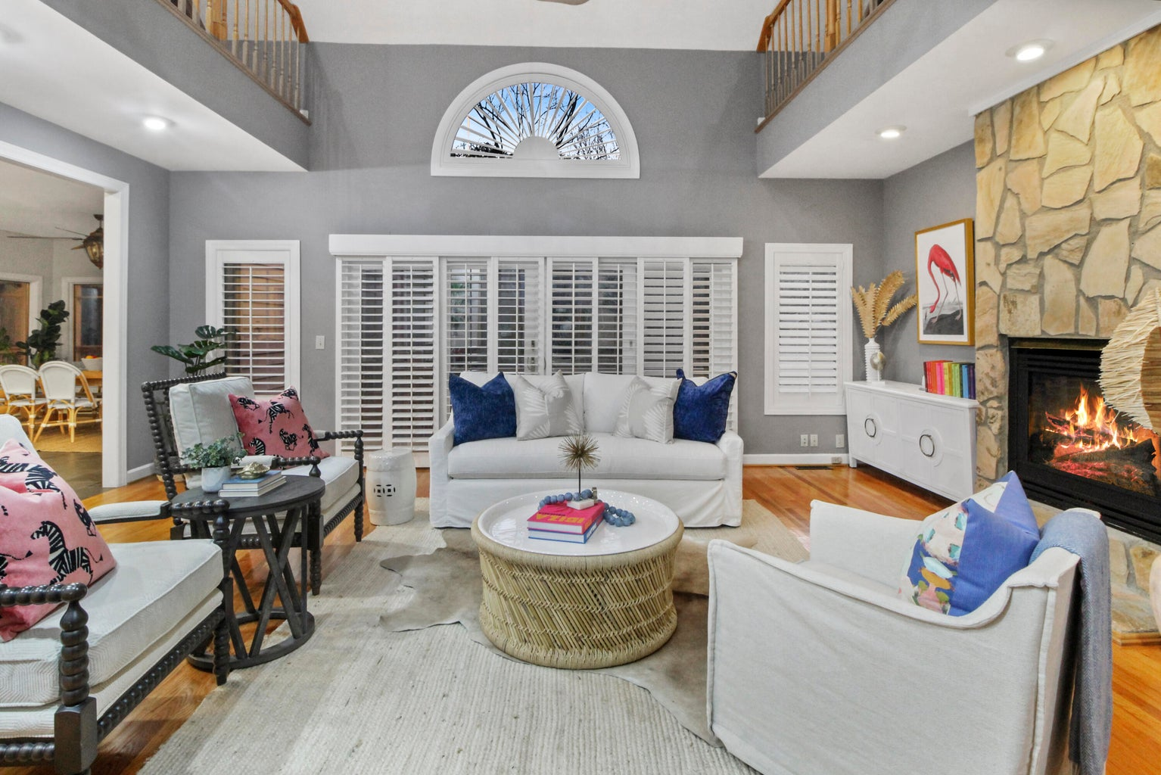
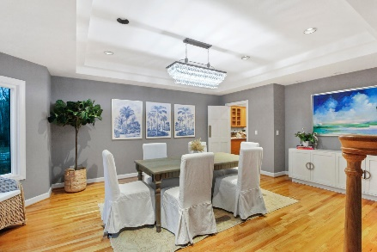
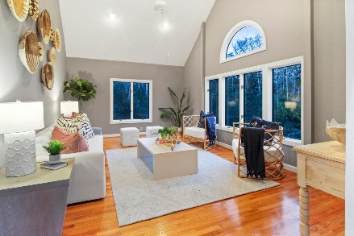

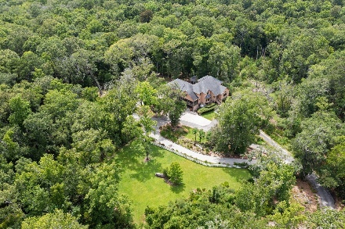
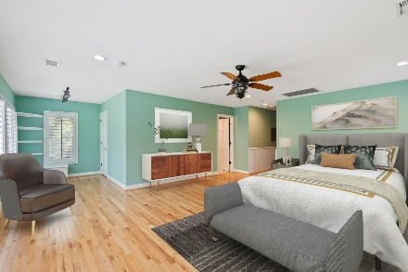
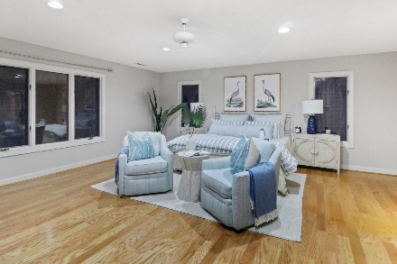
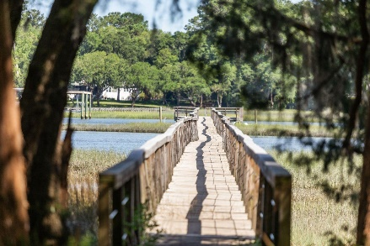


Lowcountry Retreat
1893 Long Creek Road
Longcreek Plantation | Wadmalaw Island, SC 29487 | MLS# 22016837 | $1,380,000
Broker Open House Luncheon Friday 11-2pm
Must See Home in sought after Longcreek Plantation on Beautiful Wadmalaw Island! Gated community with a Dock and Private Boat landing for residents to enjoy! Owner Spared no expense on making this home ENERGY Efficient.
Video Tour: https://youtu.be/kOErMwkkuRo
Heating/cooling -
Geothermal, HVAC, mini split
45 internet monitored Solar panels (can't be seen from ground level
Whole house automatic cycling generator.
New deep water well and Reverse Osmosis water treatment System.
2 tankless propane water heaters. 5 car garages and new decorative stoned parking area.
Landscaping-
clearing and fencing huge side and back yards.
Decorative stone patio,
Camilla grove with 45 different colored, winter blooming Camilla plants,
Entrance- 4 Flowering Bradford pear trees, and 2 giant oak trees.
Huge tiled wrap-around screen porch with fans
Slate kitchen and breakfast room floors.
Wood Plantation shutters upstairs and down.
Solid red oak floors throughout.
Marble or ceramic in all baths,
Granite kitchen counters.
New Cafe double ovens,
Extra ice machine in pantry.
Roof replaced, covered gutters and downspouts, outside repainted with new construction, children's
tree house in backyard.
Laura McLain 843-509-7647
laura@lauramclainrealty.com
The Boulevard Company, LLC | 806 Johnnie Dodds Blvd Ste 100 | Mt Pleasant, SC 29464

