Slide 1
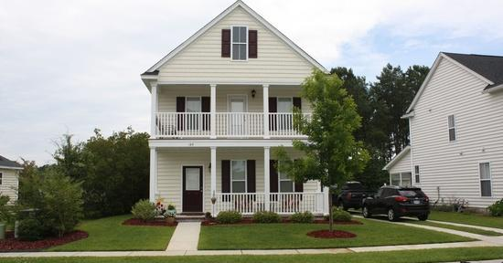
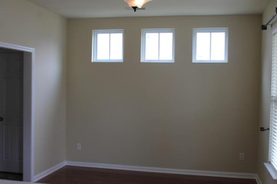
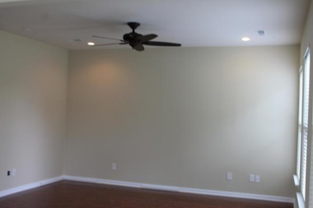
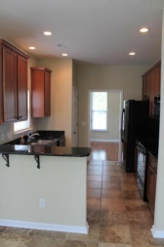
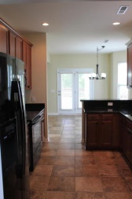
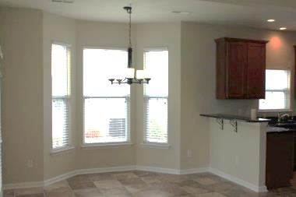
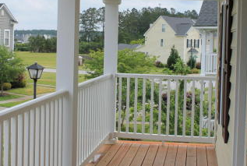
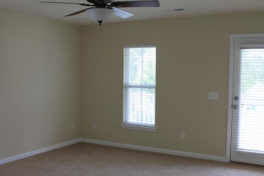
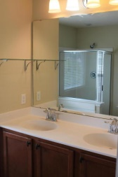
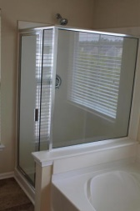
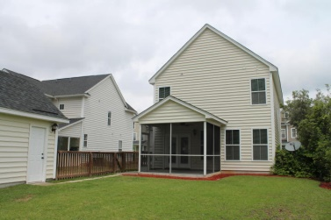
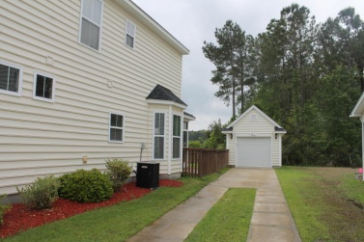
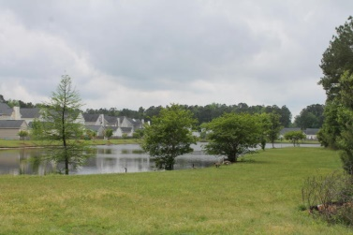


189 Avonshire Drive
Summerville, SC 29483
MLS# 15009870
$189,000
3 Bedrooms | 2½ Baths | 1,807 Sq Ft
Like New Home on the Pond in Weatherstone
Beautiful home in Mason Park at Weatherstone! All new carpeting and fresh paint! Lots of upgrades: porcelain tile, wood flooring, granite countertops, upgraded whirlpool appliances, screened porch, fenced backyard and a pond view. Living room is prewired for surround sound. This home features 3 bedrooms and 2.5 baths including a spacious master suite with a walk-in closet and large private balcony. The Master bath boasts a large soaker tub, separate stand up shower, and raised double bowl vanity. The kitchen has tall cabinets, beautiful granite countertops, a smooth surface range, built-in microwave and pantry. It opens to the living room and a breakfast area. The large screened porch and completely fenced backyard overlooking a huge fishing pond.
Justin Albright
C (803) 466.5787
jda@rarecharleston.com
Ravenel Associates Real Estate
960 Morrison Drive • Suite 100 • Charleston, SC 29403
O: 843.352.0300 • F: 843.768.5047

