Slide 1

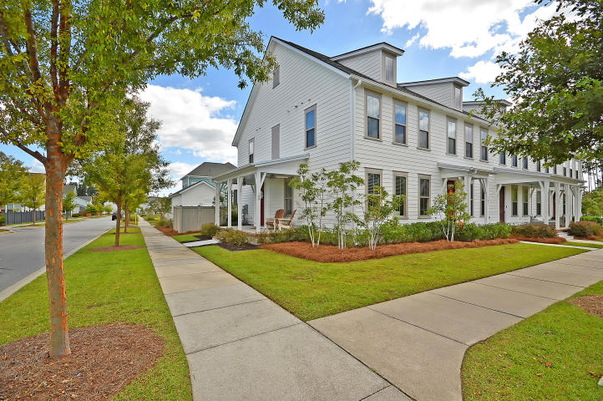
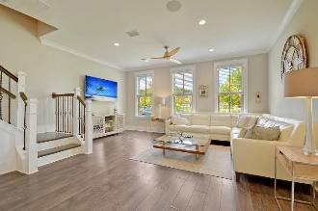
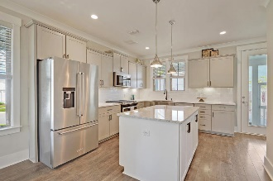
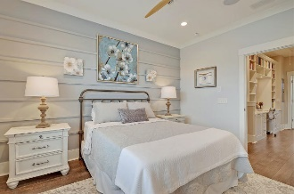
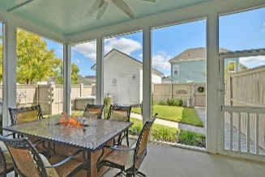
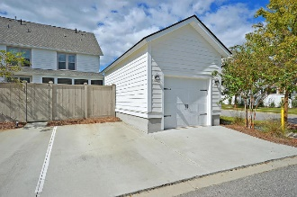


Sellers are EXTREMELY MOTIVATED!
$15,000 Agent Bonus
with ratified contract by 4/15/18
189 Great Lawn Drive
Nexton
Summerville, SC 29486
MLS# 20026243
$315,000
$12,100 Under
Recent Appraised Value
BETTER THAN NEW end-unit townhome on corner-lot in highly desirable Brighton Park Village in Nexton. As you walk up to this stunning home you will be wowed by the full front porch with metal roof, new brick steps, and a beautiful unobstructed view of the ''Great Lawn'' and community Greeting House. Upon entering the home, you are met with beautiful wood floors, tall ceilings, custom wainscotting, tons of windows allowing for a flood of natural light, whole house multi-zone integrated sound system throughout, and an open floor plan with attractive high-end finishes and fixtures throughout. The kitchen is a true showplace with gorgeous staggered soft-close cabinetry with designer hardware and under-mount lighting and an abundance of quartz countertops. This dream kitchen also has stainless steel appliances, gas stove, subway tile backsplash, a large center island (with tons of storage) and a huge walk-in pantry. Did I mention the custom beverage center with under-counter dual-zone wine/beverage fridge, custom glass cabinetry and backsplash? You can not miss the dual fuel fire place in the dining area! As you make your way to the 2nd floor, you will notice the beautiful wood staircase with iron spindles. Upstairs you will find dual spacious Owner's suites each with their own private bathroom (fully-tiled showers!) and CUSTOM shelved closets. The one-of-a-kind "office" space with floor-to-ceiling bookshelves and desk is not to be missed! Relax in your private fenced backyard "oasis" with large screened porch with built-in speakers, BBQ area, professional landscape, and irrigation system. One-car, fully finished garage with custom shelving plus dedicated parking spot. High-efficiency HVAC, tankless hot water heater, and ample storage space in attic with pull-down ladder. Regime covers exterior insurance, all landscape care, irrigation, pressure-washing, exterior termite/pest control, integrated in-wall pest control system, and roof replacement. Brighton Park Village amenities include resort-style pool, splash park, cozy shaded seating areas, dog parks, and access to miles of walking/bike trails around the community. Conveniently located only a short walk, bike, or cart ride away from all the shopping and dining that Nexton Square has to offer, and only minutes away from I-26 and historic downtown Summerville! Hurry...this home won't last long! Age, sqft, taxes, acreage, HOA dues, flood zone and schools are approximate, buyer to verify any and all information deemed necessary.
Mason Thurber
(843) 709-5109 - C (843) 576-2701 - O
mason@theeverettgroup.net
RE/MAX Pro Realty, 9209 University Blvd, Charleston, SC 29406

