Slide 1
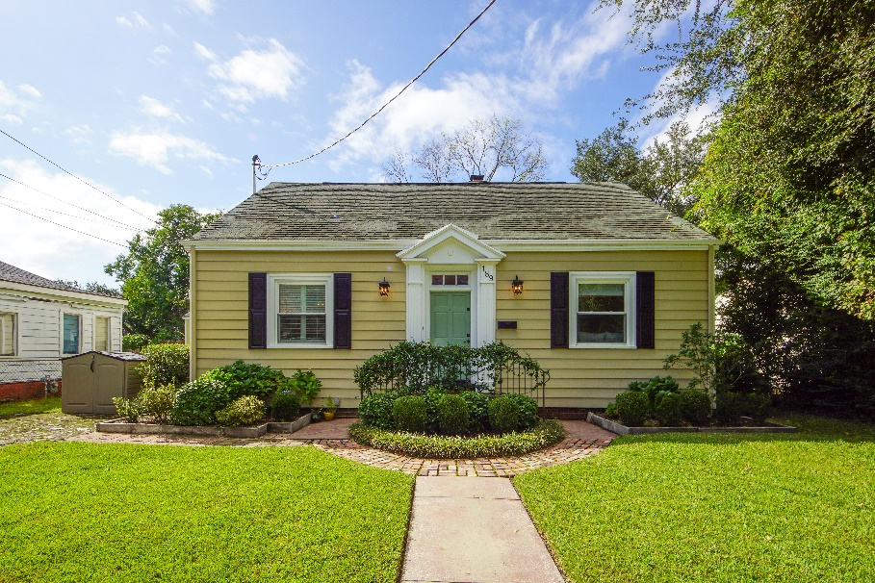
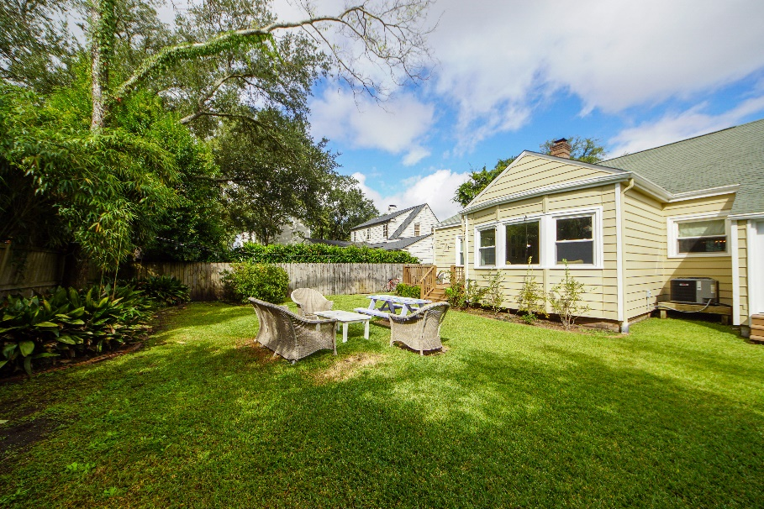
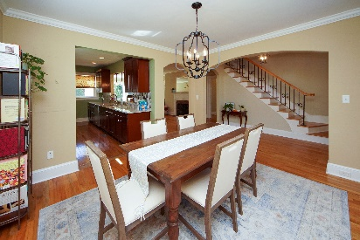
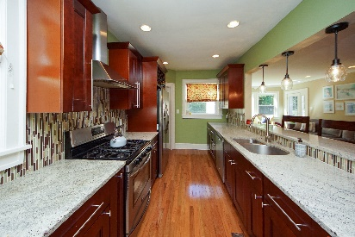
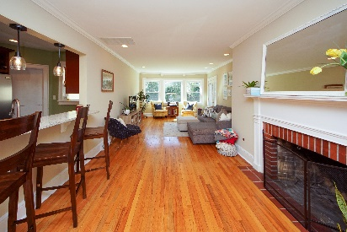
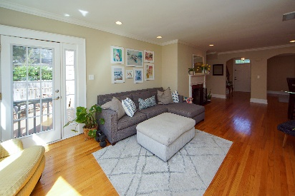
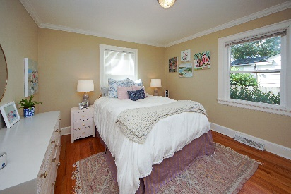
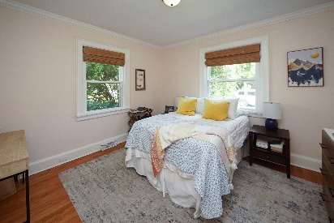
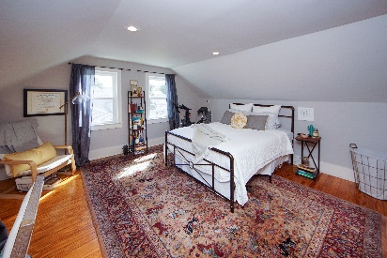
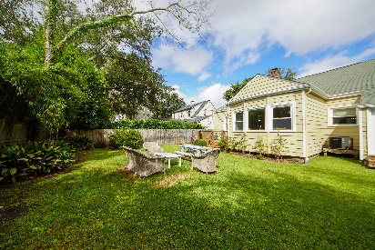
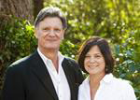

Potential Short Sale!
Open House Saturday, October 30th from 10-1
189 San Souci Street
Wagener Terrace ~ Charleston, SC 29403 ~ MLS# 21028855 ~ $899,000
Rare opportunity in Wagener Terrace to enjoy downtown living on a quiet street in a great location. You will appreciate the high ceilings, bright open floorplan and beautiful hardwood floors throughout. The 4 bed/2 bath home is completely renovated in a manner that still reflects Charleston style and character. New lighting, granite counter tops, stainless appliances, and much more. A large gathering room with a fireplace , kitchen/dining area and 3 bedrooms are located on the main floor. One bed has a separate entrance and could be an office, studio or playroom depending on need. Upstairs you will find the master, a luxury bath and additional closet space in eaves. A nice deck and fenced backyard complete the home. Walk/bike to parks, great restaurants, MUSC or a Riverdogs game.
Chuck & Edy Mimms
Cell 843-224-9507
Office 843-530-8100 www.sanddollarsc.com
www.facebook.com/Sanddollarsc
Sand Dollar Real Estate Group | 2205 Middle Street | Suite 203, Mailbox 2 | Sullivans Island, SC 29482

