Slide 1
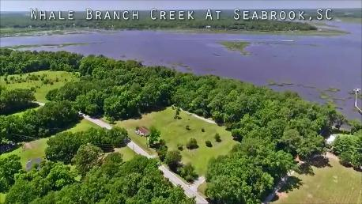
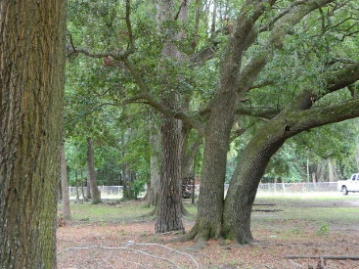
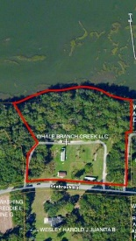
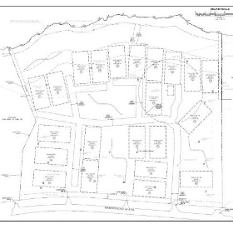
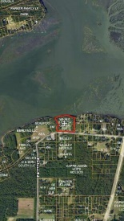
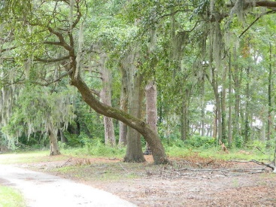
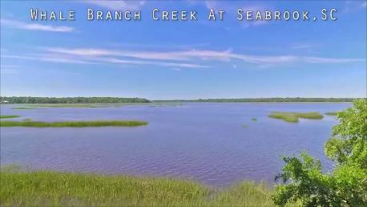
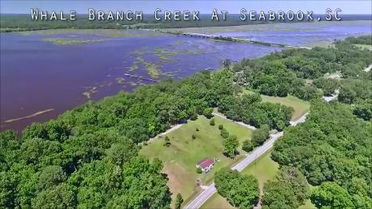
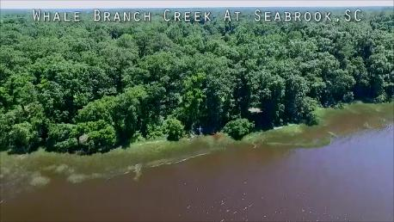
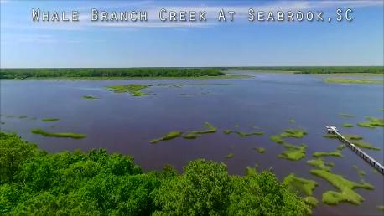


18 Briarfield
Seabrook, SC 29940 ~ MLS# 17010327 ~ $799,000
Price Reduced
in the Old Village!
Price Reduced
Well Below Appraisal
Open House Sunday 1-3
65 Finished Residential Building Lots
22 lot Deepwater development opportunity, 8+_ acres located on the Whale Branch river, , extremely high elevations, no elevated foundation construction required, mature angel live oaks, magnolias. Deepwater community dock can be obtained from OCRM. All surveying and critical marsh area work has been completed. Zoned for detached single family dwellings or mobile home park.
Billy Shuman
Broker In Charge
Residential & Land Sales
coastalpointsc.com
843.906.1159 Cell
COASTAL POINT REAL ESTATE
886 Johnnie Dodds Blvd,
Suite 102
Mt. Pleasant, SC, 294
Office 843.256.2237

