Slide 1
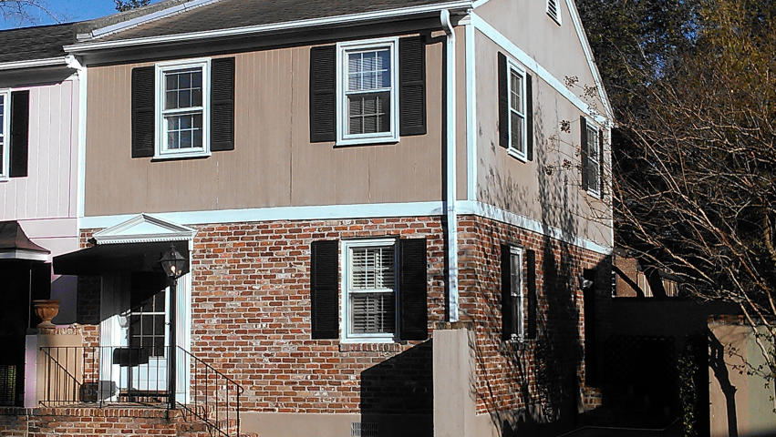
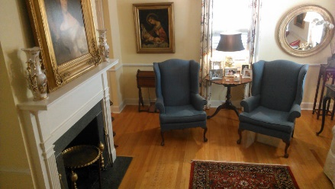
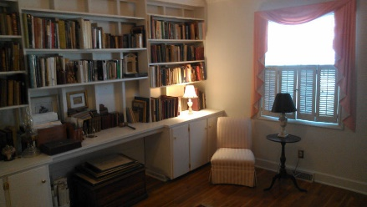
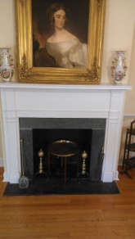
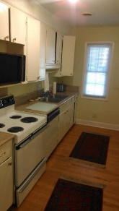
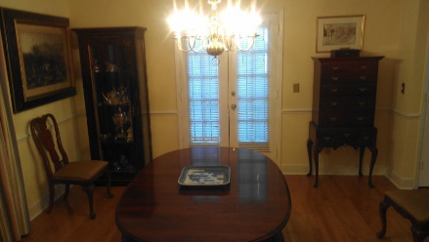
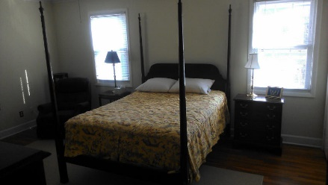
18 Poulnot Lane
Harleston Village :: Charleston :: MLS# 15004118 :: $499,000
Price Reduction $30,000
Fitzsimons Townhouse located in the Heart of Historical district tucked away off beaten path on Poulnot Lane 1 Block West of Broad St.
Lots of natural light from east and south exposure.
Quiet neighborhood.
Easy access and short walk to CofC, Restaurants,Shopping and Colonial Lake.
Private off street parking with wall garden area.
A rare find under $500k.
Gerald L McCord
(843) 224-1342
gerrymccord@gmail.com
Laurel Properties of Chas LLC
742 Lakenheath Drive
Mt Pleasant, SC 29464

