Slide 1
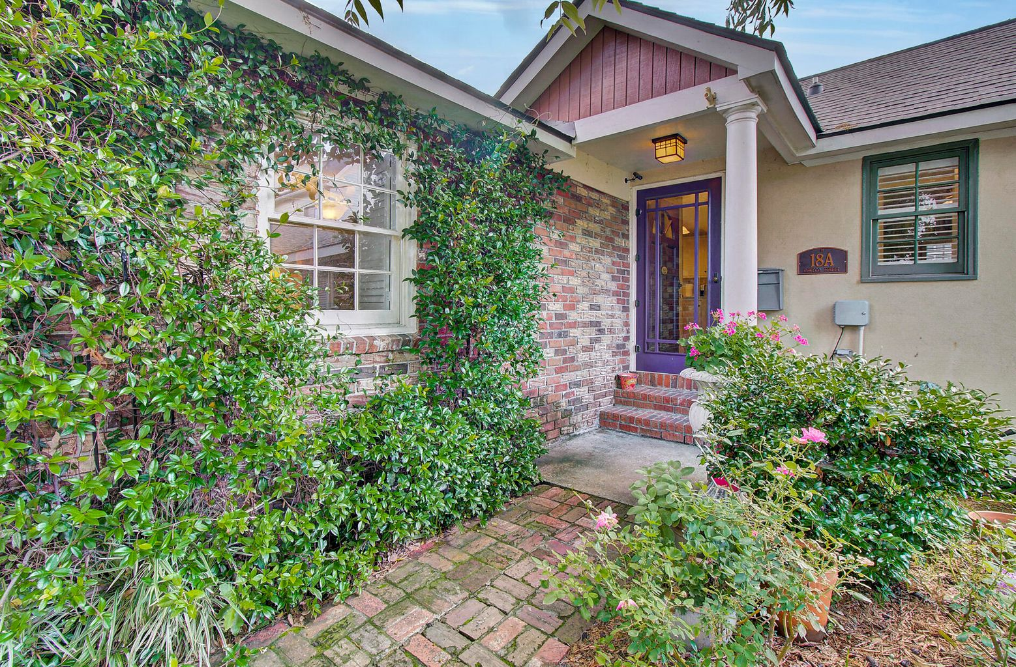
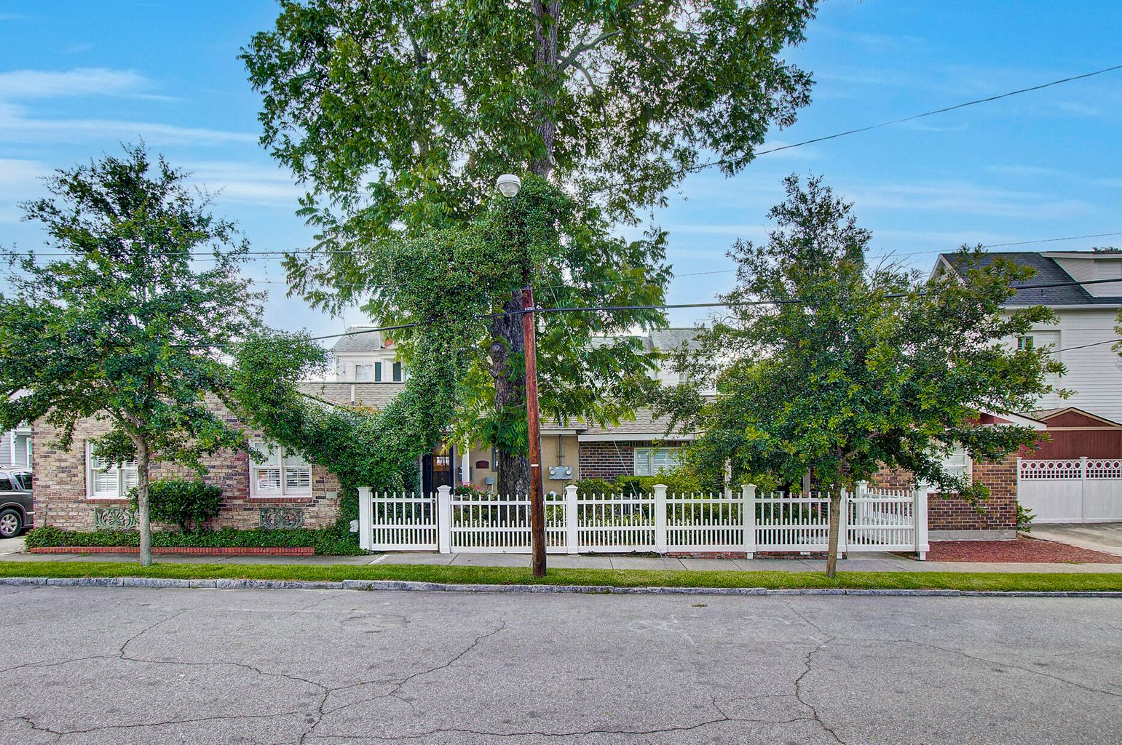
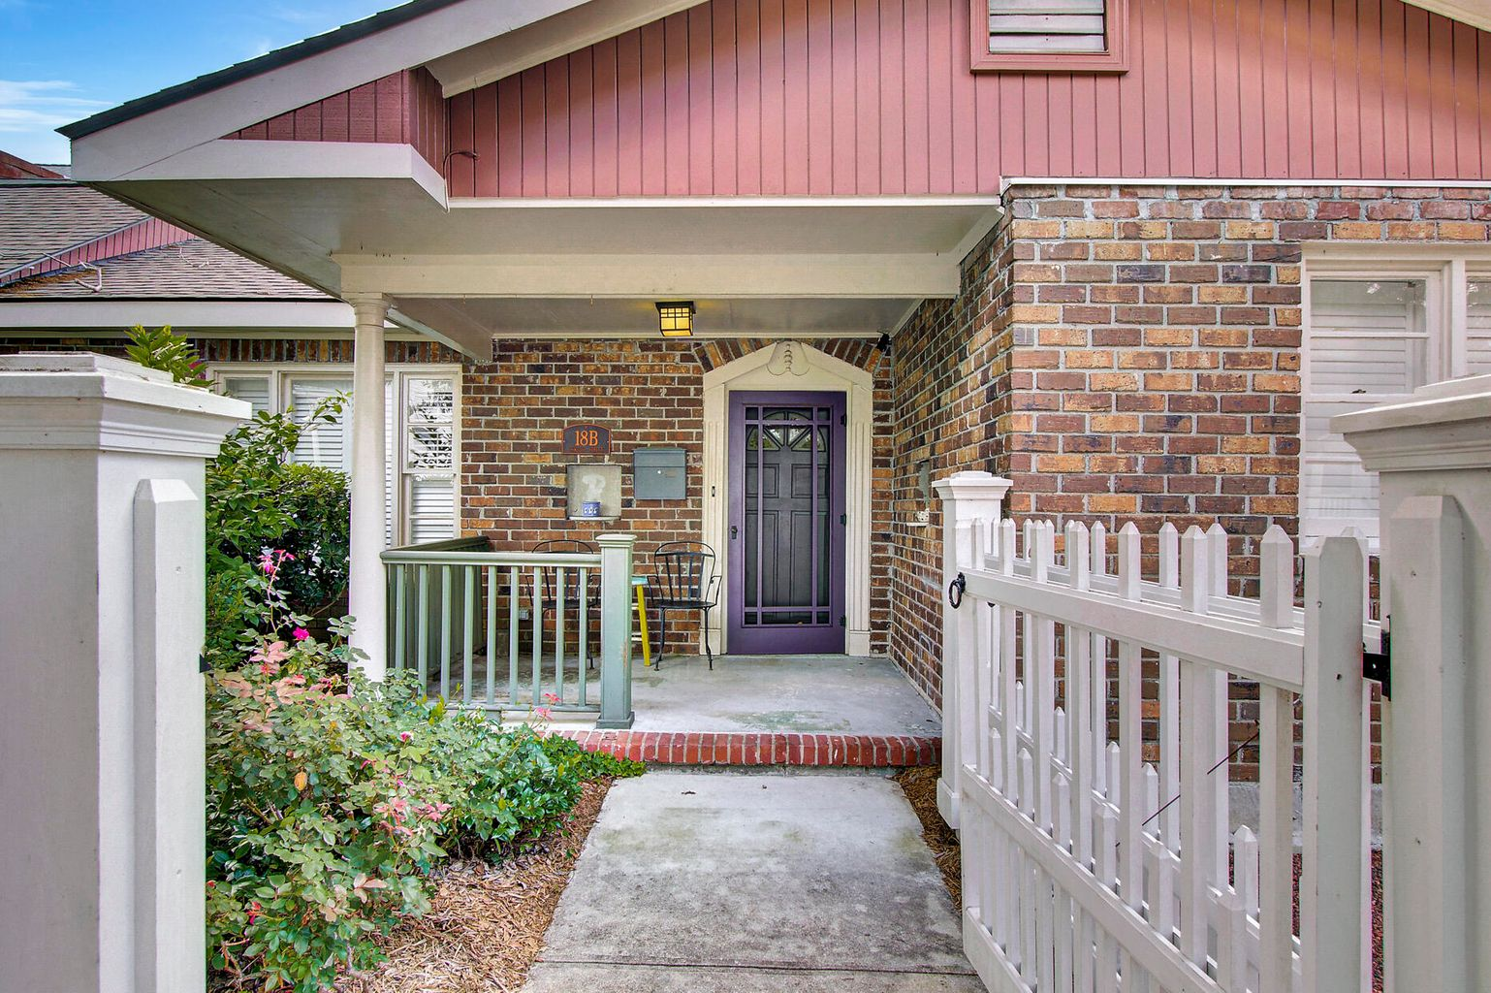
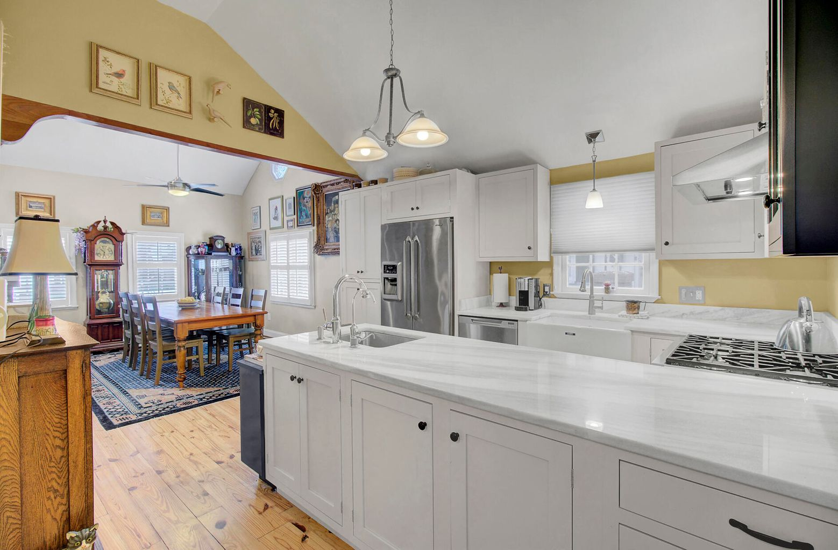
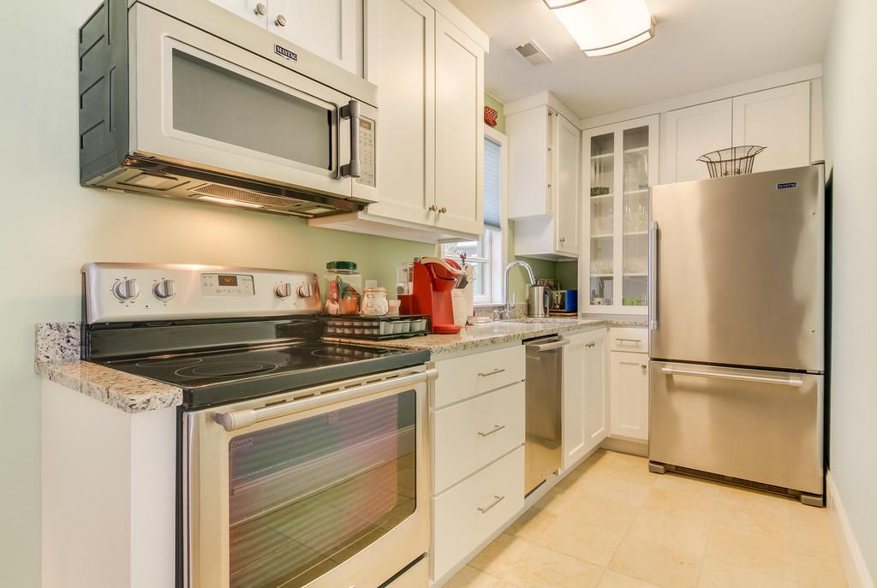
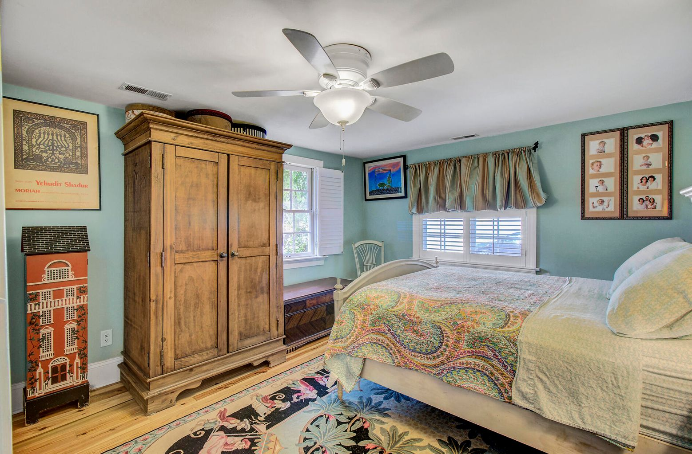
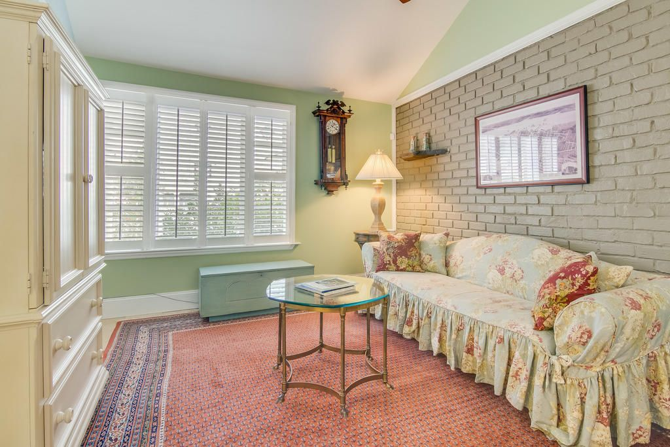


Beautifully Renovated Property
2 Separate Units in Historic Downtown Charleston
18 Oswego Street A & B
North Central
Charleston, SC 29403
MLS# 21017021 | $875,000
A very special opportunity awaits! Rarely can you find a beautifully renovated property comprised of TWO SEPARATE UNITS, with a current Short Term Rental License in hand! Located a block from Hampton Park, 18 Oswego is ready for its new owner. Live in Unit A while renting Unit B - an amazing opportunity to live in the beautiful city of Downtown Charleston for little to no cost. The current owner has spared no expense during the renovation of this fine property. As you approach you will be supremely impressed with the beautiful garden: roses, confederate jasmine, a pecan tree, azaleas, tea olives, hydrangeas, a lemon tree and gardenias make this a truly magnificent garden all lined by a charming Newport style picket fence. A cedar fence encloses the rear yard as well.There is a 4 zone sprinkler system for irrigation. The Architectural shingled roof was installed in 2015. Unit A is a 3 bedroom 2 bath home with a custom kitchen that was redesigned and expanded by its current owner. High end appliances include the Dacor counter depth refrigerator, self cleaning gas range, and hood. Fisher Paykel two drawer dishwashers were installed as well as the pot filler above the stove. There are two separate sinks including a beautiful farm sink and granite counters. This kitchen is sure to please even the most ambitious of chefs! The floorpan offers versatility. The combo dining space/family room off the kitchen is currently being used as a formal dining room large enough to accommodate numerous guests. The master bedroom is complete with its own full bath, also renovated to include an oversized marble tile shower and marble tile floors. The second full bath has also been renovated and is shared by bedrooms 2 and 3. Bedroom 2 overlooks the beautiful gardens on the front of the home. The third bedroom is currently being used as a living room. Built in cabinets with drawers add a classy touch and subzero refrigerator drawers were installed for entertaining purposes. The two brick fireplaces add undeniable charm to this home. As you tour you will note the vaulted ceilings and sun filled spaces are bright and airy. Plantation shutters grace the windows, and stunning wood floors are found throughout including original wood floors in the third bedroom. Bamboo and heart pine floors are in the remaining living spaces. This HVAC was installed in 2013 and a separate gas water tank installed in 2015. Unit B (with 2 bedrooms and 1 bath) has been renovated with superior finishes as well. Upon entry you will notice beautiful flooring throughout. Jerusalem stone floors are in the hall, living room and kitchen. Both bedrooms have bamboo floors. The full kitchen is outfitted with granite counters and stainless steel appliances. Again, the vaulted ceilings and plentiful windows create a bright and airy space for guests to enjoy. As an added bonus there are built in closet units and a laundry machine in the hall closet. Plantation shutters are also installed in Unit B and the HVAC was installed in 2014. The owner will be pleased to know storage concerns are eliminated with the 8' by 12' cedar storage shed. It has a built in shelf to optimize storage, and electricity runs to the shed which powers the ceiling fan inside. Hampton Park is a mere one block walk from 18 Oswego. This pedestrian lifestyle affords the opportunity to take advantage of the numerous cafes, restaurants, shops, and other establishments nearby. These include popular eateries such s Rodney Scott's BBQ, The Park Cafe, The Harbinger Cafe and Bakery, Moe's Crosstown Tavern, and Huriyali for instance. Upper King Street is nearby as well. Schedule your tour of 18 Oswego while this unique opportunity remains!
Check out the video tour here: https://video214.com/play/dCZbMqgYr9C6xuN5MWCw0g/s/dark
Ellen O'Neil
Broker/Owner, ABR, e-PRO, CNE
Charleston Realtor of Distinction
(843) 300-8530
www.EllenONeilProperties.com

