Slide 1
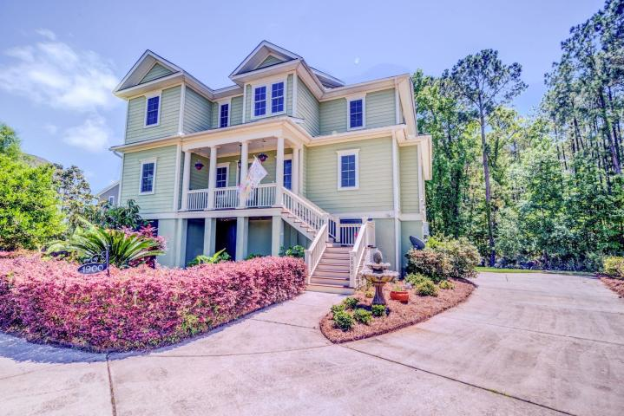
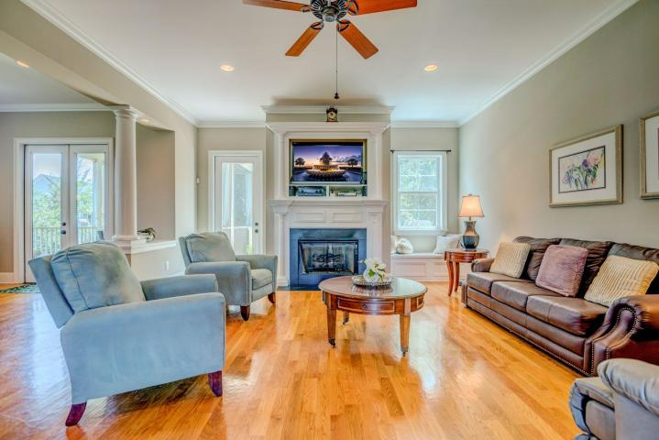
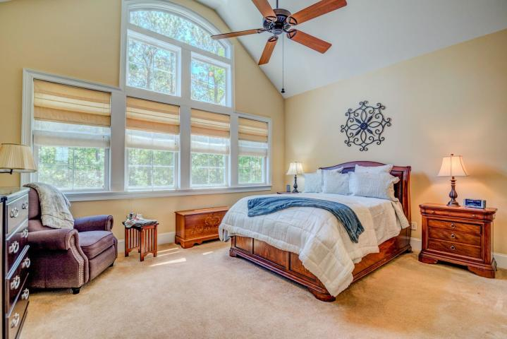
Close to Rivertowne Golf Course
$40,000
Price Reduction!
Custom High Quality / Best Price per SqFt
1900 Haviland Court
Mount Pleasant, SC 29466
MLS# 19012647 ~ $570,000
Best of the best..end of cul-de-sac, so no cars driving by...and wooded buffer behind the home for privacy (Deer in the rear yard)...Has lots of families with kids close by.
This custom built home has lots of high end features that far exceed others in the neighborhood. Features include hardwood floors, custom high end crown molding, 10+ foot ceilings on the main level. Kitchen has granite counter tops, custom cabinets, plus upgraded appliances including a new Samsung range with 5 burner cooktop, dual ovens, and a new Bosch 3 rack dishwasher.
The master suite is on the first floor. Upstairs is another master bedroom suite with vaulted ceilings. The home even has an elevator shaft for when you need one! The exterior is high quality Hardiplank cement siding and the exterior trim and decking were recently painted/stained. The upper rear deck even has a Weber gas grill attached to the home. For additional storage the owners added an extra insulated room to the garage complete with a dehumidifier. A large patio was added to the rear of the home for added privacy.
Rick Willis
843-327-3017 Rick@RickWillis.com The Group, LLC

