Slide 1
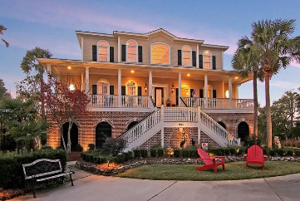
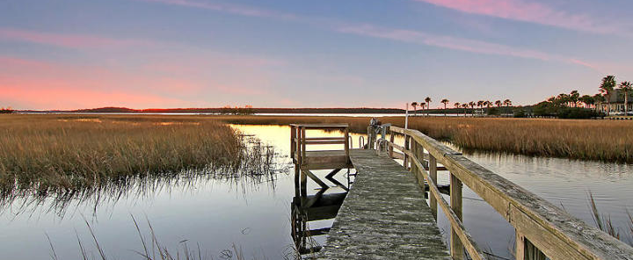
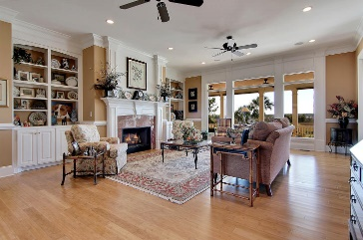

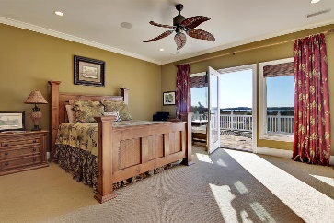
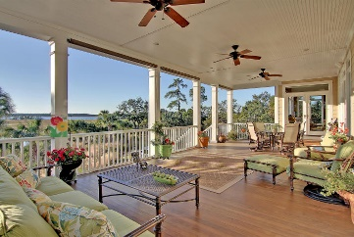
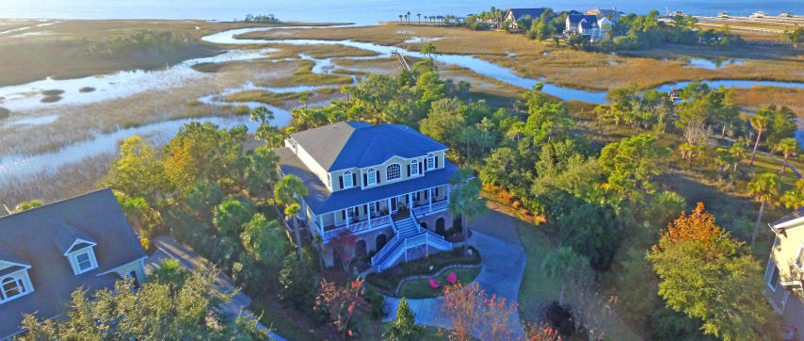
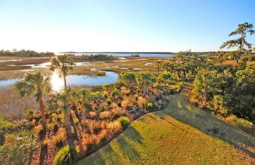
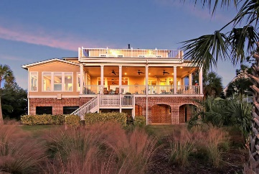


1900 N Creek Drive
Rivertowne Country Club ~ Mount Pleasant
MLS# 17000759 ~ $1,650,000
Exquisite Waterfront Home With Private Boat Dock
Exquisite waterfront home overlooking the Wando River in lovely Rivertowne Country Club. Enjoy the best of lowcountry living with spectacular sunset views in this custom built 5 bedroom, 4.5 bath home located in a prestigious golf course community with clubhouse, pool, tennis and neighborhood dock. Few homes are constructed with the attention to detail and high end features found throughout this home. Exceptional features include heated tile floors in the kitchen, sunroom and master bath, 3 stop elevator providing access from the three bay garage up to the third level bedrooms. Bamboo flooring, extensive trim work and built-ins, granite and marble counters and vanities, whirlpool tub, extraordinary rear deck, private boat dock and more.
Darlene Smith
Office - (843) 886-8110
Mobile - (843) 696-7824
darlenesmith@carolinaone.com
DarleneSmithTeam.com
Carolina One Real Estate
1503 Palm Blvd Ste
Isle of Palms, SC 29451

