Slide 1

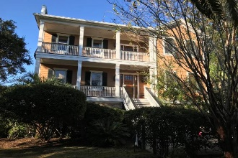
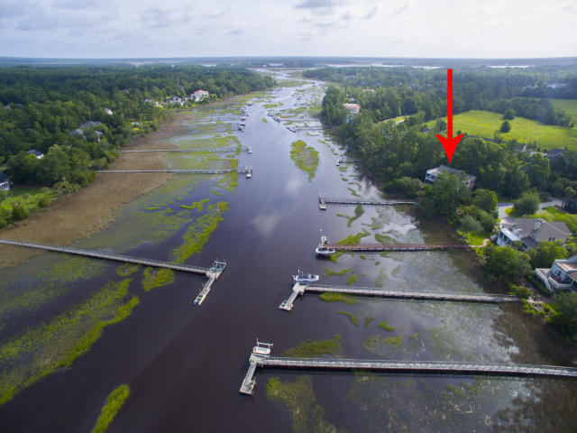
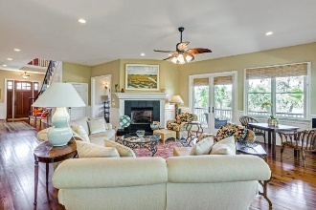
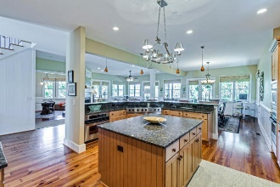
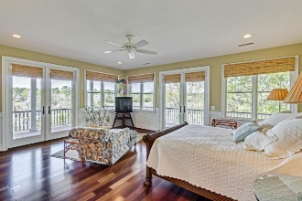
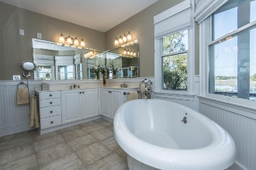
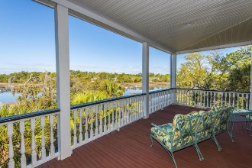
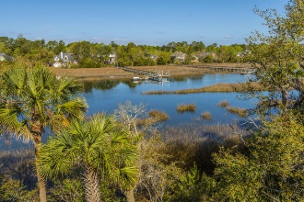
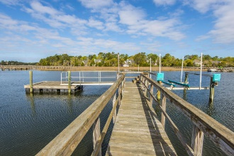


1900 N James Gregarie Road
Park West :: Mount Pleasant
MLS# 17008889 :: $1,198,000
The Only Deep Water Home On Daniel Island
Open House Friday, Jan 19th
11:00-2:00 ~ Lunch provided!
EXPANSIVE WATER AND MARSH VIEWS, GREAT PORCHES WITH FABULOUS SUNSETS! Spectacular waterfront custom home with dock & boat lift! This immaculate well-designed 4BR/4.5BA home has superior craftsmanship with lots of upgrades! The open floor plan features Brazilian cherry hardwood floors, 10-ft ceilings, 8-ft 6-paneled doors, exquisite trim package, custom window treatments, recessed lighting, stylish hardware, ceiling fans, fully screened wrap around porch, and amazing panoramic water views!
Helen Hudson
843-991-9875
helen.hudson@carolinaone.com
Carolina One Real Estate
2713 Highway 17 North
Mt. Pleasant, SC 29466

